Slide 1
Order of operations (BIDMAS): Add and divide
Silent
Teacher
Intelligent Practice
Narration
Your Turn
$$4+10÷2=$$
$$4+\frac{10}{2}=$$
Example
For more videos visit mrbartonmaths.com/videos

Slide 2
Worked Example
Your Turn
$$6+8÷3=$$
$$8+12÷4=$$
@mrbartonmaths

Slide 3
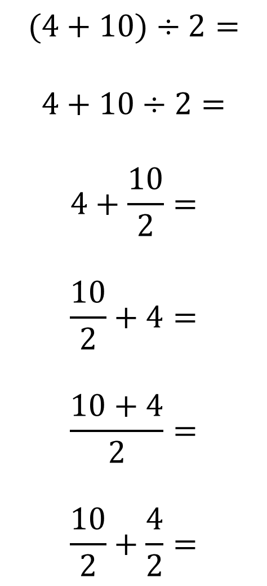
$$(4+10)÷2=$$
$$4+10÷2=$$
$$4+\frac{10}{2}=$$
$$\frac{10}{2}+4=$$
$$\frac{10+4}{2}=$$
$$\frac{10}{2}+\frac{4}{2}=$$
@mrbartonmaths

Slide 4
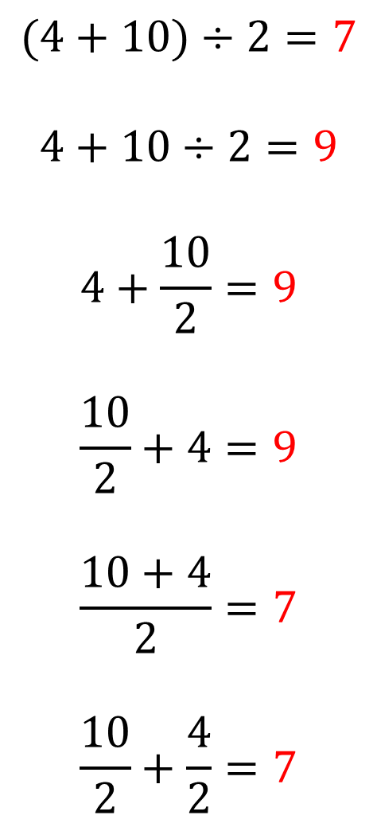
$$(4+10)÷2=7$$
$$4+10÷2=9$$
$$4+\frac{10}{2}=9$$
$$\frac{10}{2}+4=9$$
$$\frac{10+4}{2}=7$$
$$\frac{10}{2}+\frac{4}{2}=7$$
@mrbartonmaths

