Slide 1
Order of operations (BIDMAS): Add and multiply
Silent
Teacher
Intelligent Practice
Narration
Your Turn
$$5×2+3=$$
$$3+5×2=$$
$$4+5×2=$$
Practice

Slide 2
Worked Example
Your Turn
$$2+3×4=$$
$$3+2×4=$$
@mrbartonmaths

Slide 3
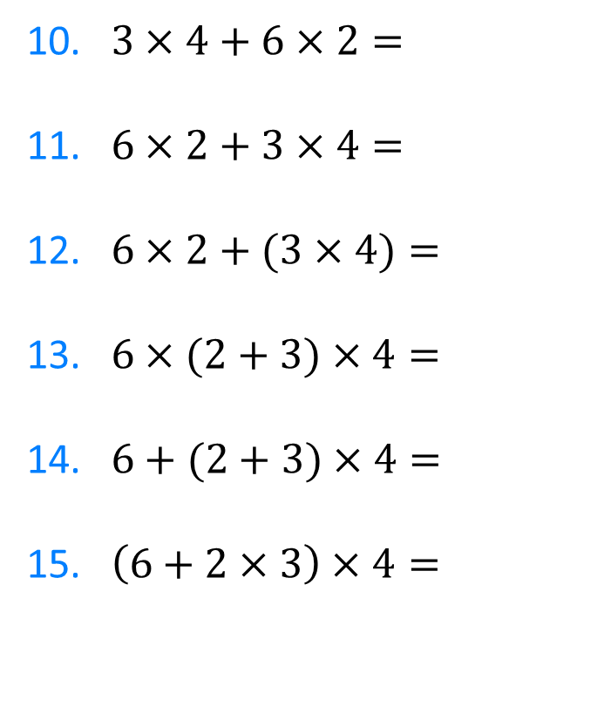
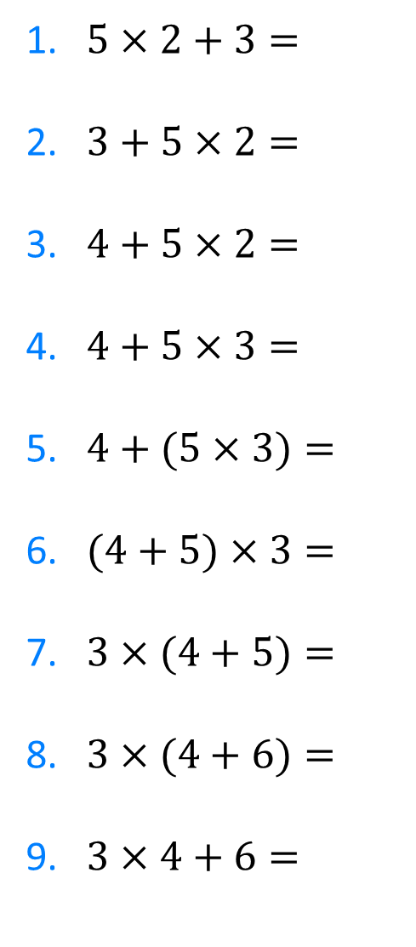
1. $5×2+3=$
2. $3+5×2=$
3. $4+5×2=$
4. $4+5×3=$
5. $4+(5×3)=$
6. $(4+5)×3=$
7. $3×(4+5)=$
8. $3×(4+6)=$
9. $3×4+6=$
10. $3×4+6×2=$
11. $6×2+3×4=$
12. $6×2+(3×4)=$
13. $6×(2+3)×4=$
14. $6+(2+3)×4=$
15. $\left(6+2×3\right)×4=$
@mrbartonmaths

Slide 4
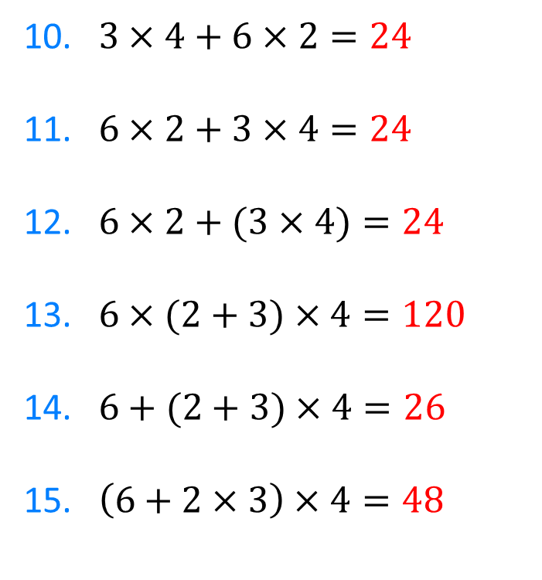
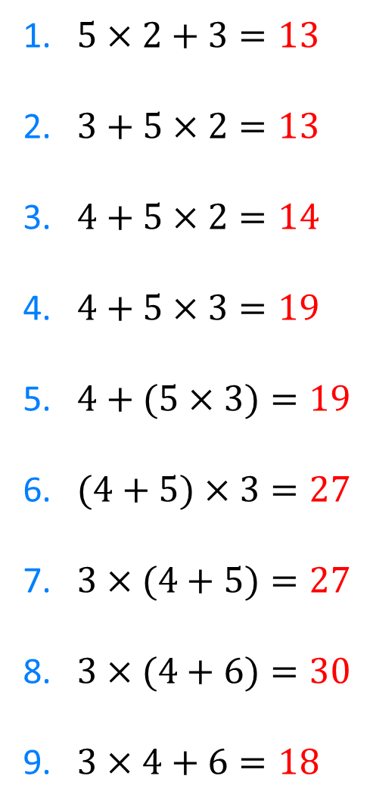
1. $5×2+3=13$
2. $3+5×2=13$
3. $4+5×2=14$
4. $4+5×3=19$
5. $4+(5×3)=19$
6. $(4+5)×3=27$
7. $3×(4+5)=27$
8. $3×(4+6)=30$
9. $3×4+6=18$
10. $3×4+6×2=24$
11. $6×2+3×4=24$
12. $6×2+(3×4)=24$
13. $6×(2+3)×4=120$
14. $6+(2+3)×4=26$
15. $\left(6+2×3\right)×4=48$
@mrbartonmaths

