Slide 1
Decimals: Adding decimals – carry
Silent
Teacher
Intelligent Practice
Narration
Your Turn
$$0.43+0.8=$$
$$4.3+0.8=$$
$$4.3+0.9=$$
Example
For more videos visit mrbartonmaths.com/videos

Slide 2
Worked Example
Your Turn
$$0.53+0.08=$$
$$0.63+0.08=$$
@mrbartonmaths

Slide 3
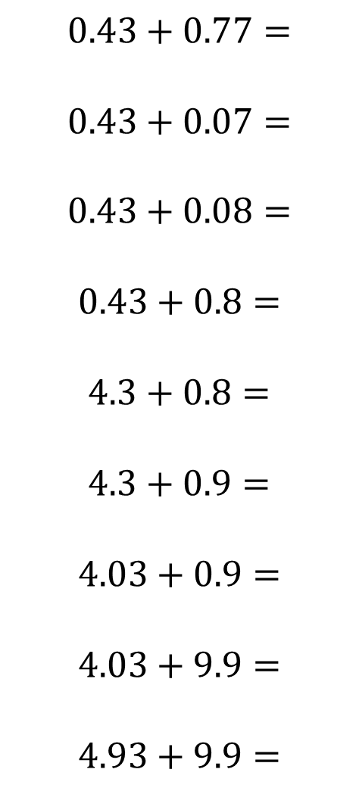
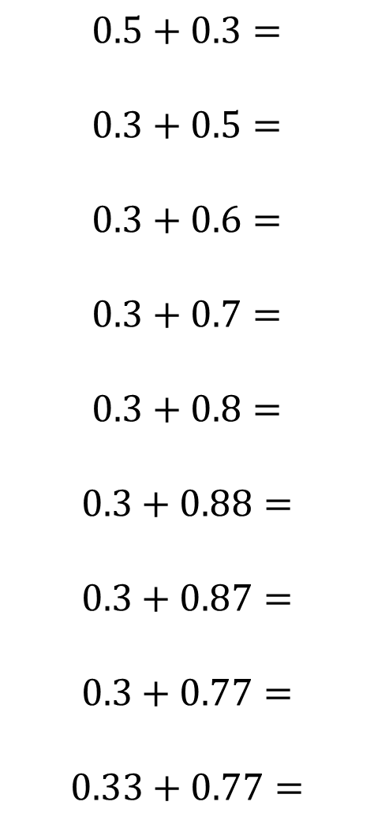
$$0.5+0.3=$$
$$0.3+0.5=$$
$$0.3+0.6=$$
$$0.3+0.7=$$
$$0.3+0.8=$$
$$0.3+0.88=$$
$$0.3+0.87=$$
$$0.3+0.77=$$
$$0.33+0.77=$$
$$0.43+0.77=$$
$$0.43+0.07=$$
$$0.43+0.08=$$
$$0.43+0.8=$$
$$4.3+0.8=$$
$$4.3+0.9=$$
$$4.03+0.9=$$
$$4.03+9.9=$$
$$4.93+9.9=$$
@mrbartonmaths

Slide 4
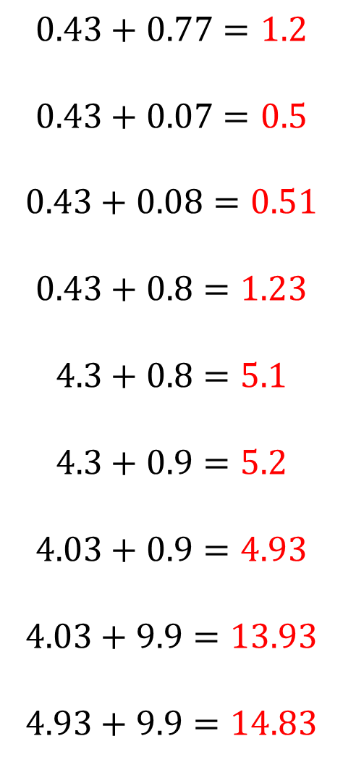
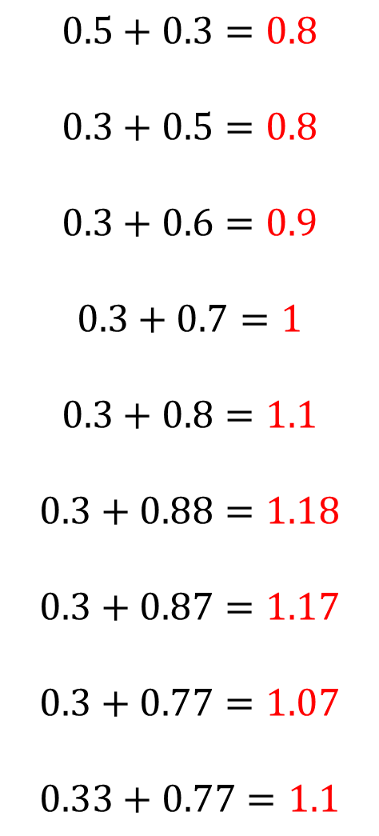
$$0.5+0.3=0.8$$
$$0.3+0.5=0.8$$
$$0.3+0.6=0.9$$
$$0.3+0.7=1$$
$$0.3+0.8=1.1$$
$$0.3+0.88=1.18$$
$$0.3+0.87=1.17$$
$$0.3+0.77=1.07$$
$$0.33+0.77=1.1$$
$$0.43+0.77=1.2$$
$$0.43+0.07=0.5$$
$$0.43+0.08=0.51$$
$$0.43+0.8=1.23$$
$$4.3+0.8=5.1$$
$$4.3+0.9=5.2$$
$$4.03+0.9=4.93$$
$$4.03+9.9=13.93$$
$$4.93+9.9=14.83$$
@mrbartonmaths

