Slide 1
Decimals: Adding decimals – no carry
Silent
Teacher
Intelligent Practice
Narration
Your Turn
$$0.22+0.06=$$
$$0.2+0.6=$$
$$0.02+0.6=$$
Example
For more videos visit mrbartonmaths.com/videos

Slide 2
Worked Example
Your Turn
$$0.35+0.6=$$
$$0.25+0.7=$$
@mrbartonmaths

Slide 3
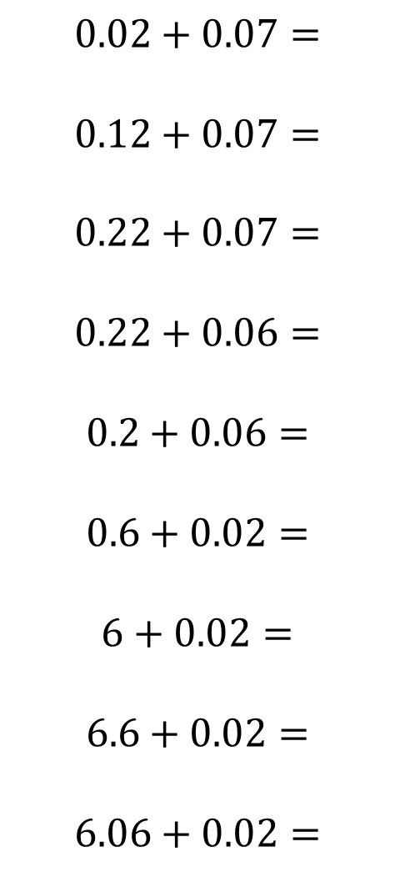
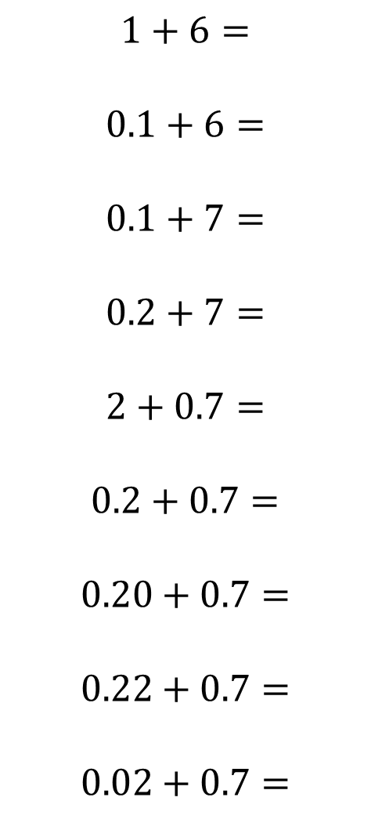
$$1+6=$$
$$0.1+6=$$
$$0.1+7=$$
$$0.2+7=$$
$$2+0.7=$$
$$0.2+0.7=$$
$$0.20+0.7=$$
$$0.22+0.7=$$
$$0.02+0.7=$$
$$0.02+0.07=$$
$$0.12+0.07=$$
$$0.22+0.07=$$
$$0.22+0.06=$$
$$0.2+0.06=$$
$$0.6+0.02=$$
$$6+0.02=$$
$$6.6+0.02=$$
$$6.06+0.02=$$
@mrbartonmaths

Slide 4
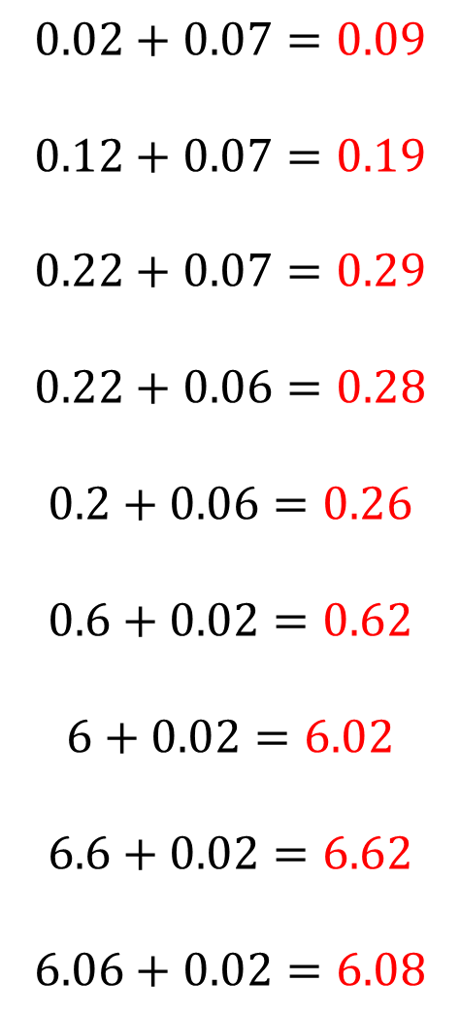
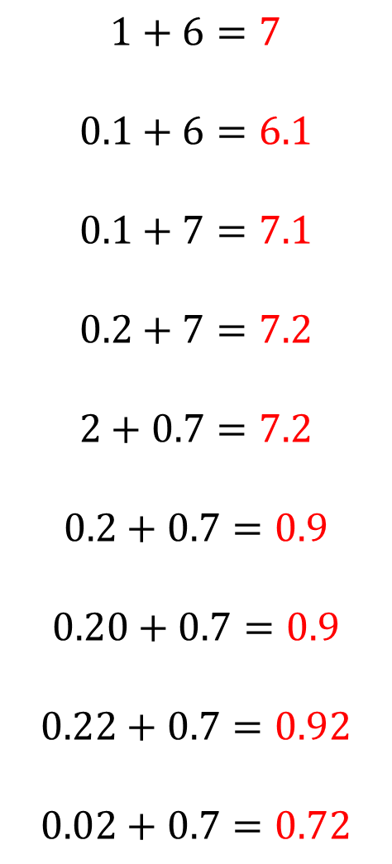
$$1+6=7$$
$$0.1+6=6.1$$
$$0.1+7=7.1$$
$$0.2+7=7.2$$
$$2+0.7=7.2$$
$$0.2+0.7=0.9$$
$$0.20+0.7=0.9$$
$$0.22+0.7=0.92$$
$$0.02+0.7=0.72$$
$$0.02+0.07=0.09$$
$$0.12+0.07=0.19$$
$$0.22+0.07=0.29$$
$$0.22+0.06=0.28$$
$$0.2+0.06=0.26$$
$$0.6+0.02=0.62$$
$$6+0.02=6.02$$
$$6.6+0.02=6.62$$
$$6.06+0.02=6.08$$
@mrbartonmaths

