Slide 1
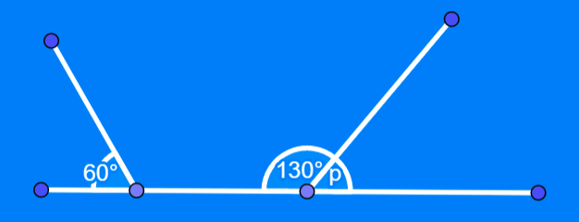
Angles: Angles on a straight line
Silent
Teacher
Intelligent Practice
Narration
Your Turn
Example
For more videos visit mrbartonmaths.com/videos

Slide 2
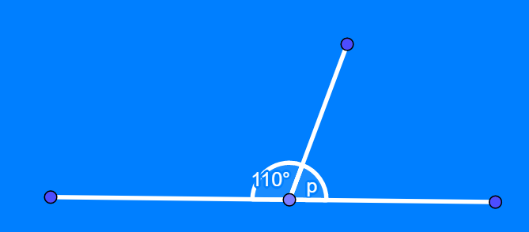
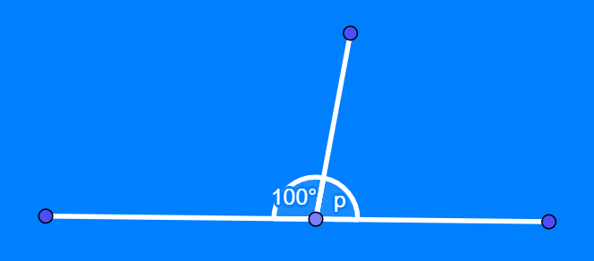
Worked Example
Your Turn
@mrbartonmaths

Slide 3
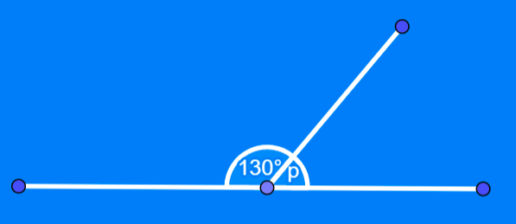
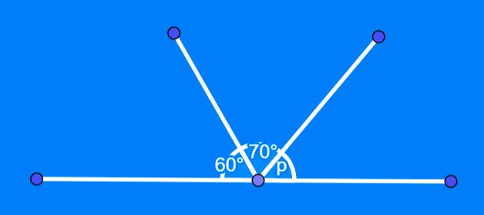
$p=$
$p=$
$p=$
@mrbartonmaths

Slide 4
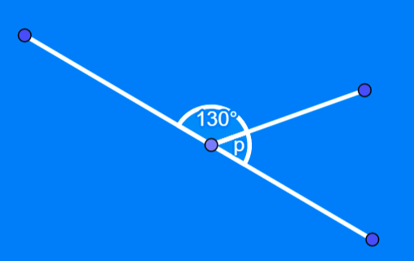
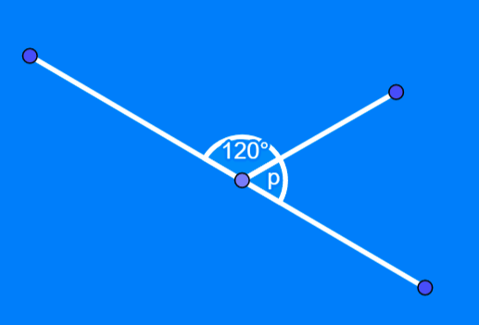
$p=$
$p=$
@mrbartonmaths

Slide 5
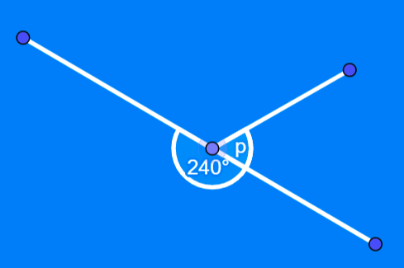
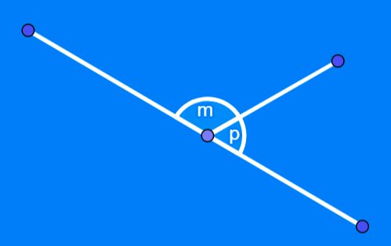
$p=$
$p=$
@mrbartonmaths

Slide 6
$p=50°$
$$p=50°$$
$$p=50°$$
@mrbartonmaths

Slide 7
$$p=50°$$
$$p=60°$$
@mrbartonmaths

Slide 8
$$p=60°$$
$$p=(180−m)°$$
@mrbartonmaths

