Slide 1
Decimals: Dividing decimals
Silent
Teacher
Intelligent Practice
Narration
Your Turn
$$5÷1=$$
$$5÷0.1=$$
$$0.1÷5=$$
Example
For more videos visit mrbartonmaths.com/videos

Slide 2
Worked Example
Your Turn
$$12÷0.3=$$
$$12÷0.4=$$
@mrbartonmaths

Slide 3
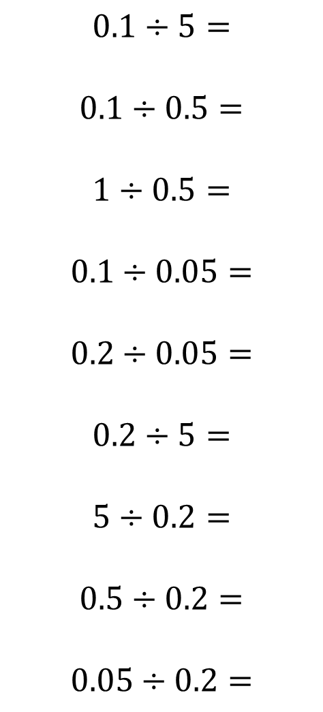

$$50÷10=$$
$$50÷20=$$
$$50÷2=$$
$$50÷0.2=$$
$$5÷0.2=$$
$$0.5÷0.2=$$
$$0.5÷0.1=$$
$$5÷1=$$
$$5÷0.1=$$
$$0.1÷5=$$
$$0.1÷0.5=$$
$$1÷0.5=$$
$$0.1÷0.05=$$
$$0.2÷0.05=$$
$$0.2÷5=$$
$$5÷0.2=$$
$$0.5÷0.2=$$
$$0.05÷0.2=$$
@mrbartonmaths

Slide 4
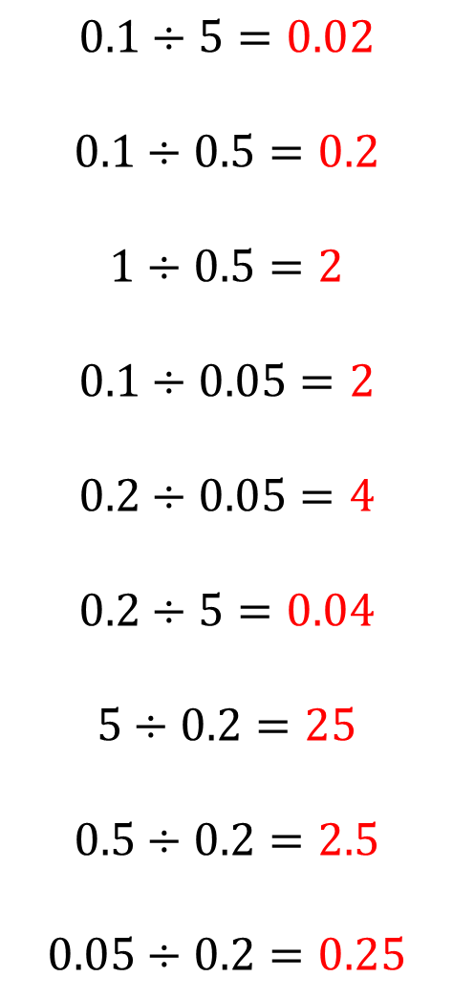
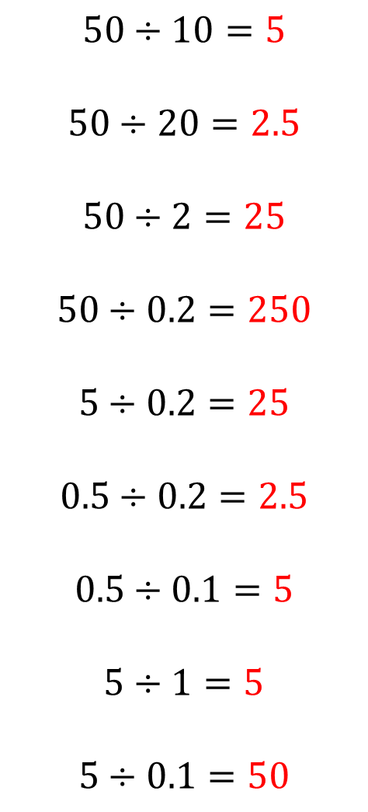
$$50÷10=5$$
$$50÷20=2.5$$
$$50÷2=25$$
$$50÷0.2=250$$
$$5÷0.2=25$$
$$0.5÷0.2=2.5$$
$$0.5÷0.1=5$$
$$5÷1=5$$
$$5÷0.1=50$$
$$0.1÷5=0.02$$
$$0.1÷0.5=0.2$$
$$1÷0.5=2$$
$$0.1÷0.05=2$$
$$0.2÷0.05=4$$
$$0.2÷5=0.04$$
$$5÷0.2=25$$
$$0.5÷0.2=2.5$$
$$0.05÷0.2=0.25$$
@mrbartonmaths

