Slide 1
Fractions: Equivalent Fractions
True/false
Reflect
Your Turn
$$\frac{6}{9} = \frac{8}{11} ?$$
$$\frac{6}{9} = \frac{10}{15} ?$$
Rule
For more videos visit mrbartonmaths.com/videos

Slide 2
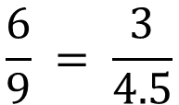
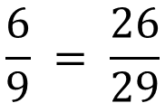
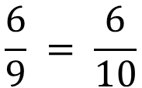
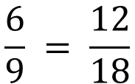
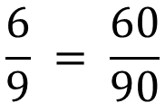
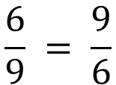
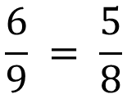
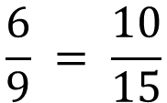
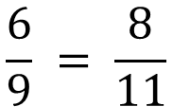
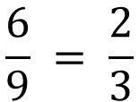
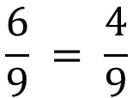
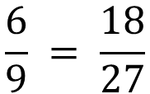
$$\frac{6}{9} = \frac{9}{6}$$
Not
Equivalent
$$\frac{6}{9} = \frac{3}{4.5}$$
Not
Equivalent
Equivalent
Equivalent
$$\frac{6}{9} = \frac{6}{10}$$
Not
Equivalent
$$\frac{6}{9} = \frac{18}{27}$$
Not
Equivalent
Equivalent
Equivalent
$$\frac{6}{9} = \frac{4}{9}$$
Not
Equivalent
$$\frac{6}{9} = \frac{2}{3}$$
Not
Equivalent
Equivalent
Equivalent
$$\frac{6}{9} = \frac{8}{11}$$
Not
Equivalent
$$\frac{6}{9} = \frac{10}{15}$$
Not
Equivalent
Equivalent
Equivalent
$$\frac{6}{9} = \frac{5}{8}$$
Not
Equivalent
$$\frac{6}{9} = \frac{60}{90}$$
Not
Equivalent
Equivalent
Equivalent
$$\frac{6}{9} = \frac{12}{18}$$
Not
Equivalent
$$\frac{6}{9} = \frac{26}{29}$$
Not
Equivalent
Equivalent
Equivalent
@mrbartonmaths

Slide 3
$$\frac{6}{9} = \frac{9}{6}$$
Not
Equivalent
$$\frac{6}{9} = \frac{3}{4.5}$$
Not
Equivalent
Equivalent
Equivalent
$$\frac{6}{9} = \frac{6}{10}$$
Not
Equivalent
$$\frac{6}{9} = \frac{18}{27}$$
Not
Equivalent
Equivalent
Equivalent
$$\frac{6}{9} = \frac{4}{9}$$
Not
Equivalent
$$\frac{6}{9} = \frac{2}{3}$$
Not
Equivalent
Equivalent
Equivalent
$$\frac{6}{9} = \frac{8}{11}$$
Not
Equivalent
$$\frac{6}{9} = \frac{10}{15}$$
Not
Equivalent
Equivalent
Equivalent
$$\frac{6}{9} = \frac{5}{8}$$
Not
Equivalent
$$\frac{6}{9} = \frac{60}{90}$$
Not
Equivalent
Equivalent
Equivalent
$$\frac{6}{9} = \frac{12}{18}$$
Not
Equivalent
$$\frac{6}{9} = \frac{26}{29}$$
Not
Equivalent
Equivalent
Equivalent
@mrbartonmaths

Slide 4
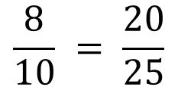
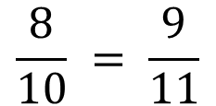
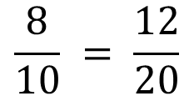
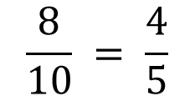
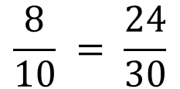
Your Turn
$$\frac{8}{10} = \frac{9}{11}$$
Not
Equivalent
Equivalent
$$\frac{8}{10} = \frac{24}{30}$$
Not
Equivalent
Equivalent
$$\frac{8}{10} = \frac{4}{5}$$
Not
Equivalent
Equivalent
$$\frac{8}{10} = \frac{12}{20}$$
Not
Equivalent
Equivalent
$$\frac{8}{10} = \frac{20}{25}$$
Not
Equivalent
Equivalent
@mrbartonmaths

Slide 5
Your Turn - answers
$$\frac{8}{10} = \frac{9}{11}$$
Not
Equivalent
Equivalent
$$\frac{8}{10} = \frac{24}{30}$$
Not
Equivalent
Equivalent
$$\frac{8}{10} = \frac{4}{5}$$
Not
Equivalent
Equivalent
$$\frac{8}{10} = \frac{12}{20}$$
Not
Equivalent
Equivalent
$$\frac{8}{10} = \frac{20}{25}$$
Not
Equivalent
Equivalent
@mrbartonmaths

