Slide 1
Brackets: Expanding double brackets 1
Silent
Teacher
Intelligent Practice
Narration
Your Turn
$$\left(x−7\right)\left(x−3\right)=$$
$$\left(x−3\right)\left(x−7\right)=$$
$$\left(x+7\right)\left(x−3\right)=$$
Example
For more videos visit mrbartonmaths.com/videos

Slide 2
Worked Example
Your Turn
$$(x+8)\left(x−4\right)=$$
$$(x−8)(x+4)=$$
@mrbartonmaths

Slide 3
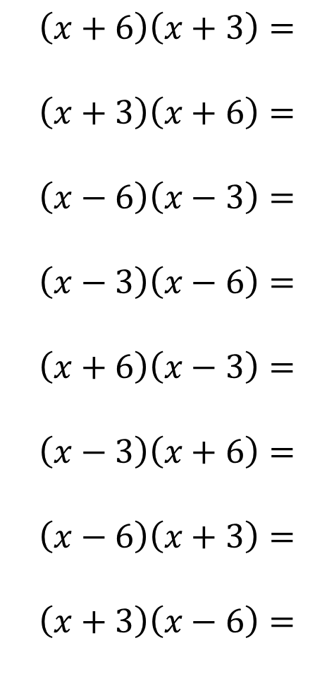
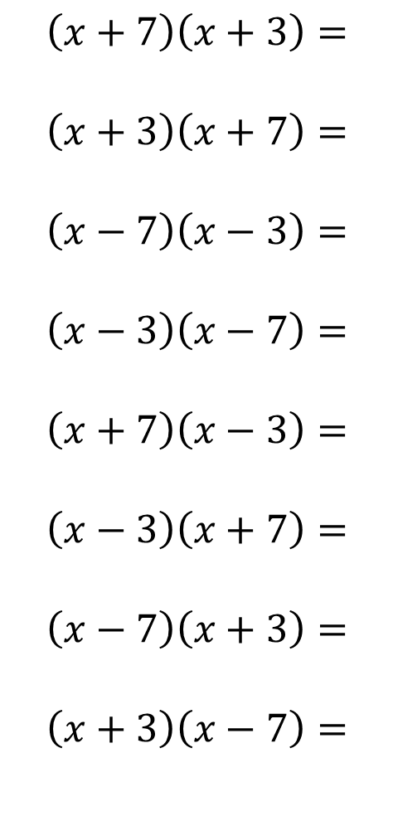
$$\left(x+7\right)\left(x+3\right)=$$
$$\left(x+3\right)\left(x+7\right)=$$
$$\left(x−7\right)\left(x−3\right)=$$
$$\left(x−3\right)\left(x−7\right)=$$
$$\left(x+7\right)\left(x−3\right)=$$
$$\left(x−3\right)\left(x+7\right)=$$
$$\left(x−7\right)\left(x+3\right)=$$
$$\left(x+3\right)\left(x−7\right)=$$
$$\left(x+6\right)\left(x+3\right)=$$
$$\left(x+3\right)\left(x+6\right)=$$
$$\left(x−6\right)\left(x−3\right)=$$
$$\left(x−3\right)\left(x−6\right)=$$
$$\left(x+6\right)\left(x−3\right)=$$
$$\left(x−3\right)\left(x+6\right)=$$
$$\left(x−6\right)\left(x+3\right)=$$
$$\left(x+3\right)\left(x−6\right)=$$
@mrbartonmaths

Slide 4
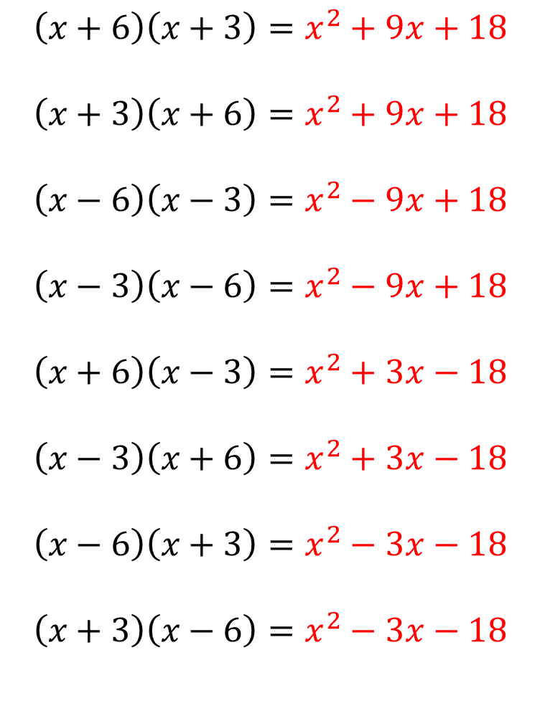
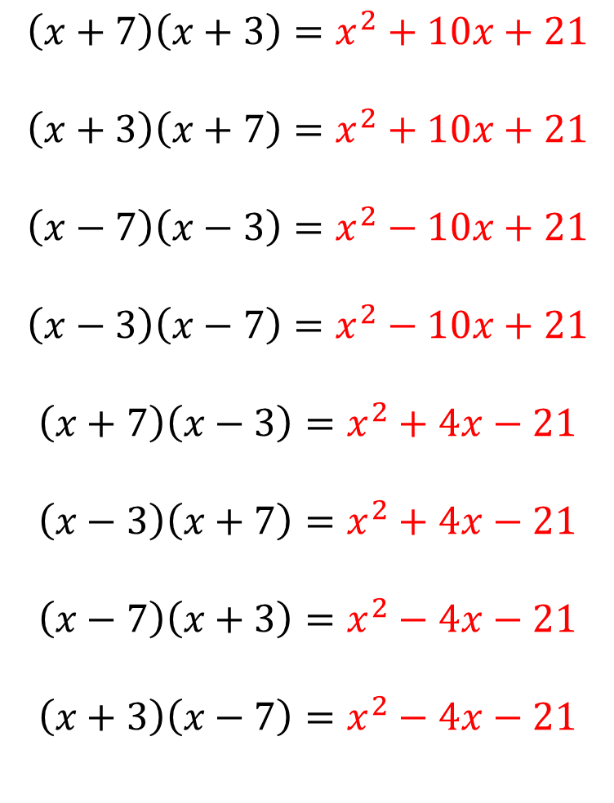
$$\left(x+7\right)\left(x+3\right)=x^{2}+10x+21$$
$$\left(x+3\right)\left(x+7\right)=x^{2}+10x+21$$
$$\left(x−7\right)\left(x−3\right)=x^{2}−10x+21$$
$$\left(x−3\right)\left(x−7\right)=x^{2}−10x+21$$
$$\left(x+7\right)\left(x−3\right)=x^{2}+4x−21$$
$$\left(x−3\right)\left(x+7\right)=x^{2}+4x−21$$
$$\left(x−7\right)\left(x+3\right)=x^{2}−4x−21$$
$$\left(x+3\right)\left(x−7\right)=x^{2}−4x−21$$
$$\left(x+6\right)\left(x+3\right)=x^{2}+9x+18$$
$$\left(x+3\right)\left(x+6\right)=x^{2}+9x+18$$
$$\left(x−6\right)\left(x−3\right)=x^{2}−9x+18$$
$$\left(x−3\right)\left(x−6\right)=x^{2}−9x+18$$
$$\left(x+6\right)\left(x−3\right)=x^{2}+3x−18$$
$$\left(x−3\right)\left(x+6\right)=x^{2}+3x−18$$
$$\left(x−6\right)\left(x+3\right)=x^{2}−3x−18$$
$$\left(x+3\right)\left(x−6\right)=x^{2}−3x−18$$
@mrbartonmaths

