Slide 1
Brackets: Expanding double brackets 2
Silent
Teacher
Intelligent Practice
Narration
Your Turn
$$\left(x+2\right)\left(x−3\right)=$$
$$\left(x−3\right)\left(x−2\right)=$$
$$\left(3−x\right)\left(2−x\right)=$$
Example
For more videos visit mrbartonmaths.com/videos

Slide 2
Worked Example
Your Turn
$$(x+5)\left(x−3\right)=$$
$$(x−5)(x+3)=$$
@mrbartonmaths

Slide 3
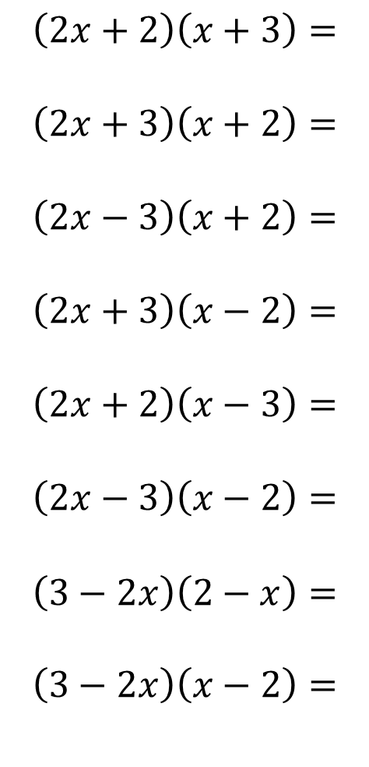
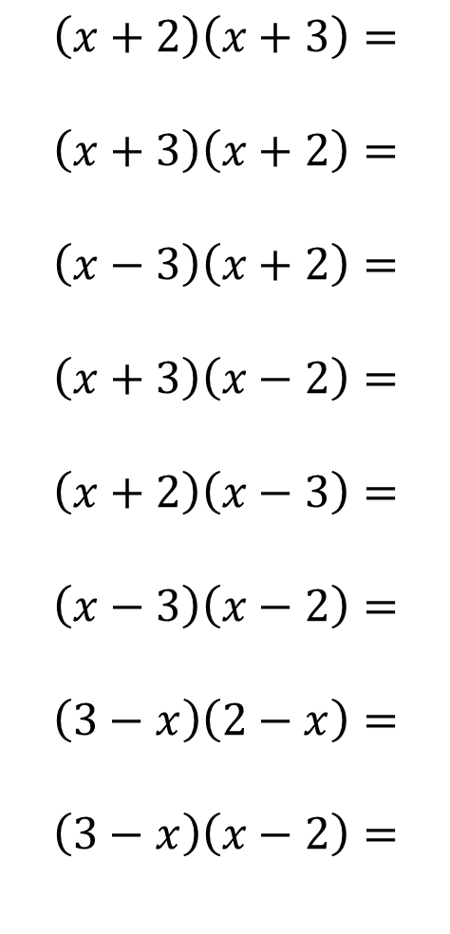
$$\left(x+2\right)\left(x+3\right)=$$
$$\left(x+3\right)\left(x+2\right)=$$
$$\left(x−3\right)\left(x+2\right)=$$
$$\left(x+3\right)\left(x−2\right)=$$
$$\left(x+2\right)\left(x−3\right)=$$
$$\left(x−3\right)\left(x−2\right)=$$
$$\left(3−x\right)\left(2−x\right)=$$
$$\left(3−x\right)\left(x−2\right)=$$
$$\left(2x+2\right)\left(x+3\right)=$$
$$\left(2x+3\right)\left(x+2\right)=$$
$$\left(2x−3\right)\left(x+2\right)=$$
$$\left(2x+3\right)\left(x−2\right)=$$
$$\left(2x+2\right)\left(x−3\right)=$$
$$\left(2x−3\right)\left(x−2\right)=$$
$$\left(3−2x\right)\left(2−x\right)=$$
$$\left(3−2x\right)\left(x−2\right)=$$
@mrbartonmaths

Slide 4
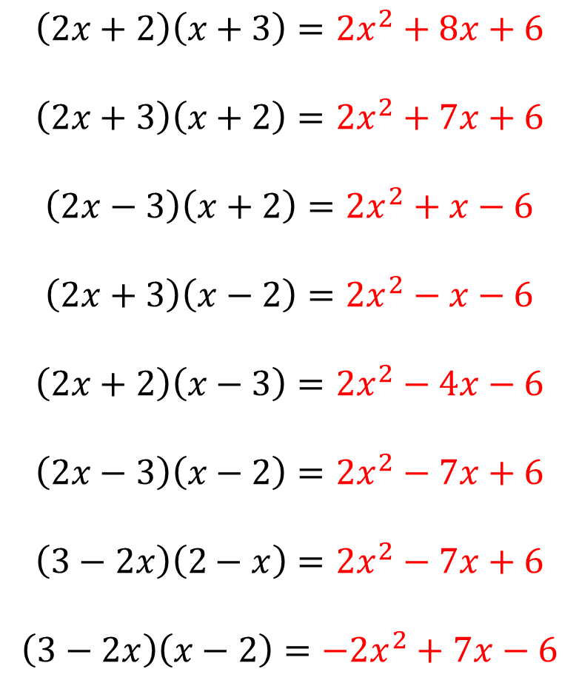
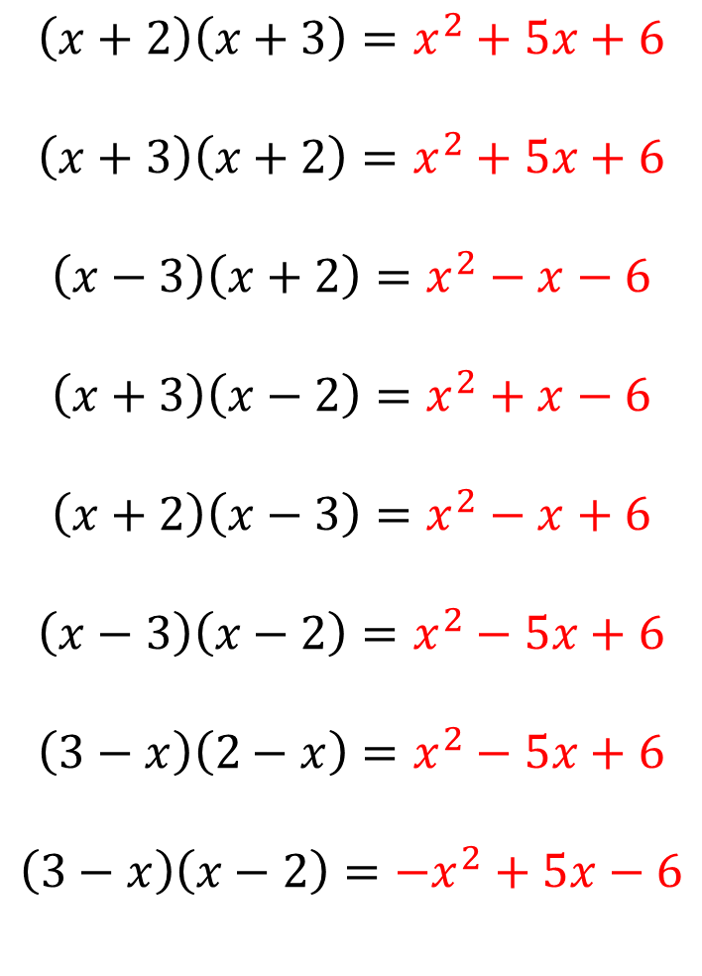
$$\left(x+2\right)\left(x+3\right)=x^{2}+5x+6$$
$$\left(x+3\right)\left(x+2\right)=x^{2}+5x+6$$
$$\left(x−3\right)\left(x+2\right)=x^{2}−x−6$$
$$\left(x+3\right)\left(x−2\right)=x^{2}+x−6$$
$$\left(x+2\right)\left(x−3\right)=x^{2}−x+6$$
$$\left(x−3\right)\left(x−2\right)=x^{2}−5x+6$$
$$\left(3−x\right)\left(2−x\right)=x^{2}−5x+6$$
$$\left(3−x\right)\left(x−2\right)=−x^{2}+5x−6$$
$$\left(2x+2\right)\left(x+3\right)=2x^{2}+8x+6$$
$$\left(2x+3\right)\left(x+2\right)=2x^{2}+7x+6$$
$$\left(2x−3\right)\left(x+2\right)=2x^{2}+x−6$$
$$\left(2x+3\right)\left(x−2\right)=2x^{2}−x−6$$
$$\left(2x+2\right)\left(x−3\right)=2x^{2}−4x−6$$
$$\left(2x−3\right)\left(x−2\right)=2x^{2}−7x+6$$
$$\left(3−2x\right)\left(2−x\right)=2x^{2}−7x+6$$
$$\left(3−2x\right)\left(x−2\right)=−2x^{2}+7x−6$$
@mrbartonmaths

