Slide 1
Brackets: Expanding double brackets
Silent
Teacher
Intelligent Practice
Narration
Your Turn
$$\left(2x+5\right)\left(3x+3\right)=$$
$$\left(2x+3\right)\left(3x+5\right)=$$
$$\left(2x−3\right)\left(3x+5\right)=$$
Practice
Notes:
Specific focus on numerical examples with non-monics

Slide 2
Worked Example
Your Turn
$$(3x+5)\left(7x−3\right)=$$
$$(3x+2)(7x−4)=$$
@kevinweav2003

Slide 3


1. $\left(3x+2\right)\left(5x+4\right)=$
2. $\left(5x+4\right)\left(3x+2\right)=$
3. $\left(3x−2\right)\left(5x+4\right)=$
4. $\left(3x+2\right)\left(5x−4\right)=$
5. $\left(3x−2\right)\left(5x−4\right)=$
6. $\left(3x−2\right)\left(4x+4\right)=$
7. $\left(3x−2\right)\left(3x+4\right)=$
8. $\left(3x+2\right)\left(3x+4\right)=$
9. $\left(3x+1\right)\left(3x+4\right)=$
10. $\left(3x+0\right)\left(3x+4\right)=$
11. $\left(3x−1\right)\left(3x+4\right)=$
12. $\left(3x−1\right)\left(4x+4\right)=$
13. $\left(3x−1\right)\left(4x−4\right)=$
14. $\left(3x+2\right)\left(3x−2\right)=$
15. $\left(3x−2\right)\left(3x−2\right)=$
16. ${(3x−2)}^{2}=$
17.${ (2x+3)}^{2}=$
@kevinweav2003

Slide 4
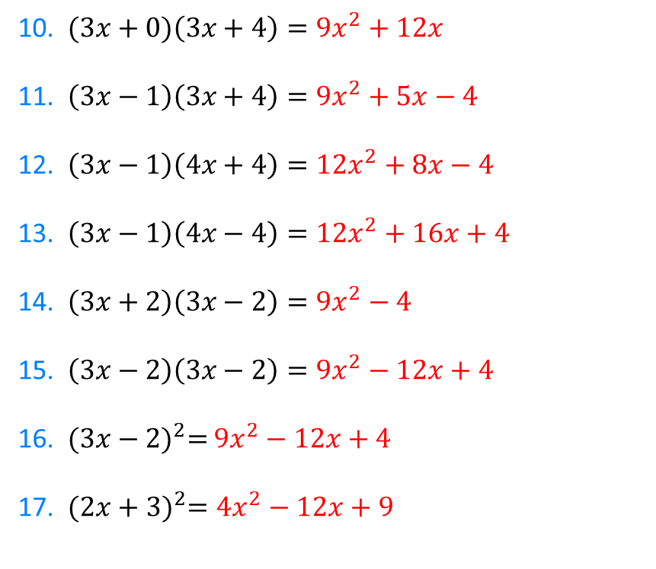
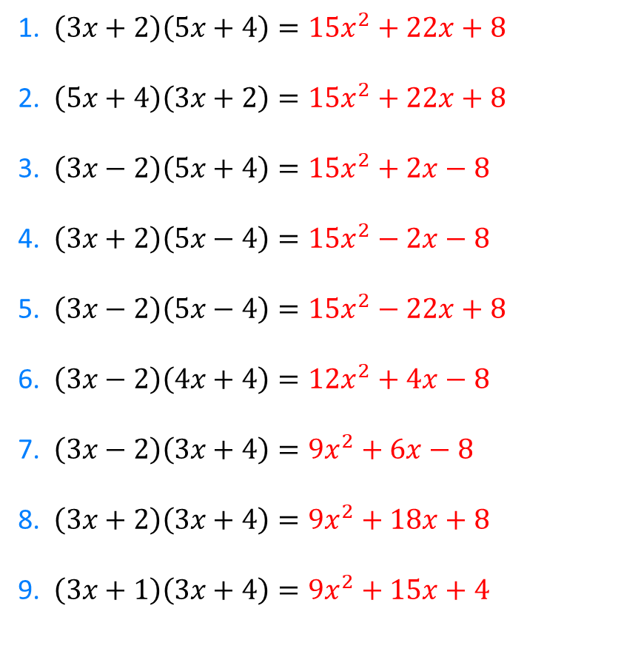
1. $\left(3x+2\right)\left(5x+4\right)={15x}^{2}+22x+8$
2. $\left(5x+4\right)\left(3x+2\right)={15x}^{2}+22x+8$
3. $\left(3x−2\right)\left(5x+4\right)={15x}^{2}+2x−8$
4. $\left(3x+2\right)\left(5x−4\right)={15x}^{2}−2x−8$
5. $\left(3x−2\right)\left(5x−4\right)={15x}^{2}−22x+8$
6. $\left(3x−2\right)\left(4x+4\right)={12x}^{2}+4x−8$
7. $\left(3x−2\right)\left(3x+4\right)={9x}^{2}+6x−8$
8. $\left(3x+2\right)\left(3x+4\right)={9x}^{2}+18x+8$
9. $\left(3x+1\right)\left(3x+4\right)={9x}^{2}+15x+4$
10. $(3x+0)\left(3x+4\right)={9x}^{2}+12x$
11. $\left(3x−1\right)\left(3x+4\right)={9x}^{2}+5x−4$
12. $\left(3x−1\right)\left(4x+4\right)={12x}^{2}+8x−4$
13. $\left(3x−1\right)\left(4x−4\right)={12x}^{2}+16x+4$
14. $\left(3x+2\right)\left(3x−2\right)={9x}^{2}−4$
15. $\left(3x−2\right)\left(3x−2\right)={9x}^{2}−12x+4$
16. ${(3x−2)}^{2}=$ ${9x}^{2}−12x+4$
17.${ (2x+3)}^{2}={4x}^{2}−12x+9$
@kevinweav2003

