Slide 1
Brackets: Expanding double brackets
Pattern spot
Reflect
Your Turn
$$\left(x+1\right)\left(x+2\right)=$$
$$\left(x+1\right)\left(x+3\right)=$$
$$\left(x+1\right)\left(x+4\right)=$$
Pattern
For more videos visit mrbartonmaths.com/videos

Slide 2
Worked Example
Your Turn
$$(x+2)\left(x+3\right)=$$
$$(x+2)(x+4)=$$
@mrbartonmaths

Slide 3
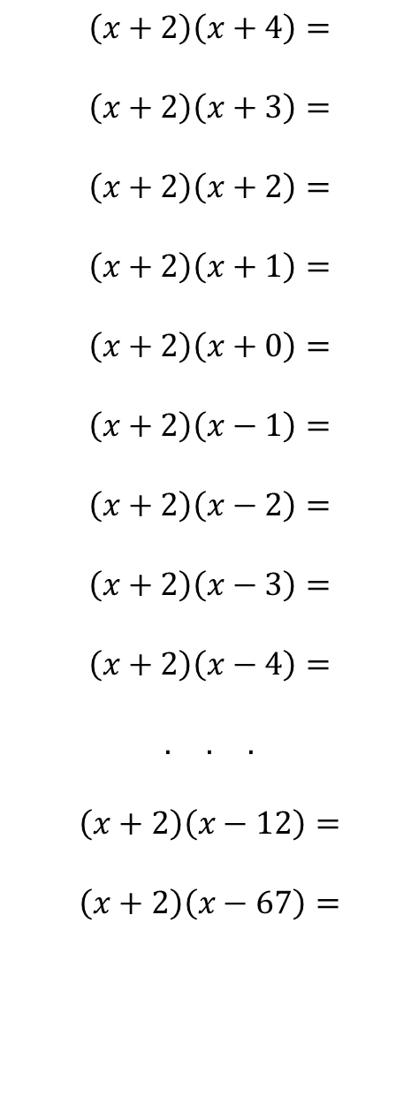
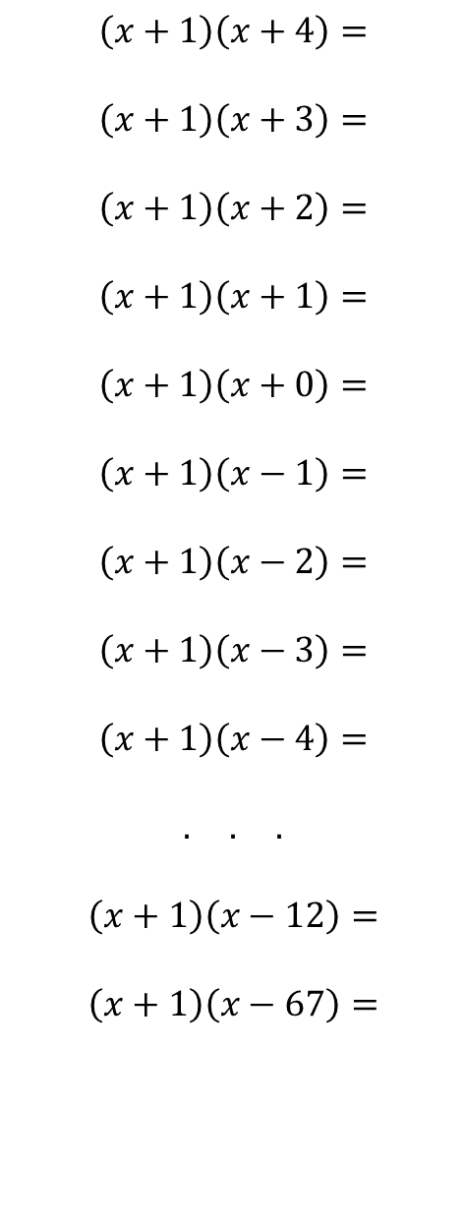
$$\left(x+1\right)\left(x+4\right)=$$
$$\left(x+1\right)\left(x+3\right)=$$
$$\left(x+1\right)\left(x+2\right)=$$
$$\left(x+1\right)\left(x+1\right)=$$
$$\left(x+1\right)\left(x+0\right)=$$
$$\left(x+1\right)\left(x−1\right)=$$
$$\left(x+1\right)\left(x−2\right)=$$
$$\left(x+1\right)\left(x−3\right)=$$
$$\left(x+1\right)\left(x−4\right)=$$
$$. . .$$
$$\left(x+1\right)\left(x−12\right)=$$
$$\left(x+1\right)\left(x−67\right)=$$
$$\left(x+2\right)\left(x+4\right)=$$
$$\left(x+2\right)\left(x+3\right)=$$
$$\left(x+2\right)\left(x+2\right)=$$
$$\left(x+2\right)\left(x+1\right)=$$
$$\left(x+2\right)\left(x+0\right)=$$
$$\left(x+2\right)\left(x−1\right)=$$
$$\left(x+2\right)\left(x−2\right)=$$
$$\left(x+2\right)\left(x−3\right)=$$
$$\left(x+2\right)\left(x−4\right)=$$
$$. . .$$
$$\left(x+2\right)\left(x−12\right)=$$
$$\left(x+2\right)\left(x−67\right)=$$
@mrbartonmaths

Slide 4
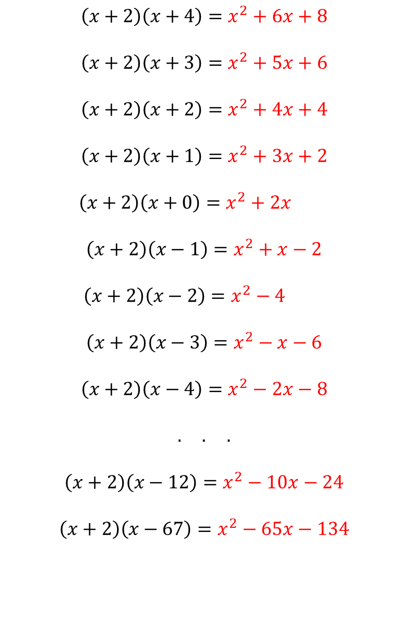
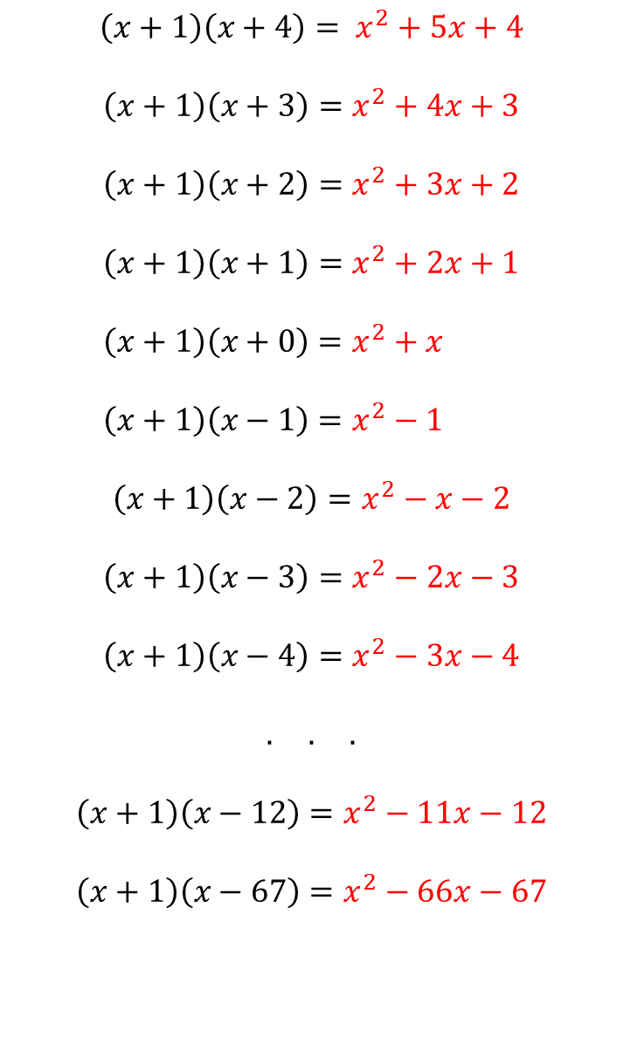
$$\left(x+1\right)\left(x+4\right)= x^{2}+5x+4$$
$$\left(x+1\right)\left(x+3\right)=x^{2}+4x+3$$
$$\left(x+1\right)\left(x+2\right)=x^{2}+3x+2$$
$$\left(x+1\right)\left(x+1\right)=x^{2}+2x+1$$
$\left(x+1\right)\left(x+0\right)=x^{2}+x$
$\left(x+1\right)\left(x−1\right)=x^{2}−1$
$$\left(x+1\right)\left(x−2\right)=x^{2}−x−2$$
$$\left(x+1\right)\left(x−3\right)=x^{2}−2x−3$$
$$\left(x+1\right)\left(x−4\right)=x^{2}−3x−4$$
$$. . .$$
$$\left(x+1\right)\left(x−12\right)=x^{2}−11x−12$$
$$\left(x+1\right)\left(x−67\right)=x^{2}−66x−67$$
$$\left(x+2\right)\left(x+4\right)=x^{2}+6x+8$$
$$\left(x+2\right)\left(x+3\right)=x^{2}+5x+6$$
$$\left(x+2\right)\left(x+2\right)=x^{2}+4x+4$$
$$\left(x+2\right)\left(x+1\right)=x^{2}+3x+2$$
$\left(x+2\right)\left(x+0\right)=x^{2}+2x$
$$\left(x+2\right)\left(x−1\right)=x^{2}+x−2$$
$\left(x+2\right)\left(x−2\right)=x^{2}−4$
$$\left(x+2\right)\left(x−3\right)=x^{2}−x−6$$
$$\left(x+2\right)\left(x−4\right)=x^{2}−2x−8$$
$$. . .$$
$$\left(x+2\right)\left(x−12\right)=x^{2}−10x−24$$
$$\left(x+2\right)\left(x−67\right)=x^{2}−65x−134$$
@mrbartonmaths

Slide 5
Your Turn
$$\left(x+1\right)\left(x+5\right)=$$
$$(x+1)(x−5)=$$
$$(x+1)(x−8)=$$
$$\left(x+1\right)\left(x+18\right)=$$
$$(x+5)(x−5)=$$
@mrbartonmaths

Slide 6
Your Turn - answers
$$\left(x+1\right)\left(x+5\right)=x^{2}+6x+5$$
$$\left(x+1\right)\left(x−5\right)=x^{2}−4x−5$$
$$\left(x+1\right)\left(x−8\right)=x^{2}−7x−8$$
$$\left(x+1\right)\left(x+18\right)=x^{2}+19x+18$$
$$\left(x+5\right)\left(x−5\right)=x^{2}−25$$
@mrbartonmaths

