Slide 1
Brackets: Expanding single brackets
Silent
Teacher
Intelligent Practice
Narration
Your Turn
$$3 \left(x−5\right)=$$
$$3 \left(5−x\right)=$$
$$3 \left(−5−x\right)=$$
Example
For more videos visit mrbartonmaths.com/videos

Slide 2


Worked Example
Your Turn
$$4 \left(x−3\right)=$$
$$5 \left(x−3\right)=$$
@mrbartonmaths

Slide 3
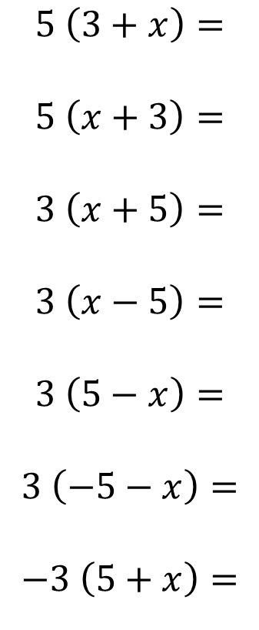
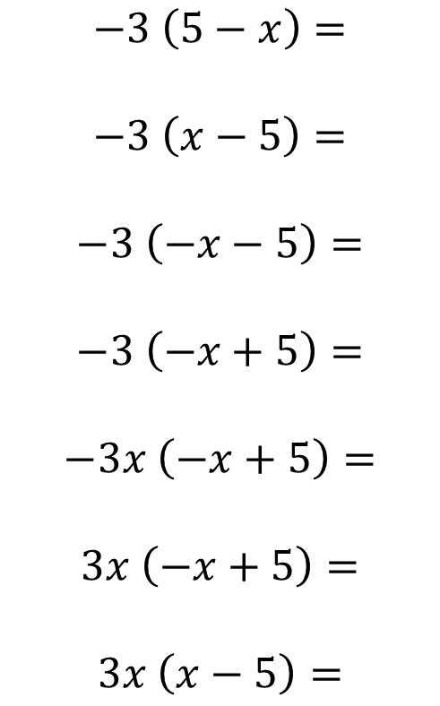
$$5 \left(3+x\right)=$$
$$5 \left(x+3\right)=$$
$$3 \left(x+5\right)=$$
$$3 \left(x−5\right)=$$
$$3 \left(5−x\right)=$$
$$3 \left(−5−x\right)=$$
$$−3 \left(5+x\right)=$$
$$−3 \left(5−x\right)=$$
$$−3 \left(x−5\right)=$$
$$−3 \left(−x−5\right)=$$
$$−3 \left(−x+5\right)=$$
$$−3x \left(−x+5\right)=$$
$$3x \left(−x+5\right)=$$
$$3x \left(x−5\right)=$$
@mrbartonmaths

Slide 4
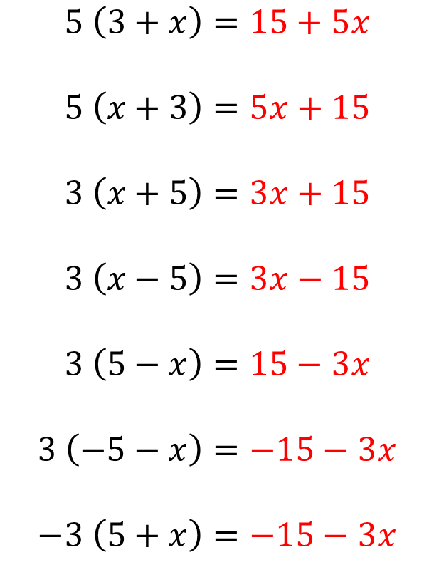
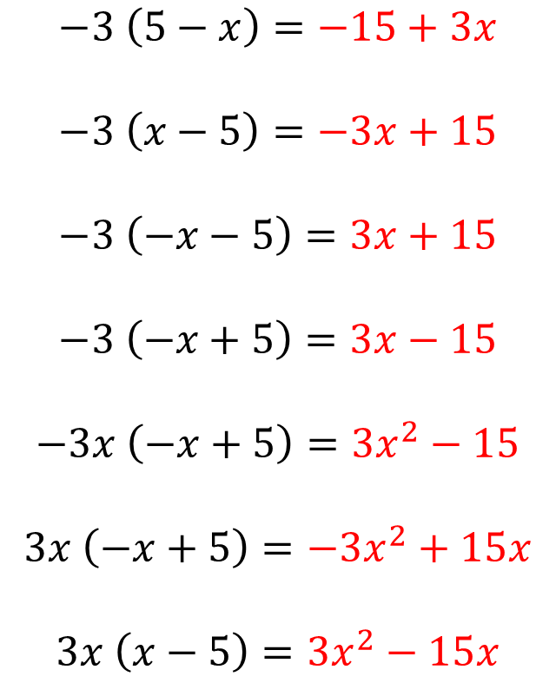
$$5 \left(3+x\right)=15+5x$$
$$5 \left(x+3\right)=5x+15$$
$$3 \left(x+5\right)=3x+15$$
$$3 \left(x−5\right)=3x−15$$
$$3 \left(5−x\right)=15−3x$$
$$3 \left(−5−x\right)=−15−3x$$
$$−3 \left(5+x\right)=−15−3x$$
$$−3 \left(5−x\right)=−15+3x$$
$$−3 \left(x−5\right)=−3x+15$$
$$−3 \left(−x−5\right)=3x+15$$
$$−3 \left(−x+5\right)=3x−15$$
$$−3x \left(−x+5\right)=3x^{2}−15$$
$$3x \left(−x+5\right)=−3x^{2}+15x$$
$$3x \left(x−5\right)=3x^{2}−15x$$
@mrbartonmaths

