Slide 1
Brackets: Expanding single brackets
Pattern spot
Reflect
Your Turn
$$3\left(x+3\right)=$$
$$3\left(x+4\right)=$$
$$3\left(x+5\right)=$$
Pattern
For more videos visit mrbartonmaths.com/videos

Slide 2
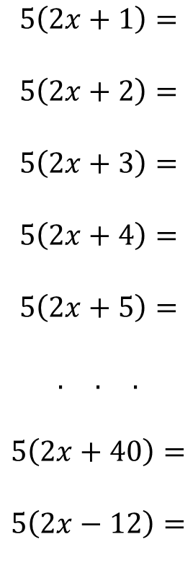
$$3\left(x+1\right)=$$
$$3\left(x+2\right)=$$
$$3\left(x+3\right)=$$
$$3\left(x+4\right)=$$
$$3\left(x+5\right)=$$
$$. . .$$
$$3\left(x+40\right)=$$
$$3\left(x−12\right)=$$
$$5\left(x+1\right)=$$
$$5\left(x+2\right)=$$
$$5\left(x+3\right)=$$
$$5\left(x+4\right)=$$
$$5\left(x+5\right)=$$
$$. . .$$
$$5\left(x+40\right)=$$
$$5\left(x−12\right)=$$
$$5\left(2x+1\right)=$$
$$5\left(2x+2\right)=$$
$$5\left(2x+3\right)=$$
$$5\left(2x+4\right)=$$
$$5\left(2x+5\right)=$$
$$. . .$$
$$5\left(2x+40\right)=$$
$$5\left(2x−12\right)=$$
@mrbartonmaths

Slide 3
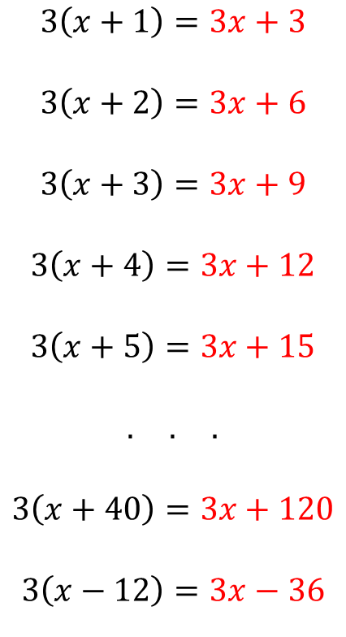
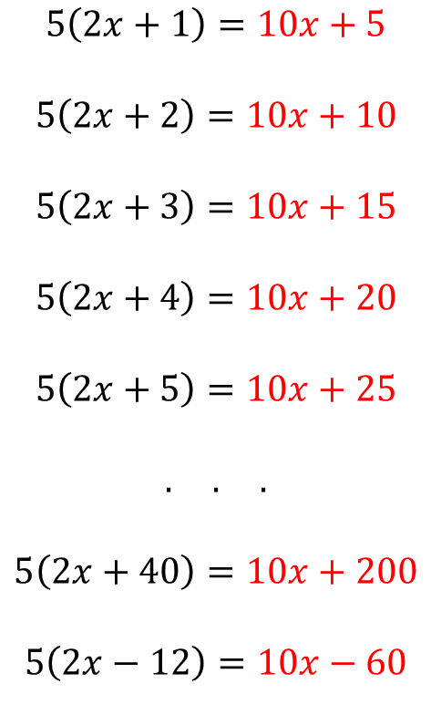
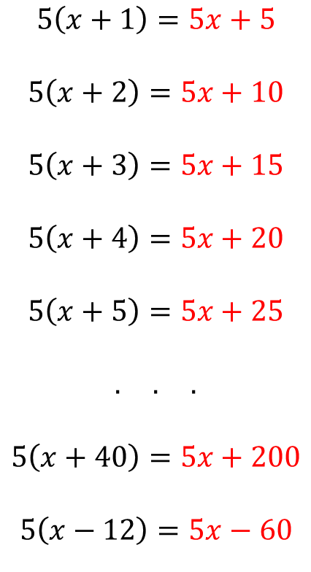
$$3\left(x+1\right)=3x+3$$
$$3\left(x+2\right)=3x+6$$
$$3\left(x+3\right)=3x+9$$
$$3\left(x+4\right)=3x+12$$
$$3\left(x+5\right)=3x+15$$
$$. . .$$
$$3\left(x+40\right)=3x+120$$
$$3\left(x−12\right)=3x−36$$
$$5\left(x+1\right)=5x+5$$
$$5\left(x+2\right)=5x+10$$
$$5\left(x+3\right)=5x+15$$
$$5\left(x+4\right)=5x+20$$
$$5\left(x+5\right)=5x+25$$
$$. . .$$
$$5\left(x+40\right)=5x+200$$
$$5\left(x−12\right)=5x−60$$
$$5\left(2x+1\right)=10x+5$$
$$5\left(2x+2\right)=10x+10$$
$$5\left(2x+3\right)=10x+15$$
$$5\left(2x+4\right)=10x+20$$
$$5\left(2x+5\right)=10x+25$$
$$. . .$$
$$5\left(2x+40\right)=10x+200$$
$$5\left(2x−12\right)=10x−60$$
@mrbartonmaths

Slide 4
Your Turn
$$4\left(x+3\right)=$$
$$6(x+3)=$$
$$6(2x+3)=$$
$$6(2x−3)=$$
$$6(5x−3)=$$
@mrbartonmaths

Slide 5
Your Turn - answers
$$4\left(x+3\right)=4x+12$$
$$6\left(x+3\right)=6x+18$$
$$6\left(2x+3\right)=12x+18$$
$$6\left(2x−3\right)=12x−18$$
$$6\left(5x−3\right)=30x−18$$
@mrbartonmaths

