Slide 1
Brackets: Expanding triple brackets
Silent
Teacher
Intelligent Practice
Narration
Your Turn
$$(x+1)(x+2)(x−2)=$$
$$(x−1)(x+2)(x−2)=$$
$$\left(x−1\right)\left(x−2\right)\left(x−2\right)=$$
Example
For more videos visit mrbartonmaths.com/videos

Slide 2
Worked Example
Your Turn
$$\left(x+3\right)\left(x+1\right)\left(x−2\right)=$$
$$\left(x+3\right)\left(x−1\right)\left(x+2\right)=$$
@mrbartonmaths

Slide 3
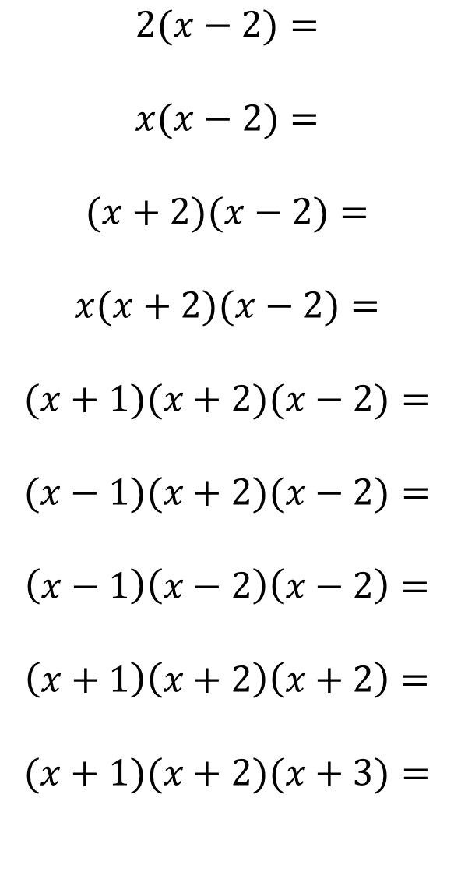
$$2(x−2)=$$
$$x(x−2)=$$
$$(x+2)(x−2)=$$
$$x(x+2)(x−2)=$$
$$(x+1)(x+2)(x−2)=$$
$$(x−1)(x+2)(x−2)=$$
$$\left(x−1\right)\left(x−2\right)\left(x−2\right)=$$
$$\left(x+1\right)\left(x+2\right)\left(x+2\right)=$$
$$(x+1)(x+2)(x+3)=$$
@mrbartonmaths

Slide 4
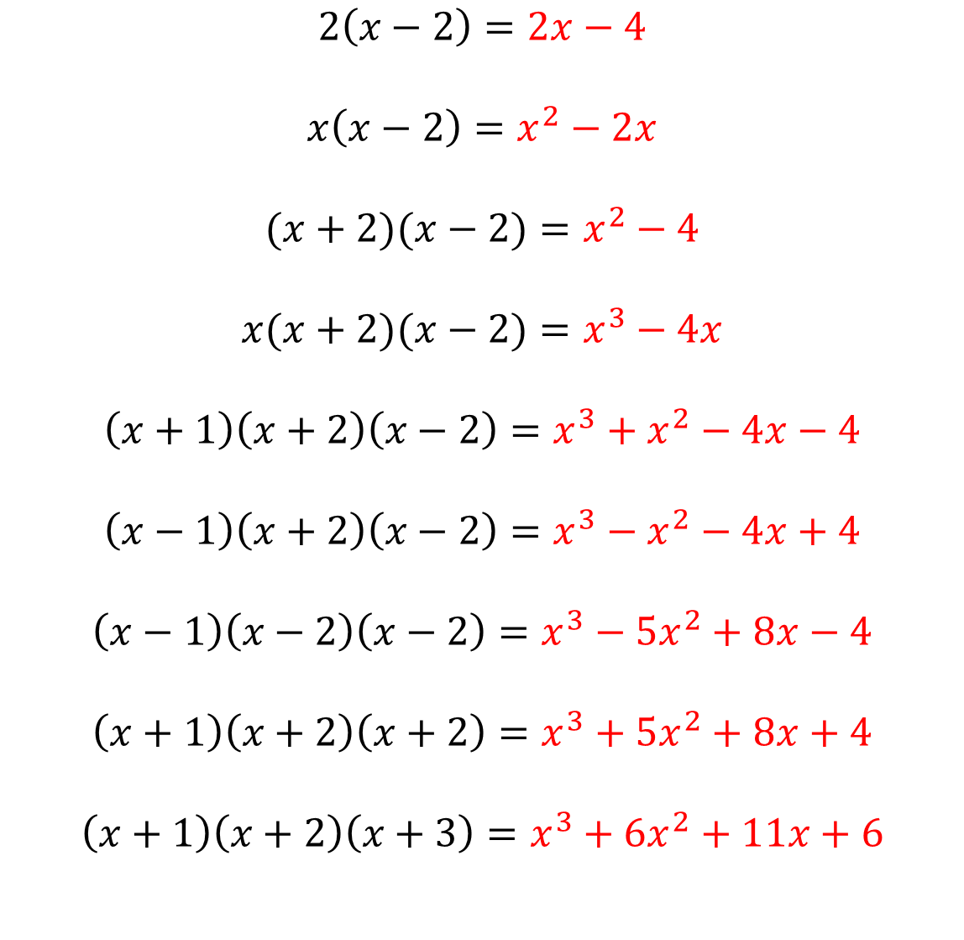
$$2\left(x−2\right)=2x−4$$
$$x\left(x−2\right)=x^{2}−2x$$
$$(x+2)(x−2)=x^{2}−4$$
$$x(x+2)(x−2)=x^{3}−4x$$
$$\left(x+1\right)\left(x+2\right)\left(x−2\right)=x^{3}+x^{2}−4x−4$$
$$\left(x−1\right)\left(x+2\right)\left(x−2\right)=x^{3}−x^{2}−4x+4$$
$$\left(x−1\right)\left(x−2\right)\left(x−2\right)=x^{3}−5x^{2}+8x−4$$
$$\left(x+1\right)\left(x+2\right)\left(x+2\right)=x^{3}+5x^{2}+8x+4$$
$$\left(x+1\right)\left(x+2\right)\left(x+3\right)=x^{3}+{6x}^{2}+11x+6$$
@mrbartonmaths

