Slide 1
Brackets: Factorising single brackets
Silent
Teacher
Intelligent Practice
Narration
Your Turn
$$9x−12=$$
$$12−9x=$$
$$12x−9=$$
Example
For more videos visit mrbartonmaths.com/videos

Slide 2


Worked Example
Your Turn
$$10x−15=$$
$$9x−15=$$
@mrbartonmaths

Slide 3
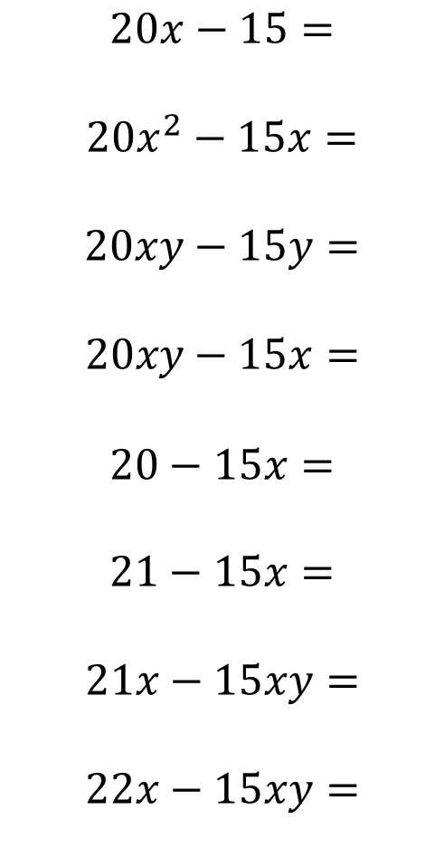
$$6x+8=$$
$$6x−8=$$
$$12x−16=$$
$$18x−24=$$
$$9x−12=$$
$$12−9x=$$
$$12x−9=$$
$$60x−45=$$
$$20x−15=$$
$$20x^{2}−15x=$$
$$20xy−15y=$$
$$20xy−15x=$$
$$20−15x=$$
$$21−15x=$$
$$21x−15xy=$$
$$22x−15xy=$$
@mrbartonmaths

Slide 4
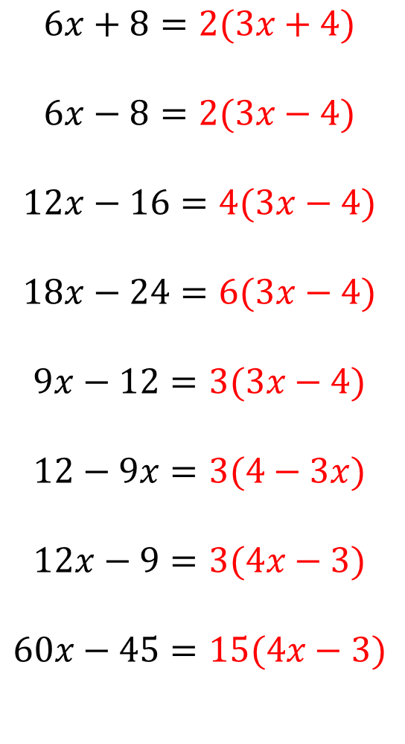
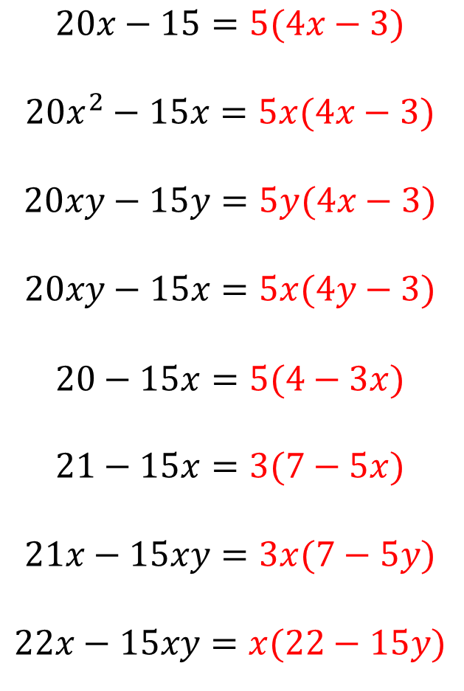
$$6x+8=2(3x+4)$$
$$6x−8=2(3x−4)$$
$$12x−16=4(3x−4)$$
$$18x−24=6(3x−4)$$
$$9x−12=3(3x−4)$$
$$12−9x=3(4−3x)$$
$$12x−9=3(4x−3)$$
$$60x−45=15(4x−3)$$
$$20x−15=5(4x−3)$$
$$20x^{2}−15x=5x(4x−3)$$
$$20xy−15y=5y(4x−3)$$
$$20xy−15x=5x(4y−3)$$
$$20−15x=5(4−3x)$$
$$21−15x=3(7−5x)$$
$$21x−15xy=3x(7−5y)$$
$$22x−15xy=x(22−15y)$$
@mrbartonmaths

