Slide 1
Fractions: Fractions of an amount
Silent
Teacher
Intelligent Practice
Narration
Your Turn
$$\frac{2}{5} of 300=$$
$$\frac{2}{5}of 3 =$$
Example
For more videos visit mrbartonmaths.com/videos

Slide 2
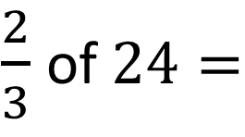
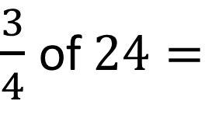
Worked Example
Your Turn
$\frac{3}{4}$ of $24=$
$\frac{2}{3}$ of $24=$
@mrbartonmaths

Slide 3

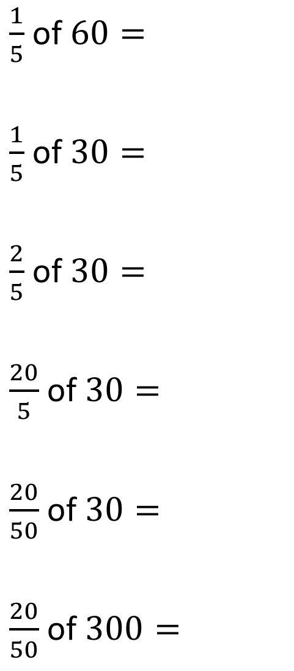
$\frac{1}{5}$ of $60=$
$\frac{1}{5}$ of $30=$
$\frac{2}{5}$ of $30=$
$\frac{20}{5}$ of $30=$
$\frac{20}{50}$ of $30=$
$\frac{20}{50}$ of $300=$
$\frac{2}{5}$ of $300=$
$\frac{2}{5}$ of $3=$
$\frac{3}{5}$ of $2=$
$\frac{3}{2}$ of $5=$
$\frac{2}{3}$ of $5=$
$\frac{2}{3}$ of $\frac{1}{2}=$
@mrbartonmaths

Slide 4

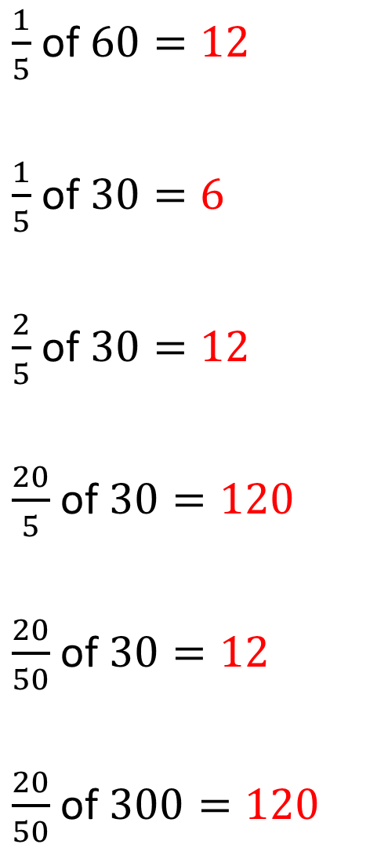
$\frac{1}{5}$ of $60=12$
$\frac{1}{5}$ of $30=6$
$\frac{2}{5}$ of $30=12$
$\frac{20}{5}$ of $30=120$
$\frac{20}{50}$ of $30=12$
$\frac{20}{50}$ of $300=120$
$\frac{2}{5}$ of $300=120$
$\frac{2}{5}$ of $3=1.2$
$\frac{3}{5}$ of $2=1.2$
$\frac{3}{2}$ of $5=7.5$
$\frac{2}{3}$ of $5=3.333…$
$\frac{2}{3}$ of $\frac{1}{2}=\frac{2}{6}=\frac{1}{3}=0.3333…$
@mrbartonmaths

