Slide 1
Factors, Multiples, Primes: HCF and LCM mixed
Silent
Teacher
Intelligent Practice
Narration
Your Turn
$$20 \text{and}\text{ 10 }\text{HCF}= \text{LCM}=$$
$$20 \text{and}\text{ 30 }\text{HCF}= \text{LCM}=$$
$$4 \text{and}\text{ 30 }\text{HCF}= \text{LCM}=$$
Example
For more videos visit mrbartonmaths.com/videos

Slide 2
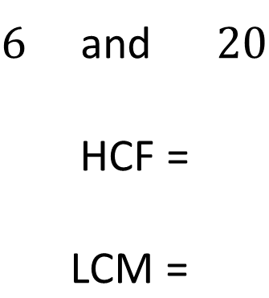
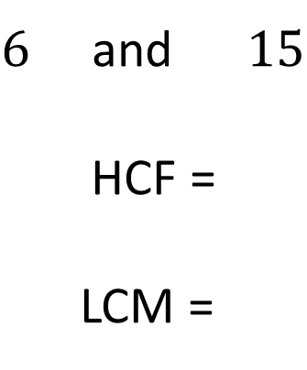
Worked Example
Your Turn
$6$and $15$
$$\text{HCF}\text{ =}$$
LCM =
$6$and $20$
$$\text{HCF}\text{ =}$$
$$\text{LCM}\text{ = }$$
@mrbartonmaths

Slide 3
$5$ and $10$ HCF = LCM =
$10$ and $5$ HCF = LCM =
$20$ and $5$ HCF = LCM =
$20$ and $10$ HCF = LCM =
$20$ and $30$ HCF = LCM =
$4$ and $30$ HCF = LCM =
$5$ and $30$ HCF = LCM =
$7$ and $30$ HCF = LCM =
@mrbartonmaths

Slide 4
$5$ and $10$ HCF = 5 LCM = 10
$10$ and $5$ HCF = 5 LCM = 10
$20$ and $5$ HCF = 5 LCM = 20
$20$ and $10$ HCF = 10 LCM = 20
$20$ and $30$ HCF = 10 LCM = 60
$4$ and $30$ HCF = 2 LCM = 60
$5$ and $30$ HCF = 5 LCM = 30
$7$ and $30$ HCF = … LCM = 210
@mrbartonmaths

