Slide 1
Factors, Multiples, Primes: Highest common factor
Silent
Teacher
Intelligent Practice
Narration
Your Turn
$$12 \text{and}\text{ 40 }\text{highest} \text{common} \text{factor} =$$
$$12 \text{and}\text{ 50 }\text{highest} \text{common} \text{factor}=$$
$$12 \text{and}\text{ 60 }\text{highest} \text{common} \text{factor}=$$
Example
For more videos visit mrbartonmaths.com/videos

Slide 2
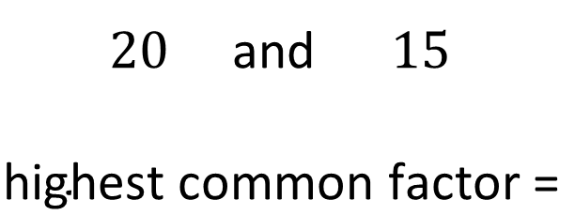
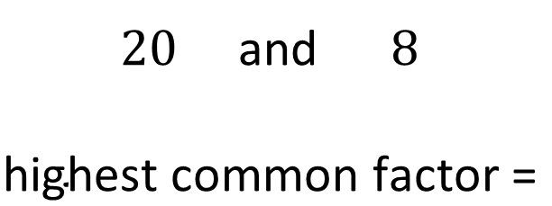
Worked Example
Your Turn
$20$and $8$
$$\text{highest} \text{common} \text{factor}\text{ =}$$
$20$and $15$
$$\text{highest} \text{common} \text{factor}\text{ =}$$
@mrbartonmaths

Slide 3
$12$ and $1$ Highest common factor =
$12$ and $2$ Highest common factor =
$12$ and $3$ Highest common factor =
$12$ and $4$ Highest common factor =
$12$ and $5$ Highest common factor =
$12$ and $6$ Highest common factor =
$12$ and $7$ Highest common factor =
$12$ and $8$ Highest common factor =
$12$ and $9$ Highest common factor =
$12$ and $10$ Highest common factor =
$12$ and $11$ Highest common factor =
$12$ and $12$ Highest common factor =
@mrbartonmaths

Slide 4
$12$ and $13$ Highest common factor =
$12$ and $14$ Highest common factor =
$12$ and $15$ Highest common factor =
$12$ and $16$ Highest common factor =
$12$ and $17$ Highest common factor =
$12$ and $18$ Highest common factor =
$12$ and $19$ Highest common factor =
$12$ and $20$ Highest common factor =
$12$ and $30$ Highest common factor =
$12$ and $40$ Highest common factor =
$12$ and $50$ Highest common factor =
$12$ and $60$ Highest common factor =
@mrbartonmaths

Slide 5
$12$ and $1$ Highest common factor = $1$
$12$ and $2$ Highest common factor = $2$
$12$ and $3$ Highest common factor = $3$
$12$ and $4$ Highest common factor = $4$
$12$ and $5$ Highest common factor = $…$
$12$ and $6$ Highest common factor = $6$
$12$ and $7$ Highest common factor = $…$
$12$ and $8$ Highest common factor = $4$
$12$ and $9$ Highest common factor = $3$
$12$ and $10$ Highest common factor = $2$
$12$ and $11$ Highest common factor = $…$
$12$ and $12$ Highest common factor = $12$
@mrbartonmaths

Slide 6
$12$ and $13$ Highest common factor = $…$
$12$ and $14$ Highest common factor = $2$
$12$ and $15$ Highest common factor = $3$
$12$ and $16$ Highest common factor = $4$
$12$ and $17$ Highest common factor = $…$
$12$ and $18$ Highest common factor = $6$
$12$ and $19$ Highest common factor = $…$
$12$ and $20$ Highest common factor = $4$
$12$ and $30$ Highest common factor = $6$
$12$ and $40$ Highest common factor = $4$
$12$ and $50$ Highest common factor = $2$
$12$ and $60$ Highest common factor = $12$
@mrbartonmaths

