Slide 1
Factors, Multiples, Primes: Lowest common multiple
Silent
Teacher
Intelligent Practice
Narration
Your Turn
$$12 \text{and}\text{ 40 }\text{lowest} \text{common} \text{multiple}=$$
$$12 \text{and}\text{ 60 }\text{lowest} \text{common} \text{multiple}=$$
$$12 \text{and}\text{ 60 }\text{lowest} \text{common} \text{multiple}=$$
Example
For more videos visit mrbartonmaths.com/videos

Slide 2
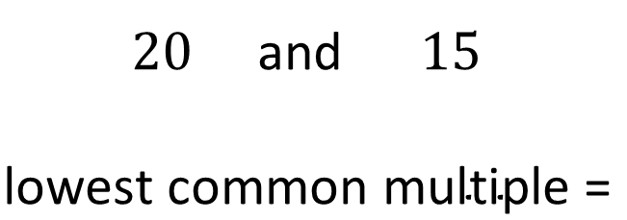
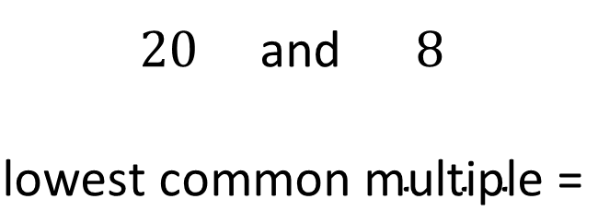
Worked Example
Your Turn
$20$and $8$
$$\text{lowest} \text{common} \text{multiple}\text{ =}$$
$20$and $15$
$$\text{lowest} \text{common} \text{multiple} \text{=}$$
@mrbartonmaths

Slide 3
$12$ and $1$ Lowest common multiple =
$12$ and $2$ Lowest common multiple =
$12$ and $3$ Lowest common multiple =
$12$ and $4$ Lowest common multiple =
$12$ and $5$ Lowest common multiple =
$12$ and $6$ Lowest common multiple =
$12$ and $7$ Lowest common multiple =
$12$ and $8$ Lowest common multiple =
$12$ and $9$ Lowest common multiple =
$12$ and $10$ Lowest common multiple =
$12$ and $11$ Lowest common multiple =
$12$ and $12$ Lowest common multiple =
@mrbartonmaths

Slide 4
$12$ and $13$ Lowest common multiple =
$12$ and $14$ Lowest common multiple =
$12$ and $15$ Lowest common multiple =
$12$ and $16$ Lowest common multiple =
$12$ and $17$ Lowest common multiple =
$12$ and $18$ Lowest common multiple =
$12$ and $19$ Lowest common multiple =
$12$ and $20$ Lowest common multiple =
$12$ and $30$ Lowest common multiple =
$12$ and $40$ Lowest common multiple =
$12$ and $50$ Lowest common multiple =
$12$ and $60$ Lowest common multiple =
@mrbartonmaths

Slide 5
$12$ and $1$ Lowest common multiple = $12$
$12$ and $2$ Lowest common multiple = $12$
$12$ and $3$ Lowest common multiple = $12$
$12$ and $4$ Lowest common multiple = $12$
$12$ and $5$ Lowest common multiple = $60$
$12$ and $6$ Lowest common multiple = $12$
$12$ and $7$ Lowest common multiple = $84$
$12$ and $8$ Lowest common multiple = $24$
$12$ and $9$ Lowest common multiple = $36$
$12$ and $10$ Lowest common multiple = $60$
$12$ and $11$ Lowest common multiple = $132$
$12$ and $12$ Lowest common multiple = $12$
@mrbartonmaths

Slide 6
$12$ and $13$ Lowest common multiple = $156$
$12$ and $14$ Lowest common multiple = $84$
$12$ and $15$ Lowest common multiple = $60$
$12$ and $16$ Lowest common multiple = $48$
$12$ and $17$ Lowest common multiple = $204$
$12$ and $18$ Lowest common multiple = $36$
$12$ and $19$ Lowest common multiple = $228$
$12$ and $20$ Lowest common multiple = $60$
$12$ and $30$ Lowest common multiple = $60$
$12$ and $40$ Lowest common multiple = $120$
$12$ and $50$ Lowest common multiple = $300$
$12$ and $60$ Lowest common multiple = $60$
@mrbartonmaths

