Slide 1
Averages and Range: Mean from a list of data - algebra
Silent
Teacher
Intelligent Practice
Narration
Your Turn
$$x,$$
$$x+2,$$
$$x+3,$$
$$x+6,$$
$$x+9$$
Example
For more videos visit mrbartonmaths.com/videos

Slide 2
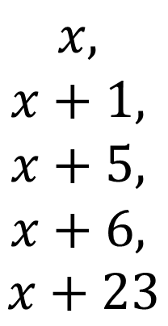
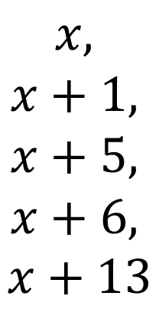
Worked Example
Your Turn
$$x,$$
$$x+1,$$
$$x+5,$$
$$x+6,$$
$$x+13$$
$$x,$$
$$x+1,$$
$$x+5,$$
$$x+6,$$
$$x+23$$
@mrbartonmaths

Slide 3
$x, x+2, x+3, x+6, x+9$
Mean =
$2x, 2x+4, 2x+6, 2x+12, 2x+18$
Mean =
$2x+1, 2x+5, 2x+7, 2x+13, 2x+19$
Mean =
$2x+1, 2x+5, 2x+7, 2x+13, 2x+9$
Mean =
@mrbartonmaths

Slide 4
$2x−1, 2x−5, 2x−7, 2x−13, 2x−9$
Mean =
$1−2x, 5−2x, 7−2x, 13−2x, 9−2x$
Mean =
$21−2x, 5−2x, 7−2x, 13−2x, 9−2x$
Mean =
$21−3x, 5−3x, 7−3x, 13−3x, 9−3x$
Mean =
@mrbartonmaths

Slide 5
$x, x+2, x+3, x+6, x+9$
Mean = $x+4$
$2x, 2x+4, 2x+6, 2x+12, 2x+18$
Mean = $2x+8$
$2x+1, 2x+5, 2x+7, 2x+13, 2x+19$
Mean = $2x+9$
$2x+1, 2x+5, 2x+7, 2x+13, 2x+9$
Mean = $2x+7$
@mrbartonmaths

Slide 6
$2x−1, 2x−5, 2x−7, 2x−13, 2x−9$
Mean = $2x−7$
$1−2x, 5−2x, 7−2x, 13−2x, 9−2x$
Mean = $7−2x$
$21−2x, 5−2x, 7−2x, 13−2x, 9−2x$
Mean = $11−2x$
$21−3x, 5−3x, 7−3x, 13−3x, 9−3x$
Mean = $11−3x$
@mrbartonmaths

