Slide 1
Averages and Range: Mean from a list of data – missing numbers
Silent
Teacher
Intelligent Practice
Narration
Your Turn
$$4, 2, 8, ?$$
$$5, 3, 9, ?$$
$$10, 6, 18, ?$$
Example
For more videos visit mrbartonmaths.com/videos

Slide 2
Worked Example
Your Turn
$5, 1, 10, ?$ Mean = $6$
$6, 2, 11, ?$ Mean = $6$
@mrbartonmaths

Slide 3
$4, 2, 8, ?$ Mean = $4$
$4, 2, 8, ?$ Mean = $5$
$5, 3, 9, ?$ Mean = $5$
$10, 6, 18, ?$ Mean = $10$
$10, 6, 18, ?$ Mean = $20$
$10, 6, 18, ?, 20$ Mean = $20$
$10, 6, 18, ?, 0$ Mean = $20$
@mrbartonmaths

Slide 4
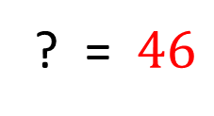
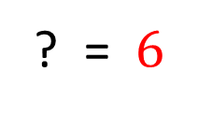
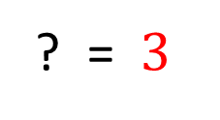
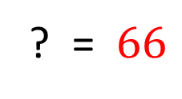
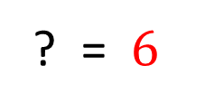
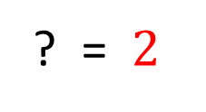
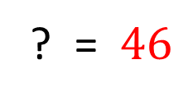
$4, 2, 8, ?$ Mean = $4$
? = $2$
$4, 2, 8, ?$ Mean = $5$
? = $6$
$5, 3, 9, ?$ Mean = $5$
? = $3$
$10, 6, 18, ?$ Mean = $10$
? = $6$
$10, 6, 18, ?$ Mean = $20$
? = $46$
$10, 6, 18, ?, 20$ Mean = $20$
? = $46$
$10, 6, 18, ?, 0$ Mean = $20$
? = $66$
@mrbartonmaths

