Slide 1
Arithmetic: Mental addition
Silent
Teacher
Intelligent Practice
Narration
Your Turn
$$38+7=$$
$$28+17=$$
$$17+28=$$
Example
For more videos visit mrbartonmaths.com/videos

Slide 2
Worked Example
Your Turn
$$29+7=$$
$$28+8=$$
@mrbartonmaths

Slide 3
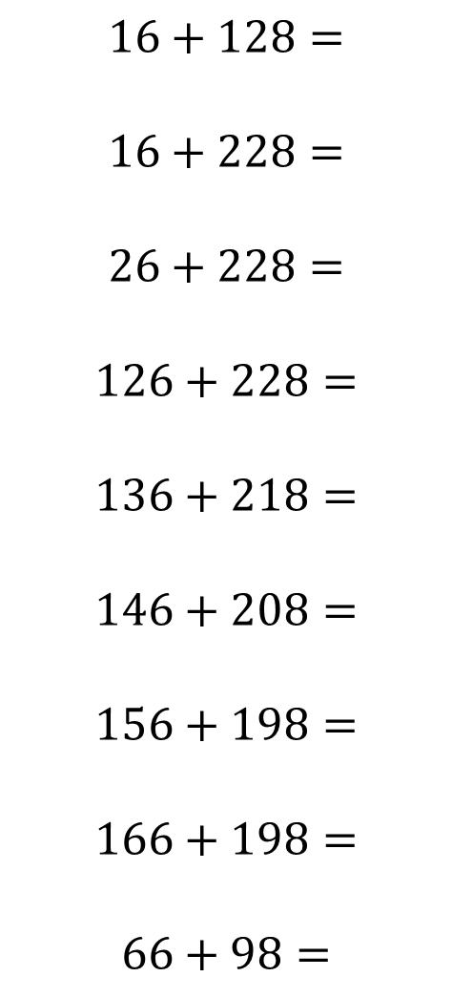

$$20+7=$$
$$20+8=$$
$$19+8=$$
$$18+7=$$
$$28+7=$$
$$38+7=$$
$$28+17=$$
$$17+28=$$
$$16+28=$$
$$16+128=$$
$$16+228=$$
$$26+228=$$
$$126+228=$$
$$136+218=$$
$$146+208=$$
$$156+198=$$
$$166+198=$$
$$66+98=$$
@mrbartonmaths

Slide 4
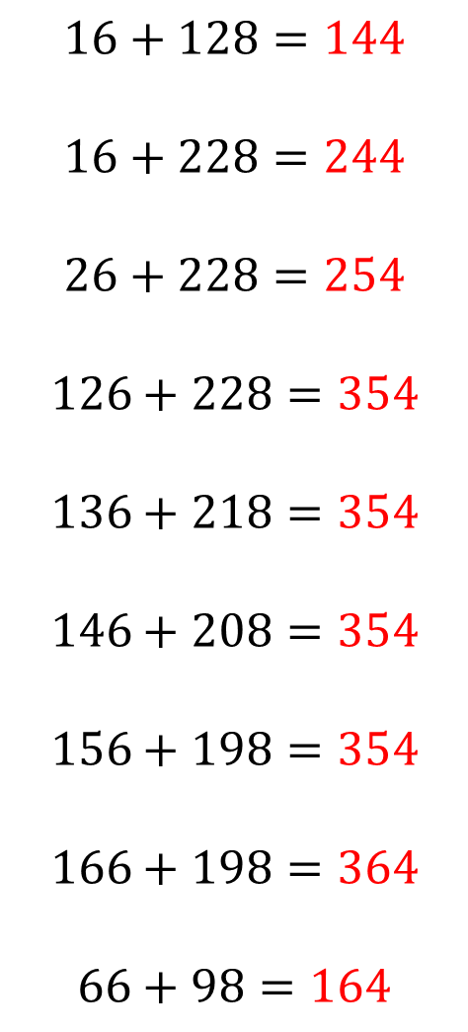
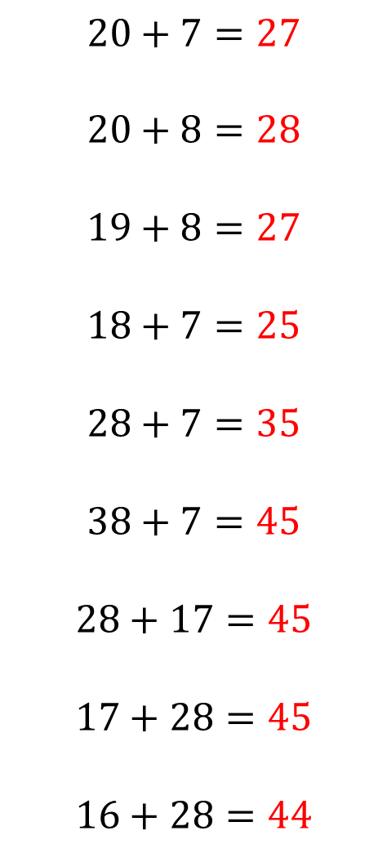
$$20+7=27$$
$$20+8=28$$
$$19+8=27$$
$$18+7=25$$
$$28+7=35$$
$$38+7=45$$
$$28+17=45$$
$$17+28=45$$
$$16+28=44$$
$$16+128=144$$
$$16+228=244$$
$$26+228=254$$
$$126+228=354$$
$$136+218=354$$
$$146+208=354$$
$$156+198=354$$
$$166+198=364$$
$$66+98=164$$
@mrbartonmaths

