Slide 1
Arithmetic: Mental subtraction
Silent
Teacher
Intelligent Practice
Narration
Your Turn
$$41−18=$$
$$51−18=$$
$$151−18=$$
Example
For more videos visit mrbartonmaths.com/videos

Slide 2
Worked Example
Your Turn
$$56−9=$$
$$57−8=$$
@mrbartonmaths

Slide 3
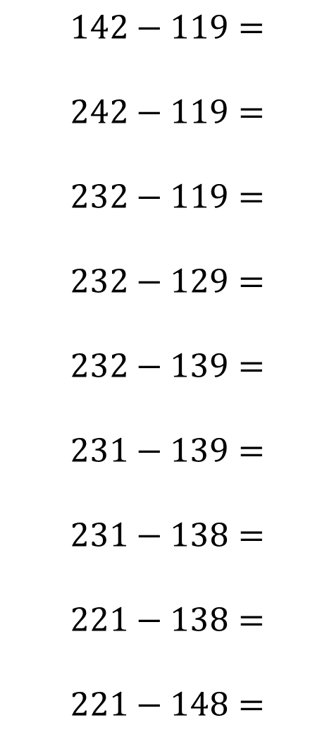

$$43−10=$$
$$43−9=$$
$$42−9=$$
$$41−8=$$
$$41−18=$$
$$51−18=$$
$$151−118=$$
$$141−118=$$
$$141−119=$$
$$142−119=$$
$$242−119=$$
$$232−119=$$
$$232−129=$$
$$232−139=$$
$$231−139=$$
$$231−138=$$
$$221−138=$$
$$221−148=$$
@mrbartonmaths

Slide 4
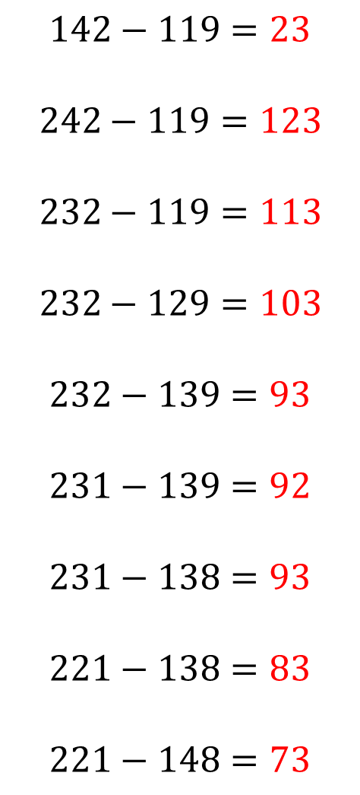
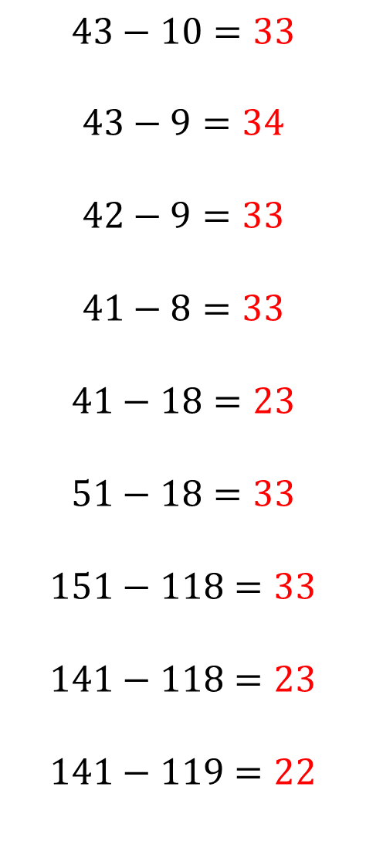
$$43−10=33$$
$$43−9=34$$
$$42−9=33$$
$$41−8=33$$
$$41−18=23$$
$$51−18=33$$
$$151−118=33$$
$$141−118=23$$
$$141−119=22$$
$$142−119=23$$
$$242−119=123$$
$$232−119=113$$
$$232−129=103$$
$$232−139=93$$
$$231−139=92$$
$$231−138=93$$
$$221−138=83$$
$$221−148=73$$
@mrbartonmaths

