Slide 1
Percentages: Mixed multipliers
Silent
Teacher
Intelligent Practice
Narration
Your Turn
To find $18\%=$
$$\text{To} \text{increase} \text{by} 18\%=$$
$$\text{To} \text{decrease} \text{by} 18\%=$$
Example
For more videos visit mrbartonmaths.com/videos

Slide 2
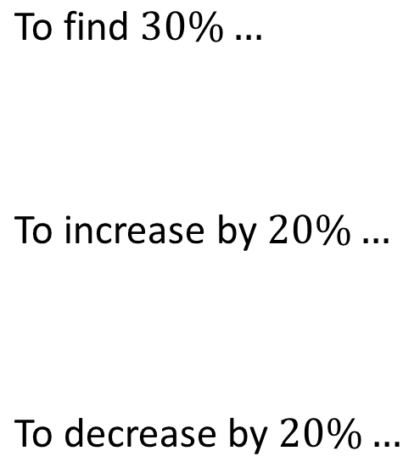
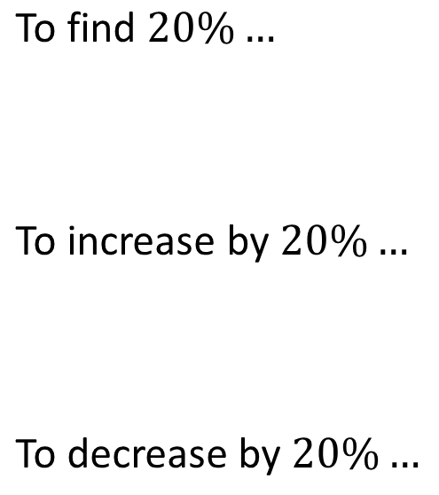
Worked Example
Your Turn
$$\text{To} \text{find} 20\%…$$
$$\text{To} \text{increase} \text{by} 20\%…$$
$$\text{To} \text{decrease} \text{by} 20\%…$$
$$\text{To} \text{find} 30\%…$$
$$\text{To} \text{increase} \text{by} 20\%…$$
$$\text{To} \text{decrease} \text{by} 20\%…$$
@mrbartonmaths

Slide 3
Percentage | To find | To increase by | To decrease by
40%
50%
60%
6%
7%
8%
18%
28%
48%
@mrbartonmaths

Slide 4
Percentage | To find | To increase by | To decrease by
88%
98%
108%
118%
218%
21.8%
2.18%
2.08%
0.08%
@mrbartonmaths

Slide 5
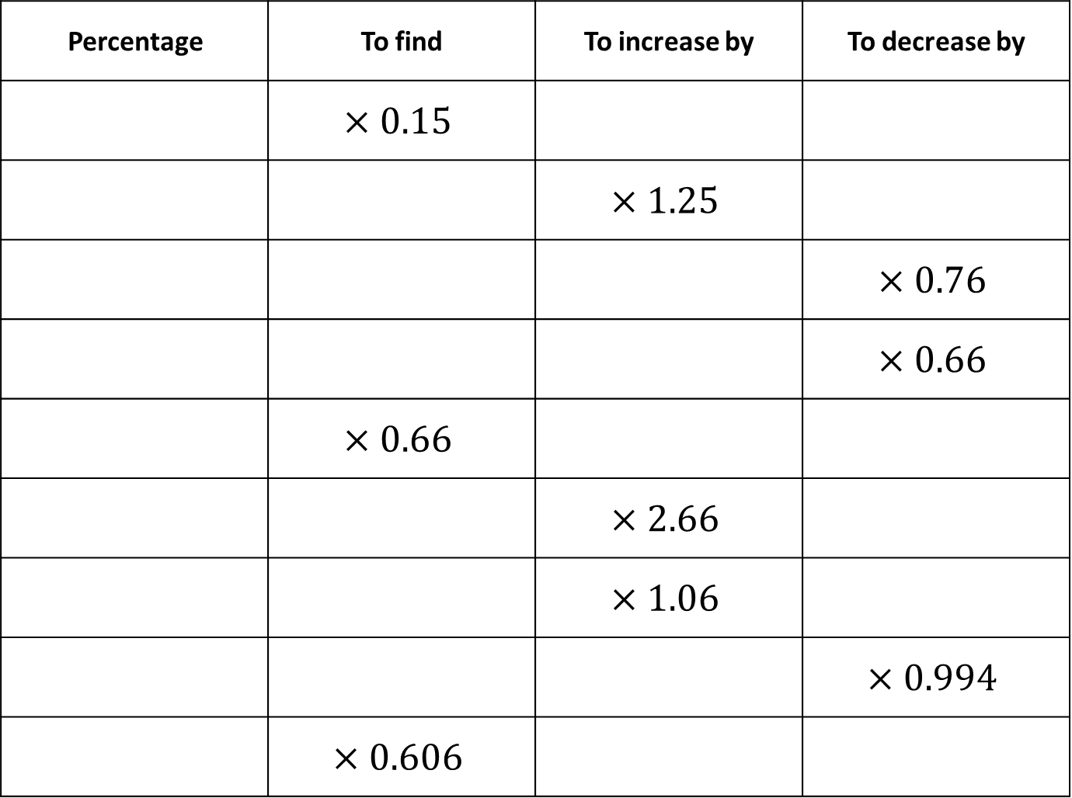
Percentage | To find | To increase by | To decrease by
 | $$×0.15$$
 |  | $$×1.25$$
 |  |  | $$×0.76$$
 |  |  | $$×0.66$$
 | $$×0.66$$
 |  | $$×2.66$$
 |  | $$×1.06$$
 |  |  | $$×0.994$$
 | $$×0.606$$
@mrbartonmaths

Slide 6
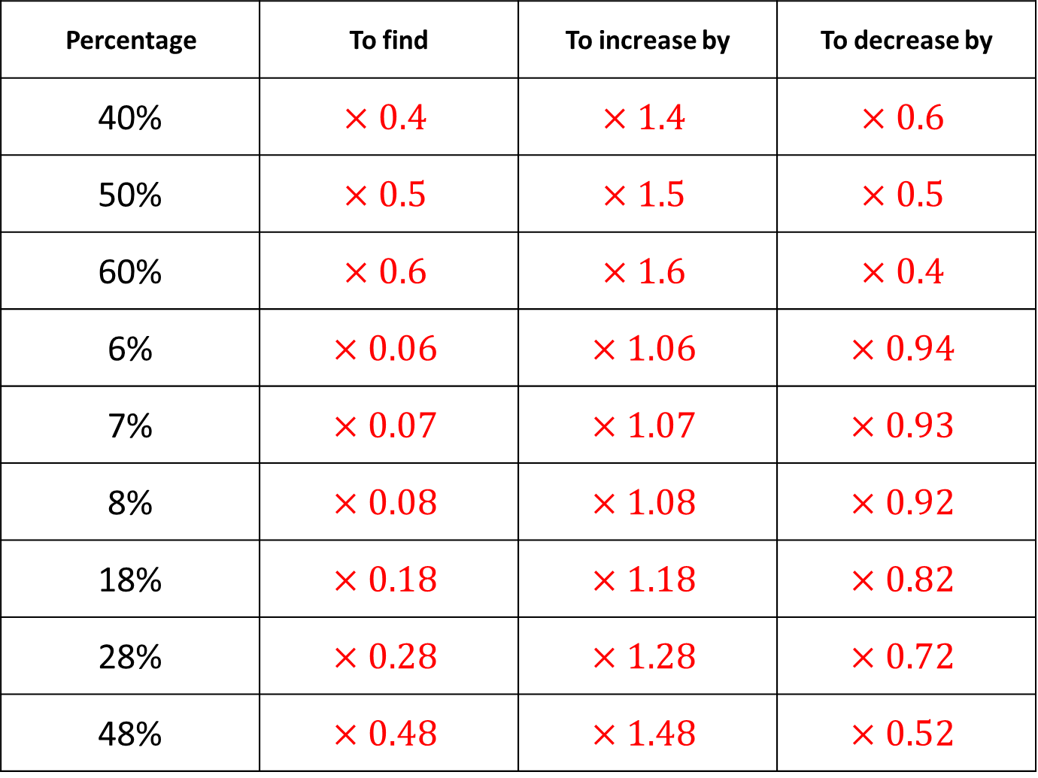
Percentage | To find | To increase by | To decrease by
40% | $$×0.4$$ | $$×1.4$$ | $$×0.6$$
50% | $$×0.5$$ | $$×1.5$$ | $$×0.5$$
60% | $$×0.6$$ | $$×1.6$$ | $$×0.4$$
6% | $$×0.06$$ | $$×1.06$$ | $$×0.94$$
7% | $$×0.07$$ | $$×1.07$$ | $$×0.93$$
8% | $$×0.08$$ | $$×1.08$$ | $$×0.92$$
18% | $$×0.18$$ | $$×1.18$$ | $$×0.82$$
28% | $$×0.28$$ | $$×1.28$$ | $$×0.72$$
48% | $$×0.48$$ | $$×1.48$$ | $$×0.52$$
@mrbartonmaths

Slide 7
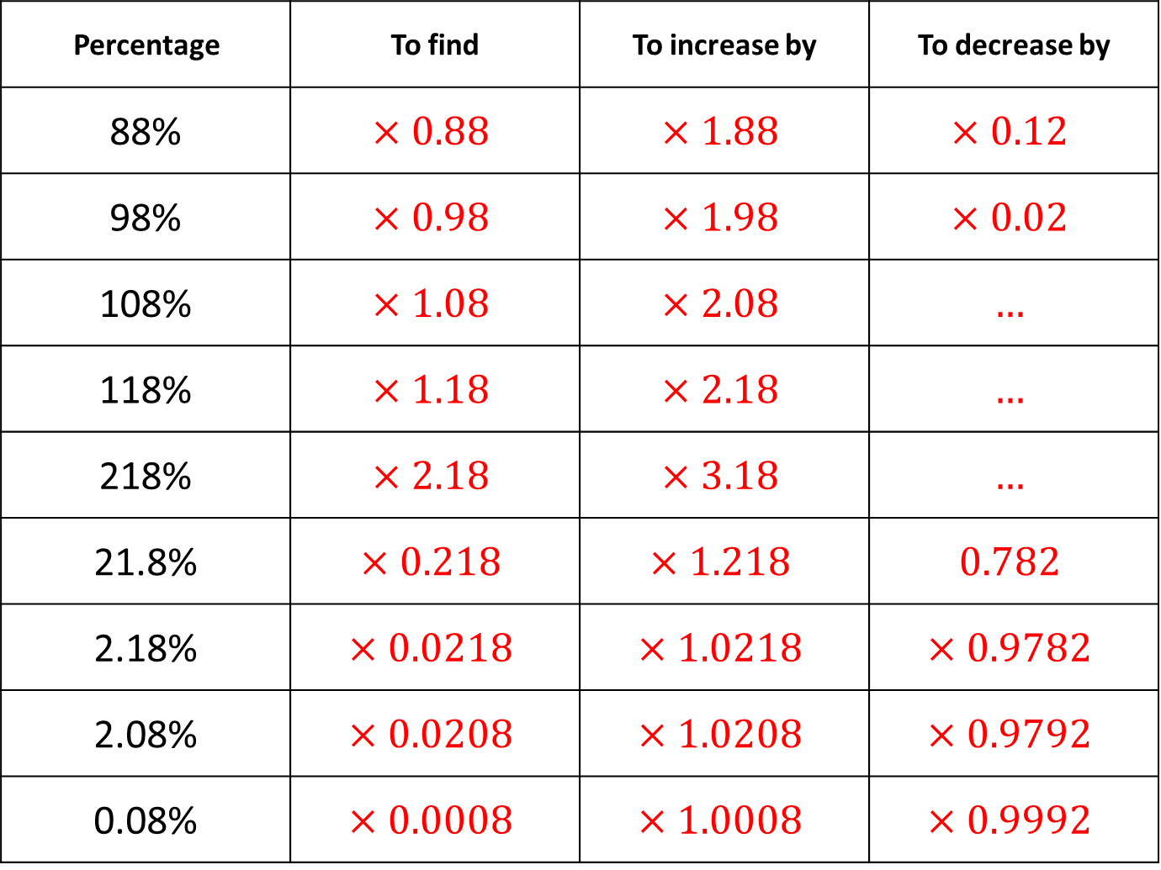
Percentage | To find | To increase by | To decrease by
88% | $$×0.88$$ | $$×1.88$$ | $$×0.12$$
98% | $$×0.98$$ | $$×1.98$$ | $$×0.02$$
108% | $$×1.08$$ | $$×2.08$$ | $$…$$
118% | $$×1.18$$ | $$×2.18$$ | $$…$$
218% | $$×2.18$$ | $$×3.18$$ | $$…$$
21.8% | $$×0.218$$ | $$×1.218$$ | $$0.782$$
2.18% | $$×0.0218$$ | $$×1.0218$$ | $$×0.9782$$
2.08% | $$×0.0208$$ | $$×1.0208$$ | $$×0.9792$$
0.08% | $$×0.0008$$ | $$×1.0008$$ | $$×0.9992$$
@mrbartonmaths

Slide 8
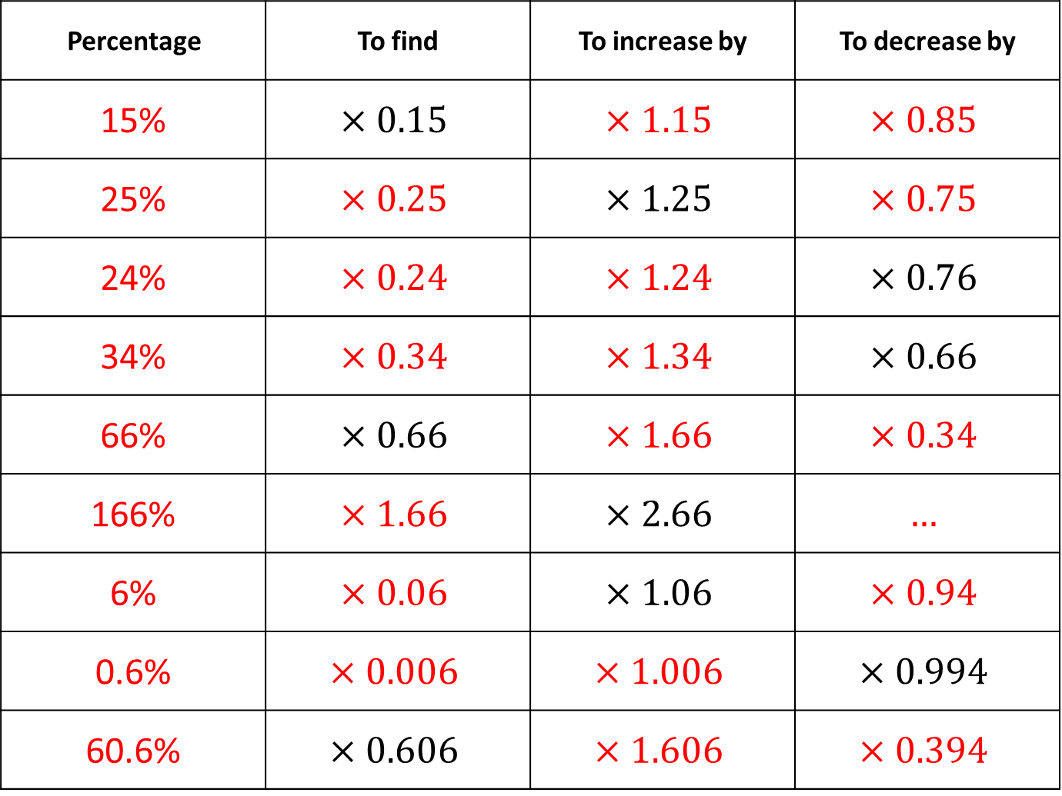
Percentage | To find | To increase by | To decrease by
15% | $$×0.15$$ | $$×1.15$$ | $$×0.85$$
25% | $$×0.25$$ | $$×1.25$$ | $$×0.75$$
24% | $$×0.24$$ | $$×1.24$$ | $$×0.76$$
34% | $$×0.34$$ | $$×1.34$$ | $$×0.66$$
66% | $$×0.66$$ | $$×1.66$$ | $$×0.34$$
166% | $$×1.66$$ | $$×2.66$$ | $$…$$
6% | $$×0.06$$ | $$×1.06$$ | $$×0.94$$
0.6% | $$×0.006$$ | $$×1.006$$ | $$×0.994$$
60.6% | $$×0.606$$ | $$×1.606$$ | $$×0.394$$
@mrbartonmaths

