Slide 1
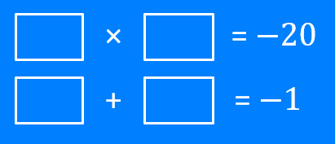
Brackets: Multiplies to…, adds to… (mixed)
Silent
Teacher
Intelligent Practice
Narration
Your Turn
Example
For more videos visit mrbartonmaths.com/videos

Slide 2
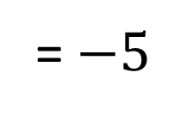
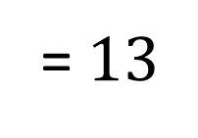
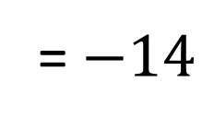
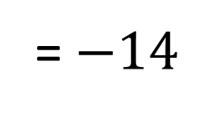
Worked Example
Your Turn
$$?$$
×
$$?$$
= $−14$
$$?$$
×
$$?$$
= $−14$
$$?$$
+
$$?$$
= $13$
$$?$$
+
$$?$$
= $−5$
@mrbartonmaths

Slide 3
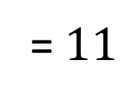
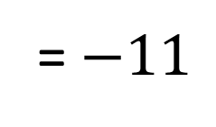
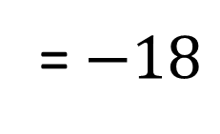
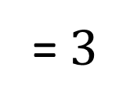
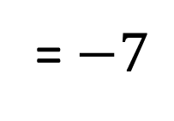
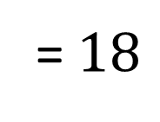
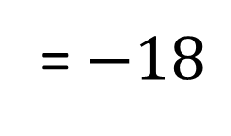
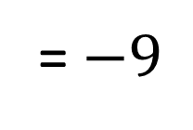
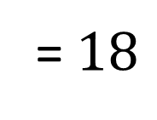
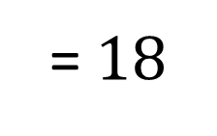
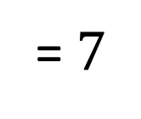
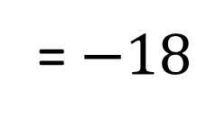
$$9$$
×
$$2$$
= $18$
$$−9$$
×
$$−2$$
= $18$
$$9$$
+
$$2$$
= $11$
$$−9$$
+
$$−2$$
= $−11$
$$9$$
×
$$−2$$
= $−18$
$$−6$$
×
$$−3$$
= $18$
$$9$$
+
$$−2$$
= $7$
$$−6$$
+
$$−3$$
= $−9$
$$−9$$
×
$$2$$
= $−18$
$$6$$
×
$$−3$$
= $−18$
$$−9$$
+
$$2$$
= $−7$
$$6$$
+
$$−3$$
= $3$
@mrbartonmaths

Slide 4
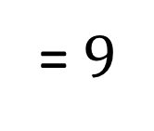
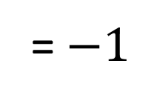
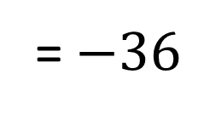
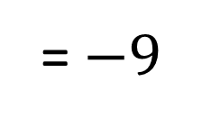
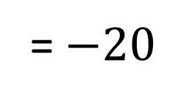
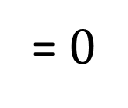
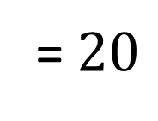
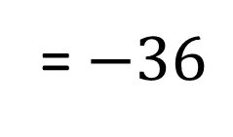
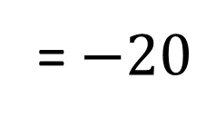
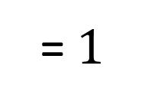
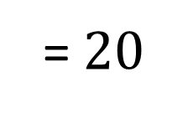
$$5$$
×
$$4$$
= $20$
$$−5$$
×
$$−4$$
= $20$
$$5$$
+
$$4$$
= $9$
$$−5$$
+
$$−4$$
= $−9$
$$−5$$
×
$$4$$
= $−20$
$$−12$$
×
$$3$$
= $−36$
$$−5$$
+
$$4$$
= $−1$
$$−12$$
+
$$3$$
= $−9$
$$5$$
×
$$−4$$
= $−20$
$$6$$
×
$$−6$$
= $−36$
$$5$$
+
$$−4$$
= $1$
$$6$$
+
$$−6$$
= $0$
@mrbartonmaths

Slide 5
$$9$$
×
$$2$$
= $18$
$$−9$$
×
$$−2$$
= $18$
$$9$$
+
$$2$$
= $11$
$$−9$$
+
$$−2$$
= $−11$
$$9$$
×
$$−2$$
= $−18$
$$−6$$
×
$$−3$$
= $18$
$$9$$
+
$$−2$$
= $7$
$$−6$$
+
$$−3$$
= $−9$
$$−9$$
×
$$2$$
= $−18$
$$6$$
×
$$−3$$
= $−18$
$$−9$$
+
$$2$$
= $−7$
$$6$$
+
$$−3$$
= $3$
@mrbartonmaths

Slide 6
$$5$$
×
$$4$$
= $20$
$$−5$$
×
$$−4$$
= $20$
$$5$$
+
$$4$$
= $9$
$$−5$$
+
$$−4$$
= $−9$
$$−5$$
×
$$4$$
= $−20$
$$−12$$
×
$$3$$
= $−36$
$$−5$$
+
$$4$$
= $−1$
$$−12$$
+
$$3$$
= $−9$
$$5$$
×
$$−4$$
= $−20$
$$6$$
×
$$−6$$
= $−36$
$$5$$
+
$$−4$$
= $1$
$$6$$
+
$$−6$$
= $0$
@mrbartonmaths

