Slide 1
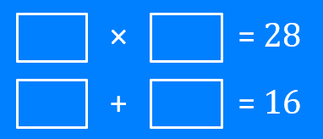
Brackets: Multiplies to…, adds to… (positive)
Silent
Teacher
Intelligent Practice
Narration
Your Turn
Example
For more videos visit mrbartonmaths.com/videos

Slide 2
Worked Example
Your Turn
$$?$$
×
$$?$$
= 18
$$?$$
×
$$?$$
= 20
$$?$$
+
$$?$$
= 9
$$?$$
+
$$?$$
= 9
@mrbartonmaths

Slide 3
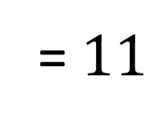
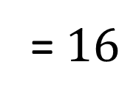
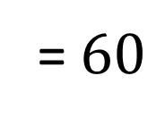
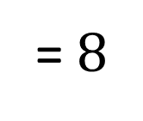
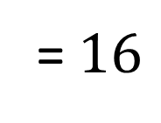
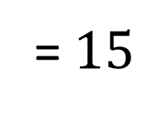
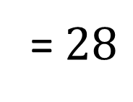
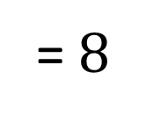
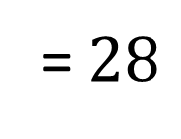
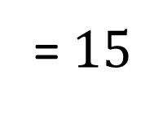
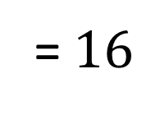
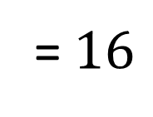
$$?$$
×
$$?$$
= $28$
$$?$$
×
$$?$$
= $15$
$$?$$
+
$$?$$
= $11$
$$?$$
+
$$?$$
= $16$
$$?$$
×
$$?$$
= $28$
$$?$$
×
$$?$$
= $15$
$$?$$
+
$$?$$
= $16$
$$?$$
+
$$?$$
= $8$
$$?$$
×
$$?$$
= $60$
$$?$$
×
$$?$$
= $16$
$$?$$
+
$$?$$
= $16$
$$?$$
+
$$?$$
= $8$
@mrbartonmaths

Slide 4
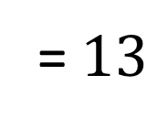
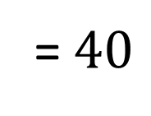
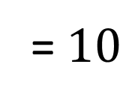
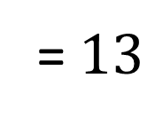
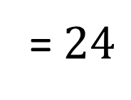
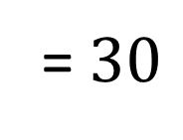
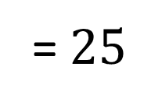
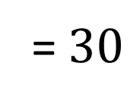
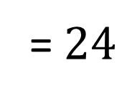
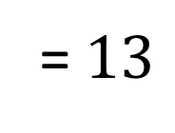
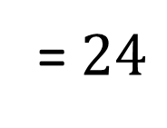
$$?$$
×
$$?$$
= $30$
$$3$$
×
$$8$$
= $24$
$$?$$
+
$$?$$
= $11$
$$3$$
+
$$8$$
= $13$
$$10$$
×
$$3$$
= $30$
$$1$$
×
$$24$$
= $24$
$$10$$
+
$$3$$
= $13$
$$1$$
+
$$24$$
= $25$
$$8$$
×
$$5$$
= $40$
$$4$$
×
$$6$$
= $24$
$$8$$
+
$$5$$
= $13$
$$4$$
+
$$6$$
= $10$
@mrbartonmaths

Slide 5
$$4$$
×
$$7$$
= $28$
$$1$$
×
$$15$$
= $15$
$$4$$
+
$$7$$
= $11$
$$1$$
+
$$15$$
= $16$
$$2$$
×
$$14$$
= $28$
$$3$$
×
$$5$$
= $15$
$$2$$
+
$$14$$
= $16$
$$3$$
+
$$5$$
= $8$
$$10$$
×
$$6$$
= $60$
$$4$$
×
$$4$$
= $16$
$$10$$
+
$$6$$
= $16$
$$4$$
+
$$4$$
= $8$
@mrbartonmaths

Slide 6
$$6$$
×
$$5$$
= $30$
$$3$$
×
$$8$$
= $24$
$$6$$
+
$$5$$
= $11$
$$3$$
+
$$8$$
= $13$
$$10$$
×
$$3$$
= $30$
$$1$$
×
$$24$$
= $24$
$$10$$
+
$$3$$
= $13$
$$1$$
+
$$24$$
= $25$
$$8$$
×
$$5$$
= $40$
$$4$$
×
$$6$$
= $24$
$$8$$
+
$$5$$
= $13$
$$4$$
+
$$6$$
= $10$
@mrbartonmaths

