Slide 1
Percentages: Percentage decrease multipliers
Silent
Teacher
Intelligent Practice
Narration
Your Turn
To decrease by $1\%=$
$$\text{To} \text{decrease} \text{by} 11\%=$$
$$\text{To} \text{decrease} \text{by} 1.1\%=$$
Example
For more videos visit mrbartonmaths.com/videos

Slide 2
Worked Example
Your Turn
$$\text{To} \text{decrease} \text{by} 60\%=$$
$$\text{To} \text{decrease} \text{by} 70\%=$$
@mrbartonmaths

Slide 3
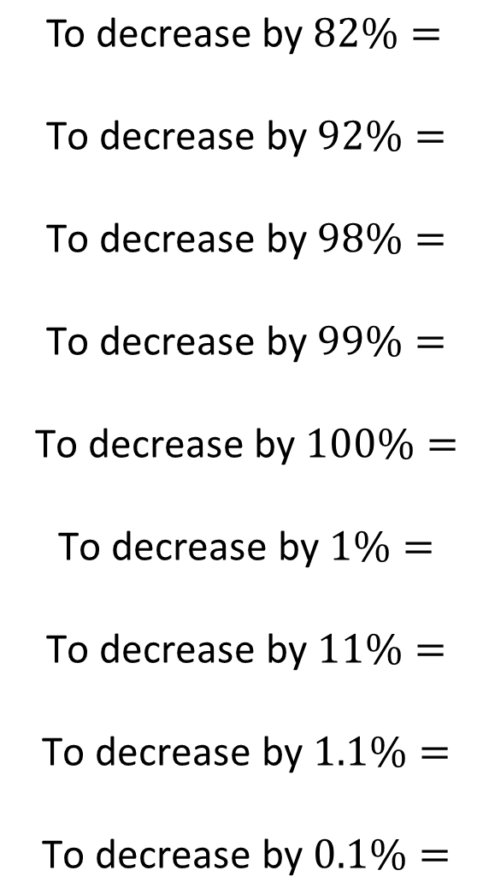
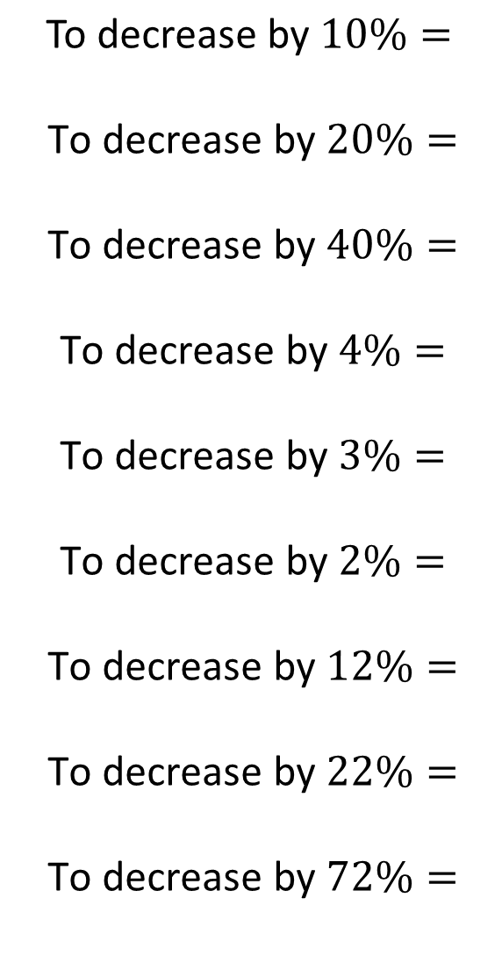
$$\text{To} \text{decrease} \text{by} 10\%=$$
$$\text{To} \text{decrease} \text{by} 20\%=$$
$$\text{To} \text{decrease} \text{by} 40\%=$$
$$\text{To} \text{decrease} \text{by} 4\%=$$
$$\text{To} \text{decrease} \text{by} 3\%=$$
$$\text{To} \text{decrease} \text{by} 2\%=$$
$$\text{To} \text{decrease} \text{by} 12\%=$$
$$\text{To} \text{decrease} \text{by} 22\%=$$
$$\text{To} \text{decrease} \text{by} 72\%=$$
$$\text{To} \text{decrease} \text{by} 82\%=$$
$$\text{To} \text{decrease} \text{by} 92\%=$$
$$\text{To} \text{decrease} \text{by} 98\%=$$
$$\text{To} \text{decrease} \text{by} 99\%=$$
$$\text{To} \text{decrease} \text{by} 100\%=$$
$$\text{To} \text{decrease} \text{by} 1\%=$$
$$\text{To} \text{decrease} \text{by} 11\%=$$
$$\text{To} \text{decrease} \text{by} 1.1\%=$$
$$\text{To} \text{decrease} \text{by} 0.1\%=$$
@mrbartonmaths

Slide 4
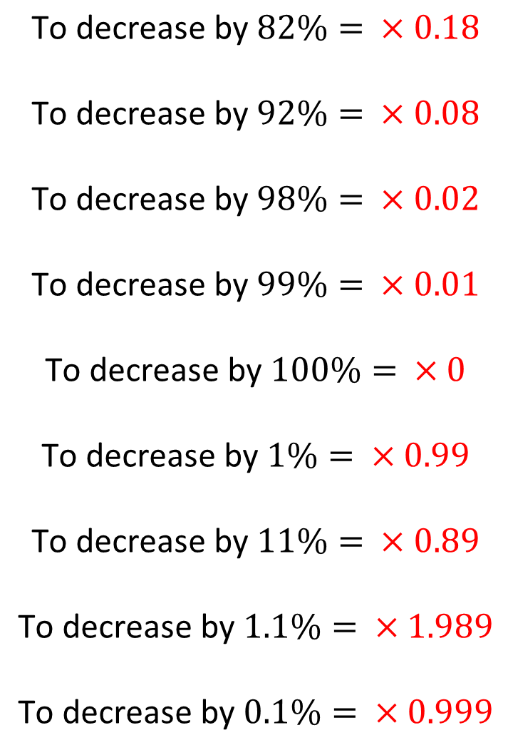
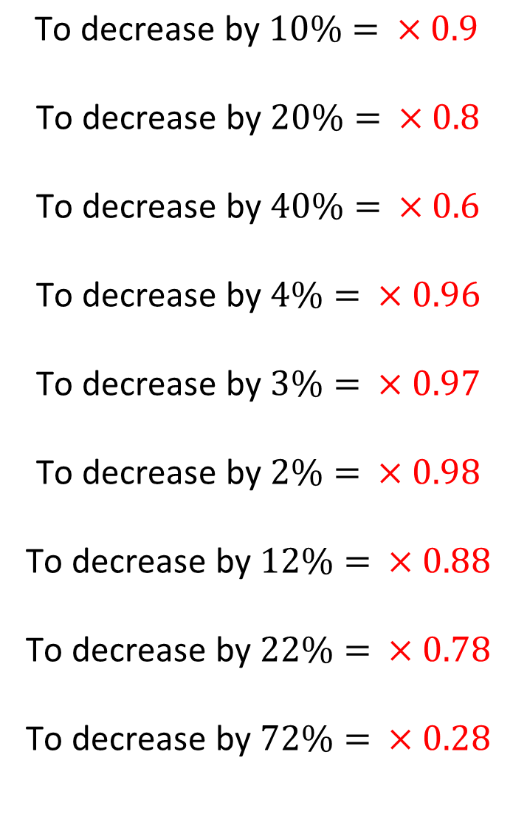
$$\text{To} \text{decrease} \text{by} 10\%= ×0.9$$
$$\text{To} \text{decrease} \text{by} 20\%= ×0.8$$
$$\text{To} \text{decrease} \text{by} 40\%= ×0.6$$
$$\text{To} \text{decrease} \text{by} 4\%= ×0.96$$
$$\text{To} \text{decrease} \text{by} 3\%= ×0.97$$
$$\text{To} \text{decrease} \text{by} 2\%= ×0.98$$
$$\text{To} \text{decrease} \text{by} 12\%= ×0.88$$
$$\text{To} \text{decrease} \text{by} 22\%= ×0.78$$
$$\text{To} \text{decrease} \text{by} 72\%= ×0.28$$
$$\text{To} \text{decrease} \text{by} 82\%= ×0.18$$
$$\text{To} \text{decrease} \text{by} 92\%= ×0.08$$
$$\text{To} \text{decrease} \text{by} 98\%= ×0.02$$
$$\text{To} \text{decrease} \text{by} 99\%= ×0.01$$
$$\text{To} \text{decrease} \text{by} 100\%= ×0$$
$$\text{To} \text{decrease} \text{by} 1\%= ×0.99$$
$$\text{To} \text{decrease} \text{by} 11\%= ×0.89$$
$$\text{To} \text{decrease} \text{by} 1.1\%= ×1.989$$
$$\text{To} \text{decrease} \text{by} 0.1\%= ×0.999$$
@mrbartonmaths

