Slide 1
Percentages: Percentage increase multipliers
Silent
Teacher
Intelligent Practice
Narration
Your Turn
To increase by $2\%=$
$$\text{To} increase \text{by} 22\%=$$
$$\text{To} increase \text{by} 2.2\%=$$
$$\text{To} increase \text{by} 0.2\%=$$
Example
@jplmaths

Slide 2
Worked Example
Your Turn
$$\text{To} increase \text{by} 60\%=$$
$$\text{To} increase \text{by} 70\%=$$
@jplmaths

Slide 3
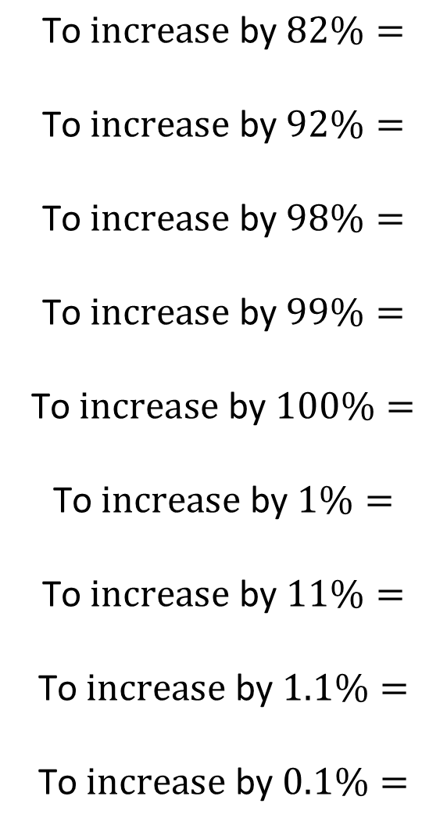
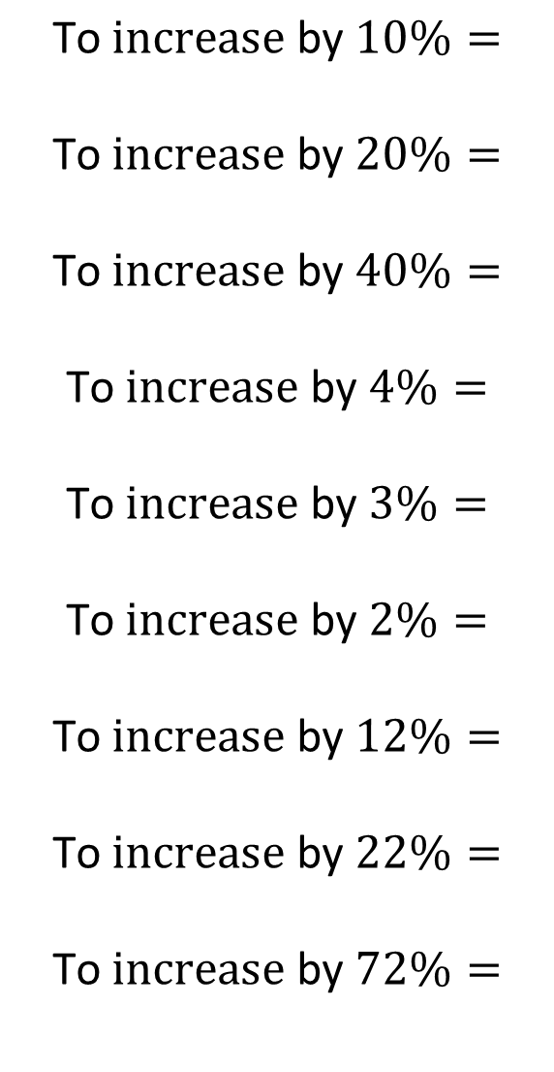
$$\text{To} increase \text{by} 10\%=$$
$$\text{To} increase \text{by} 20\%=$$
$$\text{To} increase \text{by} 40\%=$$
$$\text{To} increase \text{by} 4\%=$$
$$\text{To} increase \text{by} 3\%=$$
$$\text{To} increase \text{by} 2\%=$$
$$\text{To} increase \text{by} 12\%=$$
$$\text{To} increase \text{by} 22\%=$$
$$\text{To} increase \text{by} 72\%=$$
$$\text{To} increase \text{by} 82\%=$$
$$\text{To} increase \text{by} 92\%=$$
$$\text{To} increase \text{by} 98\%=$$
$$\text{To} increase \text{by} 99\%=$$
$$\text{To} increase \text{by} 100\%=$$
$$\text{To} increase \text{by} 1\%=$$
$$\text{To} increase \text{by} 11\%=$$
$$\text{To} increase \text{by} 1.1\%=$$
$$\text{To} increase \text{by} 0.1\%=$$
@jplmaths

Slide 4
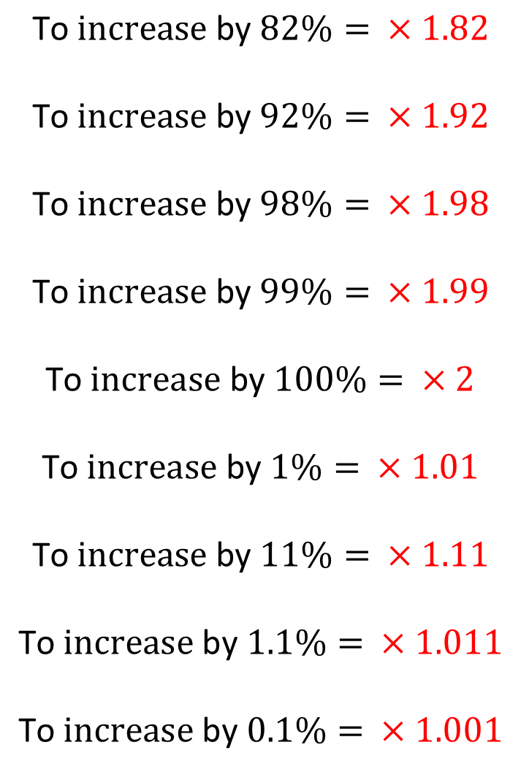
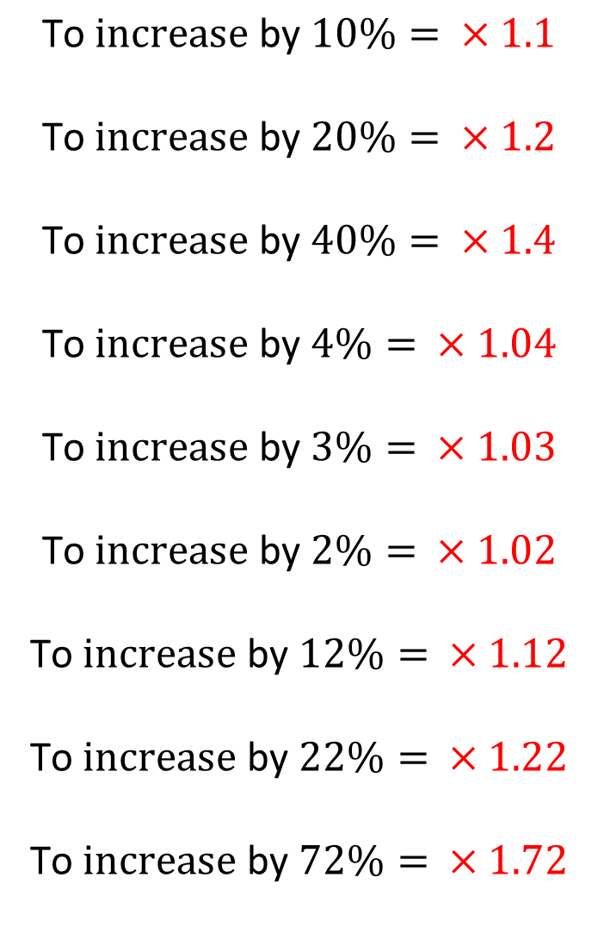
$$\text{To} increase \text{by} 10\%= ×1.1$$
$$\text{To} increase \text{by} 20\%= ×1.2$$
$$\text{To} increase \text{by} 40\%= ×1.4$$
$$\text{To} increase \text{by} 4\%= ×1.04$$
$$\text{To} increase \text{by} 3\%= ×1.03$$
$$\text{To} increase \text{by} 2\%= ×1.02$$
$$\text{To} increase \text{by} 12\%= ×1.12$$
$$\text{To} increase \text{by} 22\%= ×1.22$$
$$\text{To} increase \text{by} 72\%= ×1.72$$
$$\text{To} increase \text{by} 82\%= ×1.82$$
$$\text{To} increase \text{by} 92\%= ×1.92$$
$$\text{To} increase \text{by} 98\%= ×1.98$$
$$\text{To} increase \text{by} 99\%= ×1.99$$
$$\text{To} increase \text{by} 100\%= ×2$$
$$\text{To} increase \text{by} 1\%= ×1.01$$
$$\text{To} increase \text{by} 11\%= ×1.11$$
$$\text{To} increase \text{by} 1.1\%= ×1.011$$
$$\text{To} increase \text{by} 0.1\%= ×1.001$$
@jplmaths

