Slide 1
Percentages: Percentage increase multipliers
Silent
Teacher
Intelligent Practice
Narration
Your Turn
To increase by $12\%=$
$$\text{To} \text{increase} \text{by} 112\%=$$
$$\text{To} \text{increase} \text{by} 1.2\%=$$
Example
For more videos visit mrbartonmaths.com/videos

Slide 2
Worked Example
Your Turn
$$\text{To} \text{increase} \text{by} 60\%=$$
$$\text{To} \text{increase} \text{by} 70\%=$$
@mrbartonmaths

Slide 3
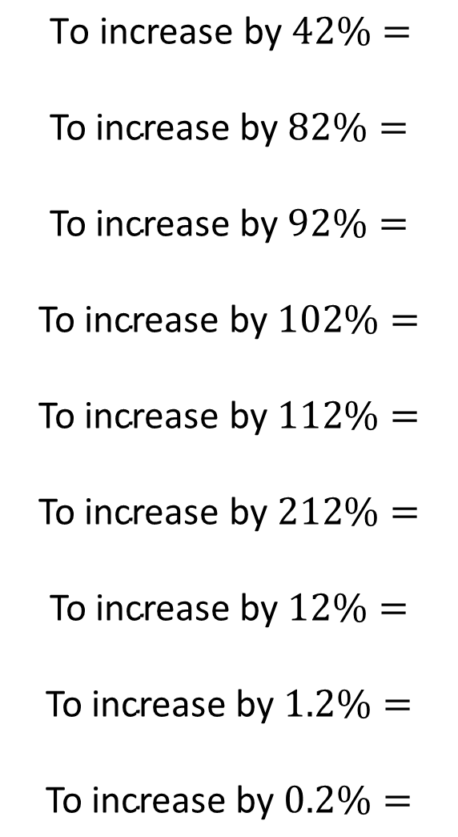
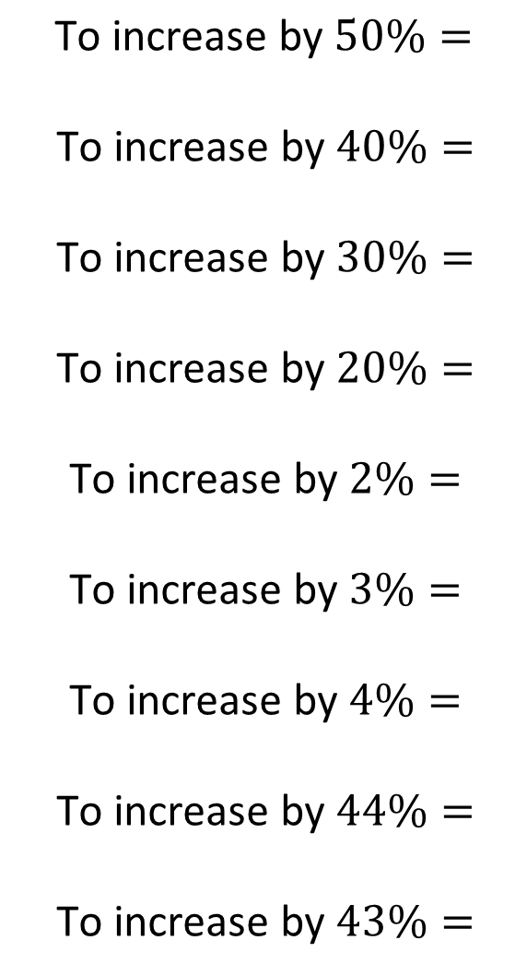
$$\text{To} \text{increase} \text{by} 50\%=$$
$$\text{To} \text{increase} \text{by} 40\%=$$
$$\text{To} \text{increase} \text{by} 30\%=$$
$$\text{To} \text{increase} \text{by} 20\%=$$
$$\text{To} \text{increase} \text{by} 2\%=$$
$$\text{To} \text{increase} \text{by} 3\%=$$
$$\text{To} \text{increase} \text{by} 4\%=$$
$$\text{To} \text{increase} \text{by} 44\%=$$
$$\text{To} \text{increase} \text{by} 43\%=$$
$$\text{To} \text{increase} \text{by} 42\%=$$
$$\text{To} \text{increase} \text{by} 82\%=$$
$$\text{To} \text{increase} \text{by} 92\%=$$
$$\text{To} \text{increase} \text{by} 102\%=$$
$$\text{To} \text{increase} \text{by} 112\%=$$
$$\text{To} \text{increase} \text{by} 212\%=$$
$$\text{To} \text{increase} \text{by} 12\%=$$
$$\text{To} \text{increase} \text{by} 1.2\%=$$
$$\text{To} \text{increase} \text{by} 0.2\%=$$
@mrbartonmaths

Slide 4
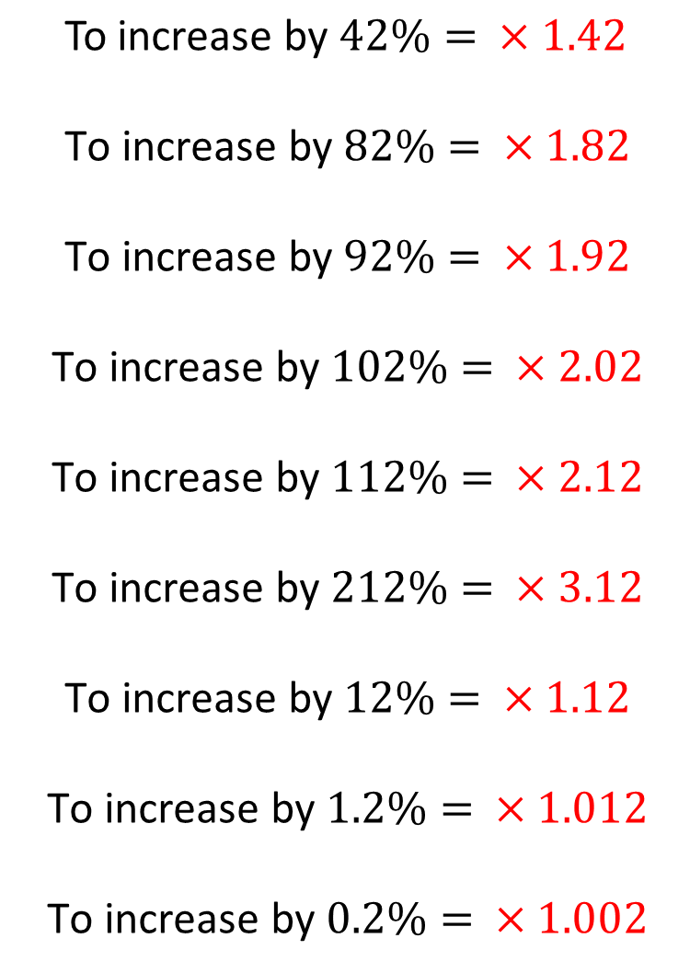
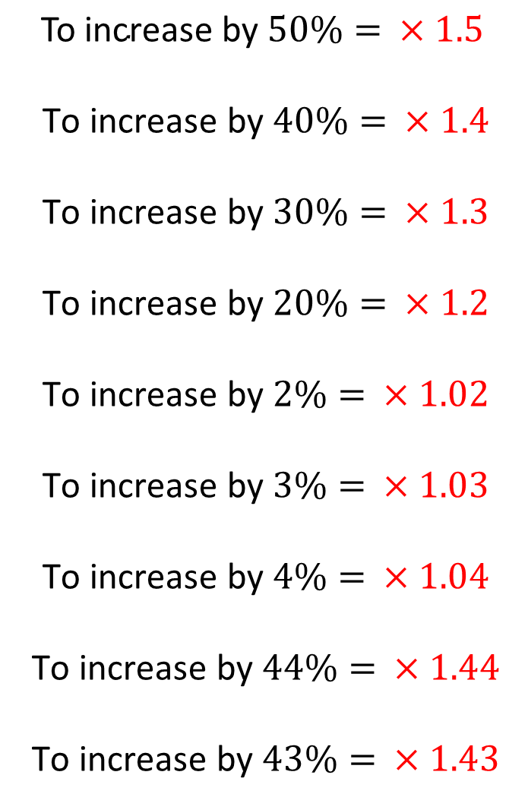
$$\text{To} \text{increase} \text{by} 50\%= ×1.5$$
$$\text{To} \text{increase} \text{by} 40\%= ×1.4$$
$$\text{To} \text{increase} \text{by} 30\%= ×1.3$$
$$\text{To} \text{increase} \text{by} 20\%= ×1.2$$
$$\text{To} \text{increase} \text{by} 2\%= ×1.02$$
$$\text{To} \text{increase} \text{by} 3\%= ×1.03$$
$$\text{To} \text{increase} \text{by} 4\%= ×1.04$$
$$\text{To} \text{increase} \text{by} 44\%= ×1.44$$
$$\text{To} \text{increase} \text{by} 43\%= ×1.43$$
$$\text{To} \text{increase} \text{by} 42\%= ×1.42$$
$$\text{To} \text{increase} \text{by} 82\%= ×1.82$$
$$\text{To} \text{increase} \text{by} 92\%= ×1.92$$
$$\text{To} \text{increase} \text{by} 102\%= ×2.02$$
$$\text{To} \text{increase} \text{by} 112\%= ×2.12$$
$$\text{To} \text{increase} \text{by} 212\%= ×3.12$$
$$\text{To} \text{increase} \text{by} 12\%= ×1.12$$
$$\text{To} \text{increase} \text{by} 1.2\%= ×1.012$$
$$\text{To} \text{increase} \text{by} 0.2\%= ×1.002$$
@mrbartonmaths

