Slide 1
Percentages: Percentage of an amount multipliers
Silent
Teacher
Intelligent Practice
Narration
Your Turn
To find $9\% …$
$$\text{To} \text{find} 99\% …$$
$$\text{To} \text{find} 109\% …$$
Example
For more videos visit mrbartonmaths.com/videos

Slide 2
Worked Example
Your Turn
$$\text{To} \text{find} 20\%…$$
$$\text{To} \text{find} 30\%…$$
@mrbartonmaths

Slide 3
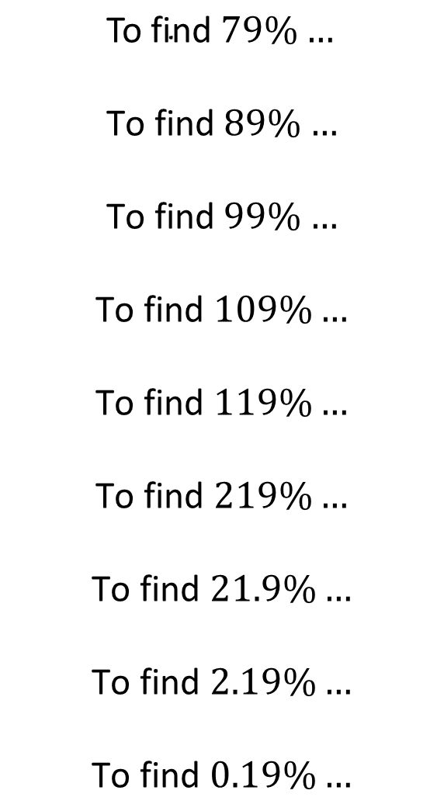
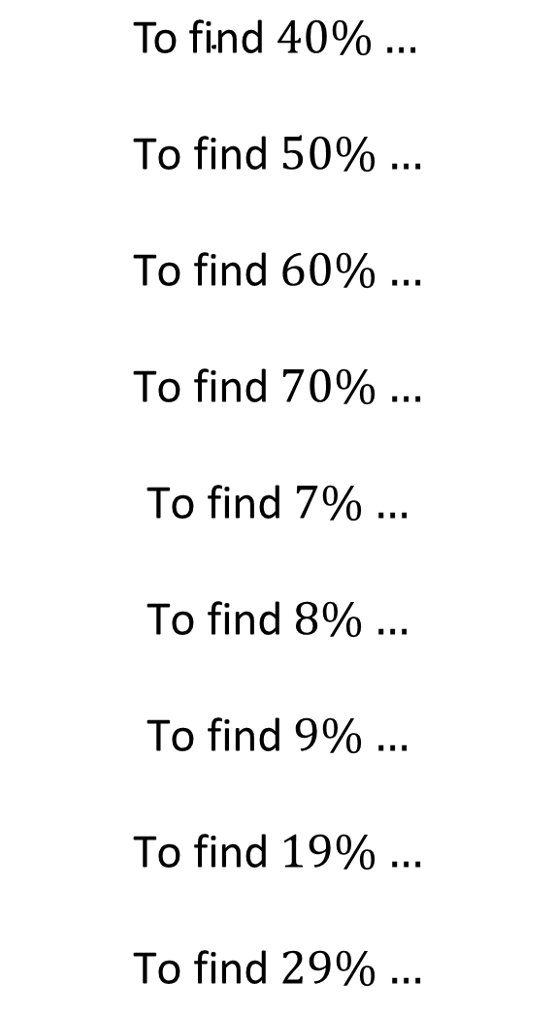
$$\text{To} \text{find} 40\%…$$
$$\text{To} \text{find} 50\%…$$
$$\text{To} \text{find} 60\%…$$
$$\text{To} \text{find} 70\%…$$
$$\text{To} \text{find} 7\%…$$
$$\text{To} \text{find} 8\%…$$
$$\text{To} \text{find} 9\%…$$
$$\text{To} \text{find} 19\%…$$
$$\text{To} \text{find} 29\%…$$
$$\text{To} \text{find} 79\%…$$
$$\text{To} \text{find} 89\%…$$
$$\text{To} \text{find} 99\%…$$
$$\text{To} \text{find} 109\%…$$
$$\text{To} \text{find} 119\%…$$
$$\text{To} \text{find} 219\%…$$
$$\text{To} \text{find} 21.9\%…$$
$$\text{To} \text{find} 2.19\%…$$
$$\text{To} \text{find} 0.19\%…$$
@mrbartonmaths

Slide 4
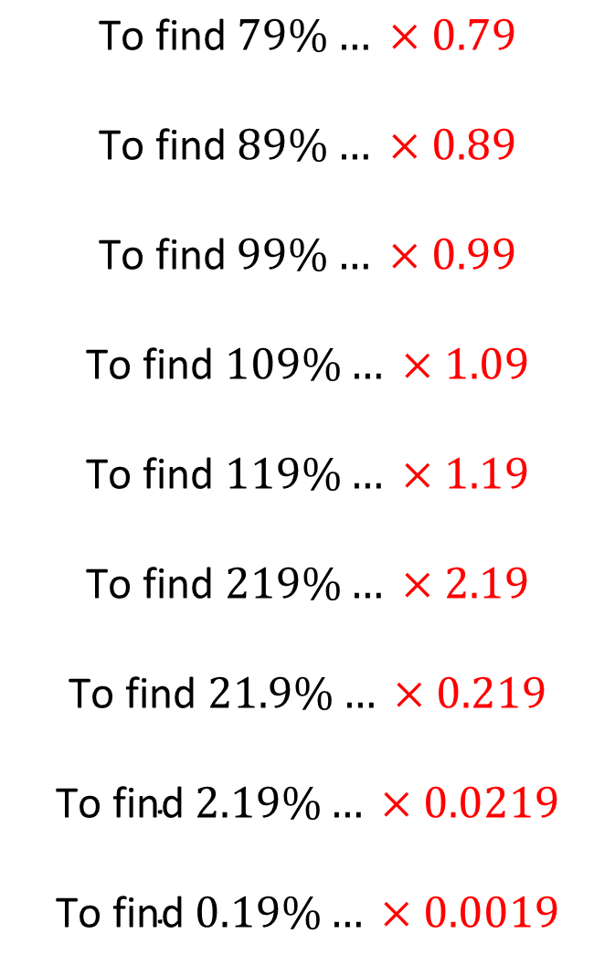
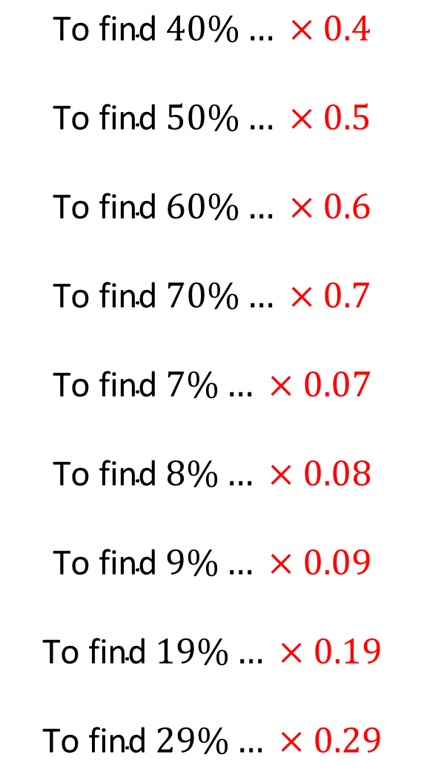
$$\text{To} \text{find} 40\%… ×0.4$$
$$\text{To} \text{find} 50\%… ×0.5$$
$$\text{To} \text{find} 60\%… ×0.6$$
$$\text{To} \text{find} 70\%… ×0.7$$
$$\text{To} \text{find} 7\%… ×0.07$$
$$\text{To} \text{find} 8\%… ×0.08$$
$$\text{To} \text{find} 9\%… ×0.09$$
$$\text{To} \text{find} 19\%… ×0.19$$
$$\text{To} \text{find} 29\%… ×0.29$$
$$\text{To} \text{find} 79\%… ×0.79$$
$$\text{To} \text{find} 89\%… ×0.89$$
$$\text{To} \text{find} 99\%… ×0.99$$
$$\text{To} \text{find} 109\%… ×1.09$$
$$\text{To} \text{find} 119\%… ×1.19$$
$$\text{To} \text{find} 219\%… ×2.19$$
$$\text{To} \text{find} 21.9\%… ×0.219$$
$$\text{To} \text{find} 2.19\%… ×0.0219$$
$$\text{To} \text{find} 0.19\%… ×0.0019$$
@mrbartonmaths

