Slide 1
Percentages: Percentage of an amount
Silent
Teacher
Intelligent Practice
Narration
Your Turn
$$30\% \text{of} 80=$$
$$3\% \text{of} 80=$$
$$30\% \text{of} 8 =$$
Example
For more videos visit mrbartonmaths.com/videos

Slide 2
Worked Example
Your Turn
$$5\% \text{of} 60=$$
$$5\% \text{of} 20=$$
@mrbartonmaths

Slide 3
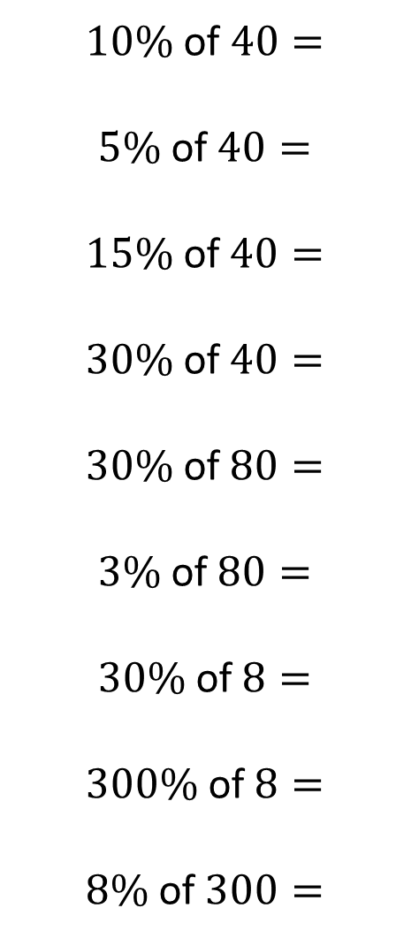
$10\%$ of $40=$
$$5\% \text{of} 40=$$
$$15\% \text{of} 40=$$
$$30\% \text{of} 40=$$
$$30\% \text{of} 80=$$
$$3\% \text{of} 80=$$
$$30\% \text{of} 8=$$
$$300\% \text{of} 8=$$
$$8\% \text{of} 300=$$
@mrbartonmaths

Slide 4
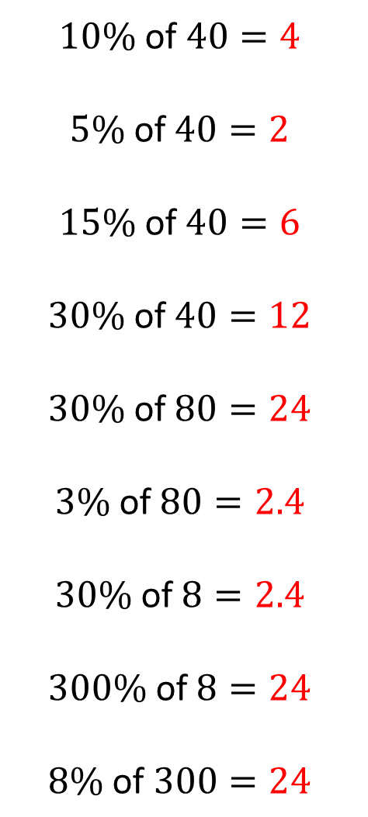
$10\%$ of $40=4$
$$5\% \text{of} 40=2$$
$$15\% \text{of} 40=6$$
$$30\% \text{of} 40=12$$
$$30\% \text{of} 80=24$$
$$3\% \text{of} 80=2.4$$
$$30\% \text{of} 8=2.4$$
$$300\% \text{of} 8=24$$
$$8\% \text{of} 300=24$$
@mrbartonmaths

