Slide 1
Probability: Single event
Silent
Teacher
Intelligent Practice
Narration
Your Turn
Example
For more videos visit mrbartonmaths.com/videos

Slide 2
Worked Example
Your Turn
P(yellow) =
P(yellow) =
@mrbartonmaths

Slide 3
P(yellow) =
P(yellow) =
P(yellow) =
P(yellow) =
P(yellow) =
@mrbartonmaths

Slide 4
P(yellow) =
P(yellow) =
P(yellow) =
P(yellow) =
P(yellow) =
@mrbartonmaths

Slide 5
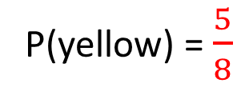
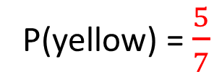
P(yellow) = $\frac{4}{8}=\frac{1}{2}$
P(yellow) = $\frac{5}{8}$
P(yellow) = $\frac{5}{7}$
P(yellow) = $\frac{4}{6}=\frac{2}{3}$
P(yellow) = $\frac{4}{4}=1$
@mrbartonmaths

Slide 6
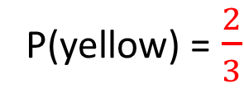
P(yellow) = $\frac{2}{2}=1$
P(yellow) = $\frac{2}{3}$
P(yellow) = $\frac{2}{4}=\frac{1}{2}$
P(yellow) = $\frac{4}{8}=\frac{1}{2}$
P(yellow) = $\frac{6}{10}=\frac{3}{5}$
@mrbartonmaths

