Slide 1
Powers and Indices: Positive Integer Powers
Silent
Teacher
Intelligent Practice
Narration
Your Turn
$$2^{3}=$$
$$(0.{2)}^{4}=$$
$${(−\frac{3}{2})}^{4}=$$
Practice

Slide 2
Worked Example
Your Turn
$$3^{3}=$$
$$6^{3}=$$
@mrbartonmaths

Slide 3
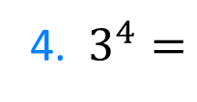
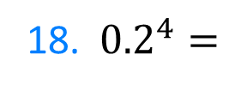
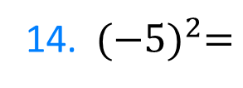
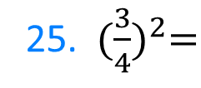
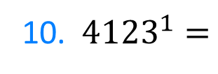
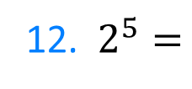
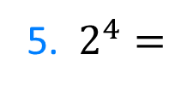
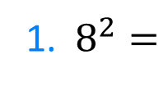
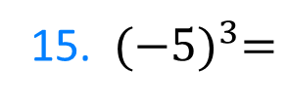
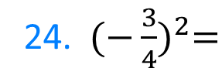
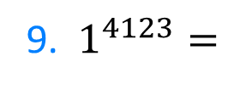
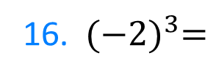
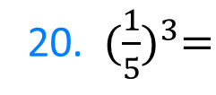
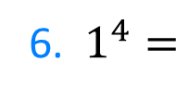
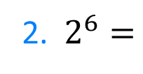
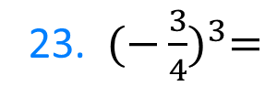
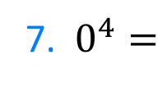
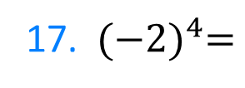
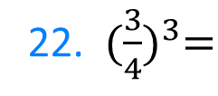
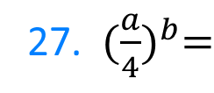
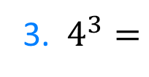
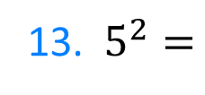
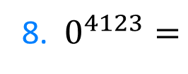
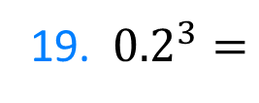
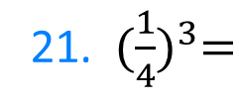
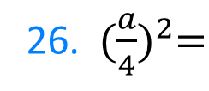
1. $8^{2}=$
12. $2^{5}=$
21. ${(\frac{1}{4})}^{3}=$
2. $2^{6}=$
13. $5^{2}=$
22. ${(\frac{3}{4})}^{3}=$
3. $4^{3}=$
14. ${(−5)}^{2}=$
23. ${(−\frac{3}{4})}^{3}=$
4. $3^{4}=$
15. ${(−5)}^{3}=$
24. ${(−\frac{3}{4})}^{2}=$
5. $2^{4}=$
16. ${(−2)}^{3}=$
6. $1^{4}=$
25. ${(\frac{3}{4})}^{2}=$
17. ${(−2)}^{4}=$
7. $0^{4}=$
26. ${(\frac{a}{4})}^{2}=$
8. $0^{4123}=$
18. ${0.2}^{4}=$
27. ${(\frac{a}{4})}^{b}=$
9. $1^{4123}=$
19. ${0.2}^{3}=$
10. ${4123}^{1}=$
20. ${(\frac{1}{5})}^{3}=$
11. ${(−4123)}^{1}=$
@mrbartonmaths

Slide 4
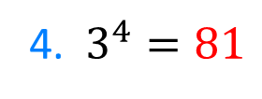
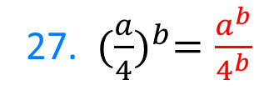
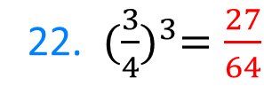
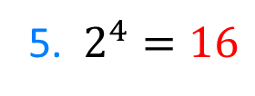
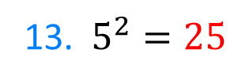
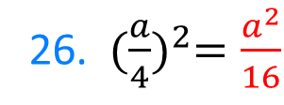
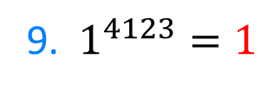
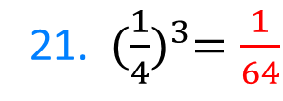
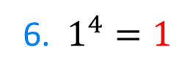
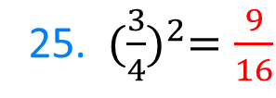
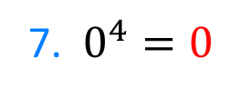
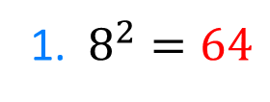
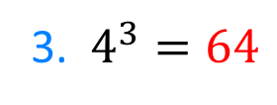
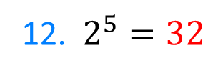
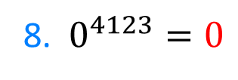
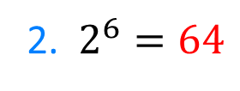
1. $8^{2}=64$
12. $2^{5}=32$
21. ${(\frac{1}{4})}^{3}=\frac{1}{64}$
2. $2^{6}=64$
13. $5^{2}=25$
22. ${(\frac{3}{4})}^{3}=\frac{27}{64}$
3. $4^{3}=64$
14. ${(−5)}^{2}=25$
23. ${(−\frac{3}{4})}^{3}=−\frac{27}{64}$
4. $3^{4}=81$
15. ${(−5)}^{3}=−125$
24. ${(−\frac{3}{4})}^{2}=\frac{9}{16}$
5. $2^{4}=16$
16. ${(−2)}^{3}=−8$
6. $1^{4}=1$
25. ${(\frac{3}{4})}^{2}=\frac{9}{16}$
17. ${(−2)}^{4}=16$
7. $0^{4}=0$
26. ${(\frac{a}{4})}^{2}=\frac{a^{2}}{16}$
8. $0^{4123}=0$
18. ${0.2}^{4}=0.0016$
27. ${(\frac{a}{4})}^{b}=\frac{a^{b}}{4^{b}}$
9. $1^{4123}=1$
19. ${0.2}^{3}=0.008$
10. ${4123}^{1}=4123$
20. ${(\frac{1}{5})}^{3}=\frac{1}{125}$
11. ${(−4123)}^{1}=−4123$
@mrbartonmaths

