Slide 1
Order of operations (BIDMAS): Powers
Silent
Teacher
Intelligent Practice
Narration
Your Turn
$$(4+2)×3^{2}=$$
$$4+(2×{3)}^{2}=$$
$$(4+2×{3)}^{2}=$$
Example
For more videos visit mrbartonmaths.com/videos

Slide 2
Worked Example
Your Turn
$$5+3×4^{2}=$$
$$5+4×3^{2}=$$
@mrbartonmaths

Slide 3
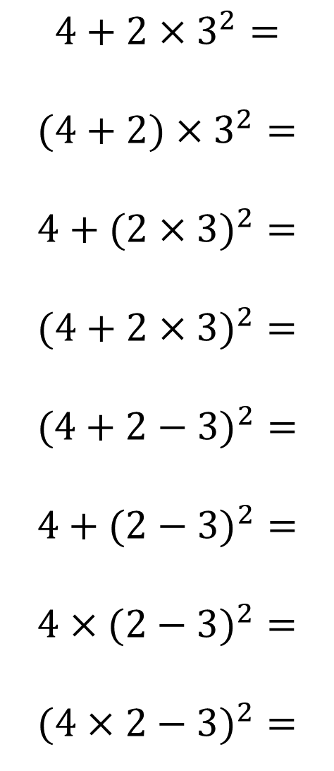
$$4+2×3^{2}=$$
$$(4+2)×3^{2}=$$
$$4+(2×{3)}^{2}=$$
$$(4+2×{3)}^{2}=$$
$$(4+2−{3)}^{2}=$$
$$4+(2−{3)}^{2}=$$
$$4×(2−{3)}^{2}=$$
$$(4×2−{3)}^{2}=$$
@mrbartonmaths

Slide 4
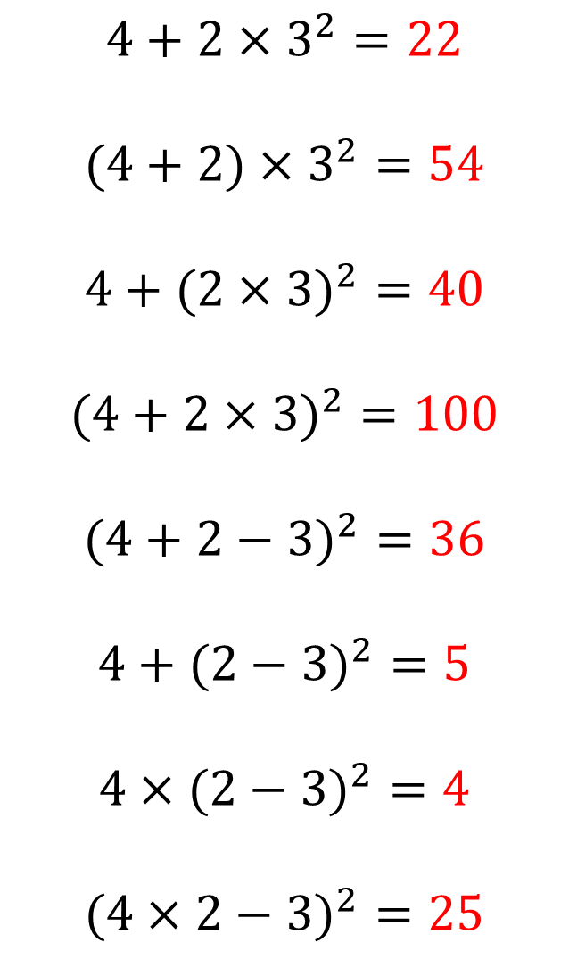
$$4+2×3^{2}=22$$
$$(4+2)×3^{2}=54$$
$$4+(2×{3)}^{2}=40$$
$$(4+2×{3)}^{2}=100$$
$$(4+2−{3)}^{2}=36$$
$$4+(2−{3)}^{2}=5$$
$$4×(2−{3)}^{2}=4$$
$$(4×2−{3)}^{2}=25$$
@mrbartonmaths

