Slide 1
Order of operations (BIDMAS): Same level operations
Silent
Teacher
Intelligent Practice
Narration
Your Turn
$$5−4−3=$$
$$5−(4−3)=$$
$$(5+4)−3=$$
Example
For more videos visit mrbartonmaths.com/videos

Slide 2
Worked Example
Your Turn
$$8−3+2=$$
$$10−4+1=$$
@mrbartonmaths

Slide 3
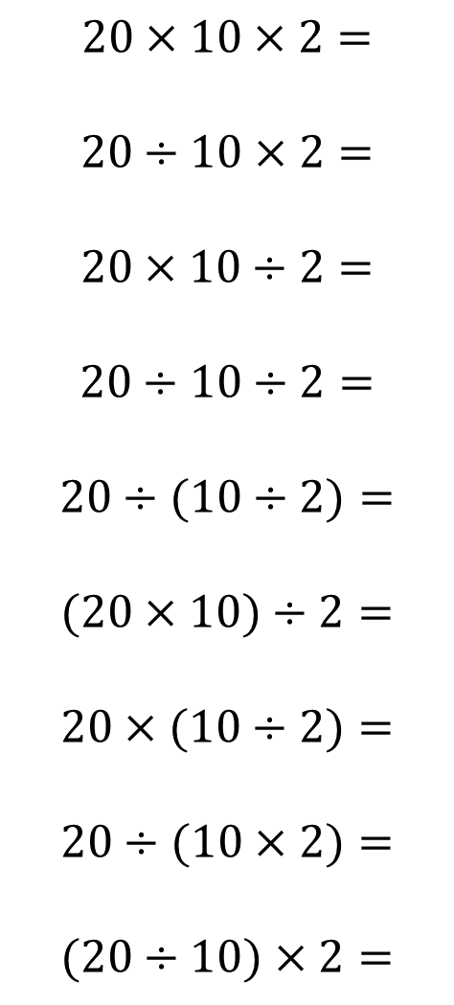
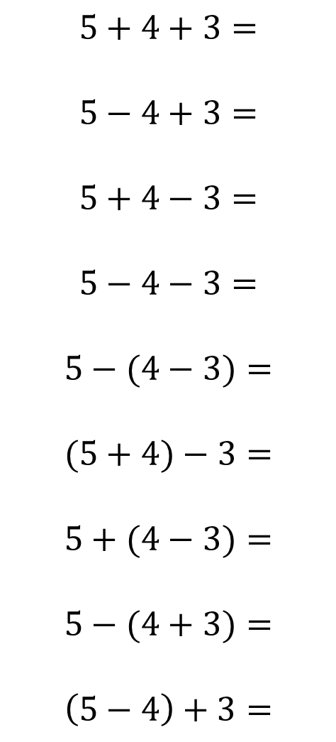
$$5+4+3=$$
$$5−4+3=$$
$$5+4−3=$$
$$5−4−3=$$
$$5−(4−3)=$$
$$(5+4)−3=$$
$$5+(4−3)=$$
$$5−(4+3)=$$
$$\left(5−4\right)+3=$$
$$20×10×2=$$
$$20÷10×2=$$
$$20×10÷2=$$
$$20÷10÷2=$$
$$20÷(10÷2)=$$
$$(20×10)÷2=$$
$$20×(10÷2)=$$
$$20÷(10×2)=$$
$$(20÷10)×2=$$
@mrbartonmaths

Slide 4
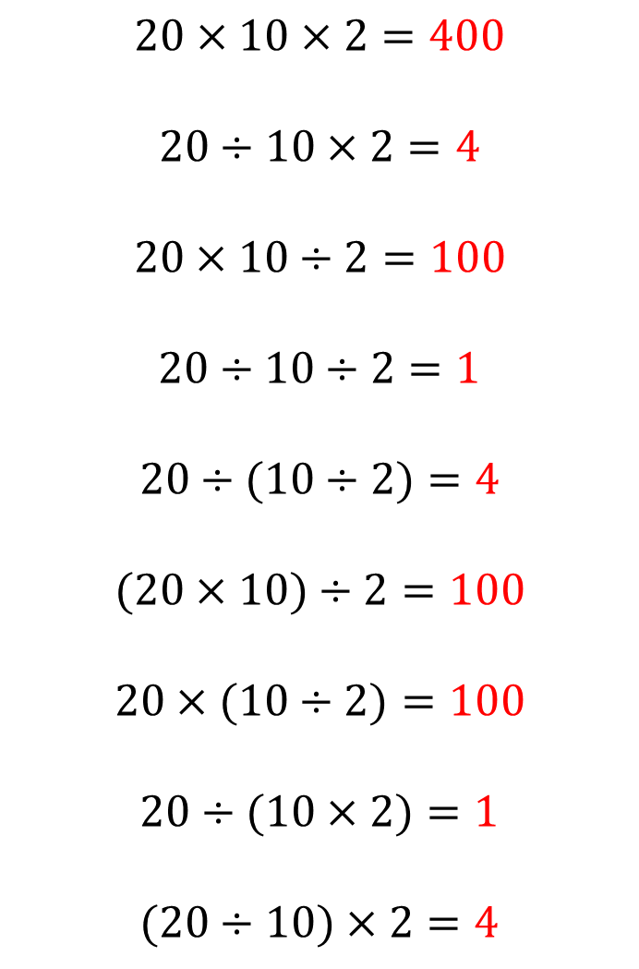
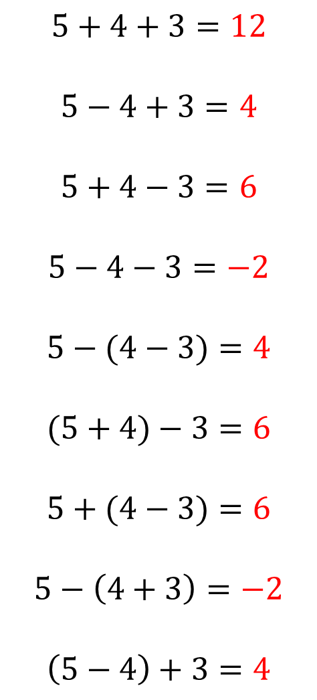
$$5+4+3=12$$
$$5−4+3=4$$
$$5+4−3=6$$
$$5−4−3=−2$$
$$5−(4−3)=4$$
$$(5+4)−3=6$$
$$5+(4−3)=6$$
$$5−\left(4+3\right)=−2$$
$$\left(5−4\right)+3=4$$
$$20×10×2=400$$
$$20÷10×2=4$$
$$20×10÷2=100$$
$$20÷10÷2=1$$
$$20÷(10÷2)=4$$
$$(20×10)÷2=100$$
$$20×(10÷2)=100$$
$$20÷(10×2)=1$$
$$(20÷10)×2=4$$
@mrbartonmaths

