Slide 1
Fractions: Four operations: setting them up
Silent
Teacher
Intelligent Practice
Narration
Your Turn
$$\frac{3}{4} − \frac{2}{3} =$$
$$\frac{3}{4} × \frac{2}{3} =$$
Example
For more videos visit mrbartonmaths.com/videos

Slide 2
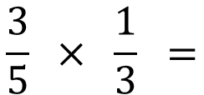
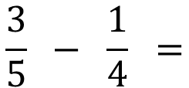
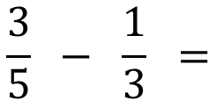
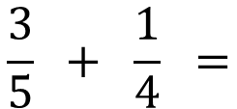
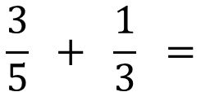
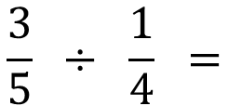
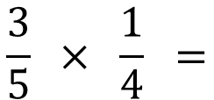
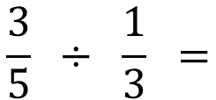
Worked Example
Your Turn
$$\frac{3}{5} + \frac{1}{4} =$$
$$\frac{3}{5} + \frac{1}{3} =$$
$$\frac{3}{5} − \frac{1}{4} =$$
$$\frac{3}{5} − \frac{1}{3} =$$
$$\frac{3}{5} × \frac{1}{4} =$$
$$\frac{3}{5} × \frac{1}{3} =$$
$$\frac{3}{5} ÷ \frac{1}{4} =$$
$$\frac{3}{5} ÷ \frac{1}{3} =$$
@mrbartonmaths

Slide 3
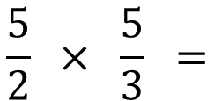
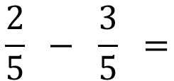
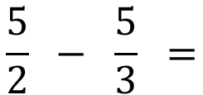
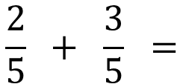
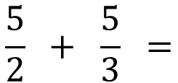
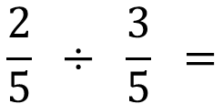
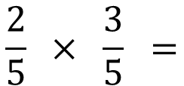
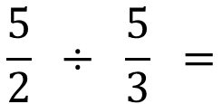
$$\frac{2}{5} + \frac{3}{5} =$$
$$\frac{5}{2} + \frac{5}{3} =$$
$$\frac{2}{5} − \frac{3}{5} =$$
$$\frac{5}{2} − \frac{5}{3} =$$
$$\frac{2}{5} × \frac{3}{5} =$$
$$\frac{5}{2} × \frac{5}{3} =$$
$$\frac{2}{5} ÷ \frac{3}{5} =$$
$$\frac{5}{2} ÷ \frac{5}{3} =$$
@mrbartonmaths

Slide 4
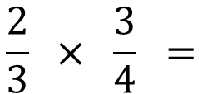
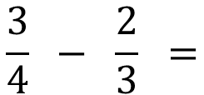
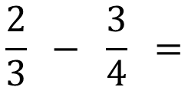
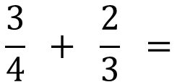
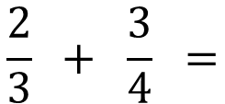
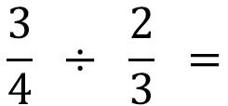
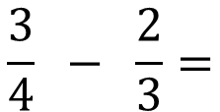
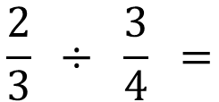
$$\frac{3}{4} + \frac{2}{3} =$$
$$\frac{2}{3} + \frac{3}{4} =$$
$$\frac{3}{4} − \frac{2}{3} =$$
$$\frac{2}{3} − \frac{3}{4} =$$
$$\frac{3}{4} − \frac{2}{3}=$$
$$\frac{2}{3} × \frac{3}{4} =$$
$$\frac{3}{4} ÷ \frac{2}{3} =$$
$$\frac{2}{3} ÷ \frac{3}{4} =$$
@mrbartonmaths

Slide 5
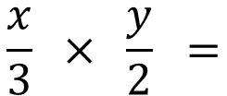
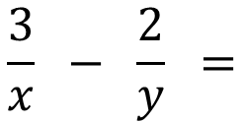
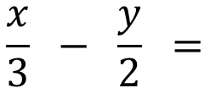
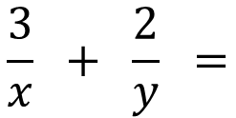
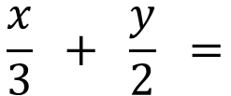
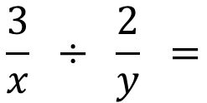
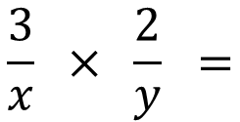
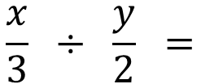
$$\frac{3}{x} + \frac{2}{y} =$$
$$\frac{x}{3} + \frac{y}{2} =$$
$$\frac{3}{x} − \frac{2}{y} =$$
$$\frac{x}{3} − \frac{y}{2} =$$
$$\frac{3}{x} × \frac{2}{y} =$$
$$\frac{x}{3} × \frac{y}{2} =$$
$$\frac{3}{x} ÷ \frac{2}{y} =$$
$$\frac{x}{3} ÷ \frac{y}{2} =$$
@mrbartonmaths

Slide 6
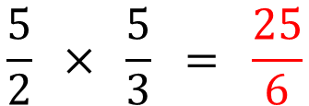
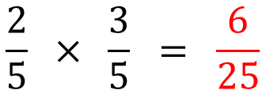
$$\frac{2}{5} + \frac{3}{5} = \frac{5}{5} = 1$$
$$\frac{5}{2} + \frac{5}{3} = \frac{15}{6} + \frac{10}{6}$$
$$\frac{2}{5} − \frac{3}{5} = −\frac{1}{5}$$
$$\frac{5}{2} − \frac{5}{3} = \frac{15}{6} − \frac{10}{6}$$
$$\frac{2}{5} × \frac{3}{5} = \frac{6}{25}$$
$$\frac{5}{2} × \frac{5}{3} = \frac{25}{6}$$
$$\frac{2}{5} ÷ \frac{3}{5} = \frac{2}{5} × \frac{5}{3}$$
$$\frac{5}{2} ÷ \frac{5}{3} = \frac{5}{2} × \frac{3}{5}$$
@mrbartonmaths

Slide 7
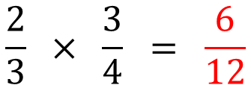
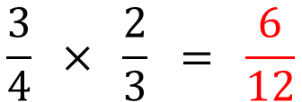
$$\frac{3}{4} + \frac{2}{3} = \frac{9}{12} + \frac{8}{12}$$
$$\frac{2}{3} + \frac{3}{4} = \frac{8}{12} + \frac{9}{12}$$
$$\frac{3}{4} − \frac{2}{3} = \frac{9}{12} − \frac{8}{12}$$
$$\frac{2}{3} − \frac{3}{4} = \frac{8}{12} − \frac{9}{12}$$
$$\frac{3}{4} × \frac{2}{3} = \frac{6}{12}$$
$$\frac{2}{3} × \frac{3}{4} = \frac{6}{12}$$
$$\frac{3}{4} ÷ \frac{2}{3} = \frac{3}{4} × \frac{3}{2}$$
$$\frac{2}{3} ÷ \frac{3}{4} = \frac{2}{3} × \frac{4}{3}$$
@mrbartonmaths

Slide 8
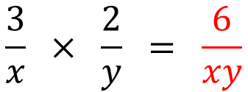
$$\frac{3}{x} + \frac{2}{y} = \frac{3y}{xy} + \frac{2x}{xy}$$
$$\frac{x}{3} + \frac{y}{2} = \frac{2x}{6} + \frac{3y}{6}$$
$$\frac{3}{x} − \frac{2}{y} = \frac{3y}{xy} − \frac{2x}{xy}$$
$$\frac{x}{3} − \frac{y}{2} = \frac{2x}{6} − \frac{3y}{6}$$
$$\frac{3}{x} × \frac{2}{y} = \frac{6}{xy}$$
$$\frac{x}{3} × \frac{y}{2} = \frac{xy}{6}$$
$$\frac{3}{x} ÷ \frac{2}{y} = \frac{3}{x} × \frac{y}{2}$$
$$\frac{x}{3} ÷ \frac{y}{2} = \frac{x}{3} × \frac{2}{y}$$
@mrbartonmaths

