Slide 1
Fractions: Simplifying Fractions
Silent
Teacher
Intelligent Practice
Narration
Your Turn
$$\frac{6}{16} =$$
$$\frac{16}{6} =$$
Example
For more videos visit mrbartonmaths.com/videos

Slide 2
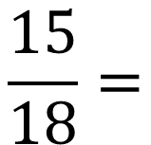
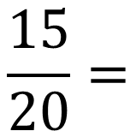
Worked Example
Your Turn
$$\frac{15}{20}=$$
$$\frac{15}{18}=$$
@mrbartonmaths

Slide 3
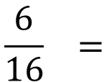
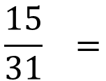
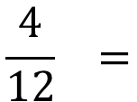
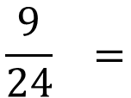
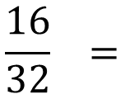
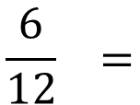
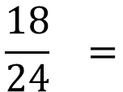
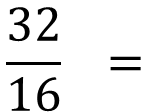
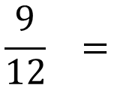
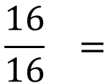
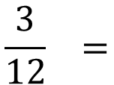
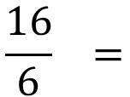
$$\frac{6}{12} =$$
$$\frac{6}{16} =$$
$$\frac{4}{12} =$$
$$\frac{16}{6} =$$
$$\frac{3}{12} =$$
$$\frac{16}{16} =$$
$$\frac{9}{12} =$$
$$\frac{32}{16} =$$
$$\frac{18}{24} =$$
$$\frac{16}{32} =$$
$$\frac{9}{24} =$$
$$\frac{15}{31} =$$
@mrbartonmaths

Slide 4
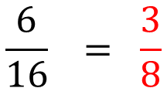
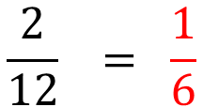
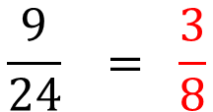
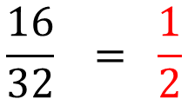
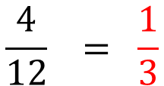
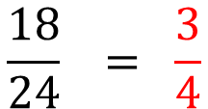
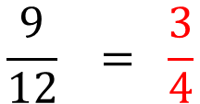
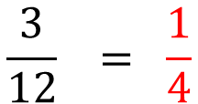
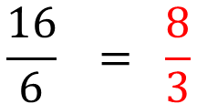
$$\frac{4}{12} = \frac{1}{3}$$
$$\frac{6}{16} = \frac{3}{8}$$
$$\frac{2}{12} = \frac{1}{6}$$
$$\frac{16}{6} = \frac{8}{3}$$
$$\frac{3}{12} = \frac{1}{4}$$
$$\frac{16}{16} = \frac{1}{1} = 1$$
$$\frac{9}{12} = \frac{3}{4}$$
$$\frac{32}{16} = \frac{2}{1} = 2$$
$$\frac{18}{24} = \frac{3}{4}$$
$$\frac{16}{32} = \frac{1}{2}$$
$$\frac{9}{24} = \frac{3}{8}$$
$$\frac{15}{31} = \frac{15}{31}$$
@mrbartonmaths

