Slide 1
Formula: Substitution
Silent
Teacher
Intelligent Practice
Narration
Your Turn
$$\frac{3q+r}{p}−q=$$
$${(\frac{3q+r}{p}−q)}^{2}=$$
Example
For more videos visit mrbartonmaths.com/videos

Slide 2


Worked Example
Your Turn
$$p=3, q=5, r=6$$
$$p=2, q=4, r=8$$
$$pr−q=$$
$$pq−r=$$
@mrbartonmaths

Slide 3
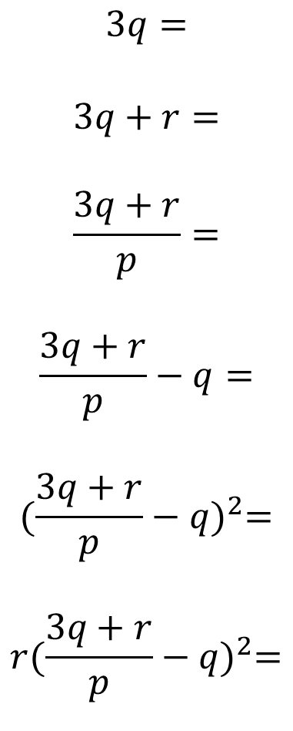
$$p=2, q=3, r=5$$
$$3q=$$
$$3q+r=$$
$$\frac{3q+r}{p}=$$
$$\frac{3q+r}{p}−q=$$
$${(\frac{3q+r}{p}−q)}^{2}=$$
$$r{(\frac{3q+r}{p}−q)}^{2}=$$
@mrbartonmaths

Slide 4
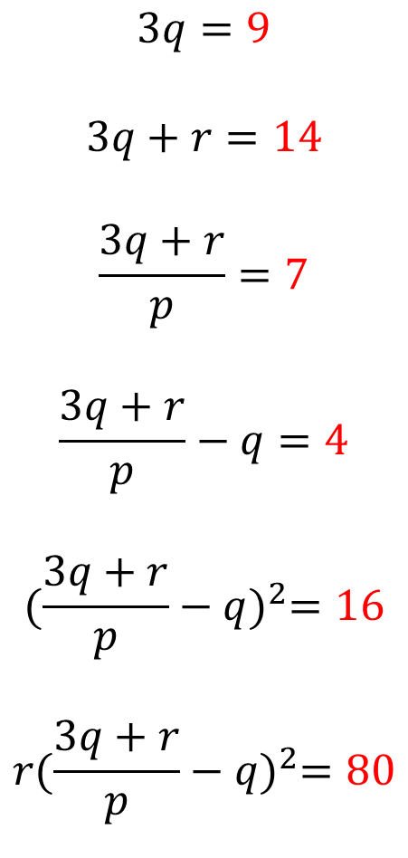
$$p=2, q=3, r=5$$
$$3q=9$$
$$3q+r=14$$
$$\frac{3q+r}{p}=7$$
$$\frac{3q+r}{p}−q=4$$
$${(\frac{3q+r}{p}−q)}^{2}=16$$
$$r{(\frac{3q+r}{p}−q)}^{2}=80$$
@mrbartonmaths

