Slide 1
Arithmetic: Times tables
Silent
Teacher
Intelligent Practice
Narration
Your Turn
$$4×7=$$
$$4×6=$$
$$8×6=$$
Example
For more videos visit mrbartonmaths.com/videos

Slide 2
Worked Example
Your Turn
$$6×7=$$
$$12×7=$$
@mrbartonmaths

Slide 3


$$5×3=$$
$$3×5=$$
$$3×6=$$
$$3×7=$$
$$4×7=$$
$$4×6=$$
$$8×6=$$
$$6×8=$$
$$7×7=$$
$$9×7=$$
$$7×9=$$
$$7×3=$$
$$7×12=$$
$$7×11=$$
$$9×11=$$
$$11×11=$$
$$11×12=$$
$$12×12=$$
@mrbartonmaths

Slide 4
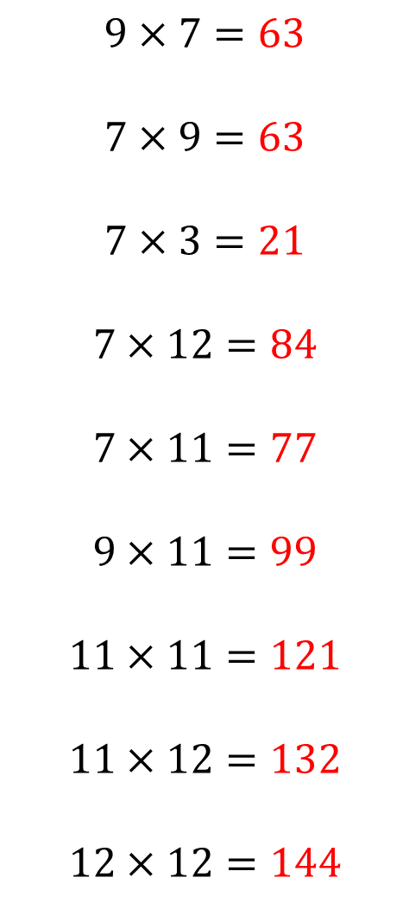
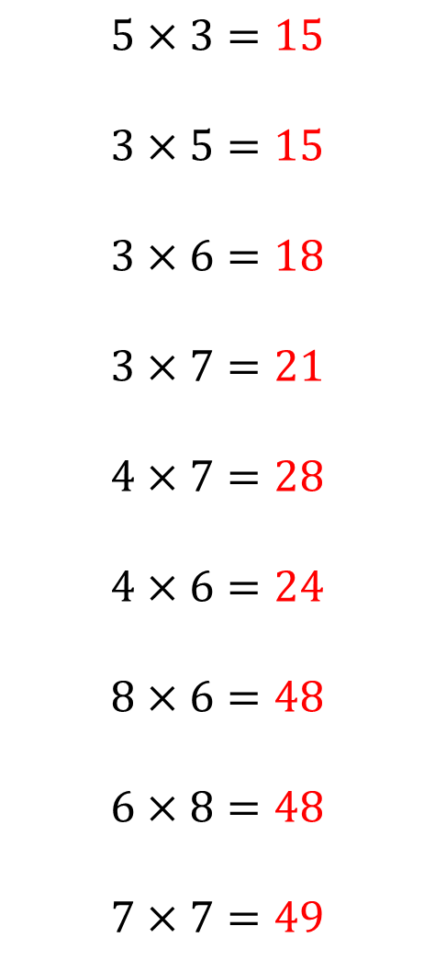
$$5×3=15$$
$$3×5=15$$
$$3×6=18$$
$$3×7=21$$
$$4×7=28$$
$$4×6=24$$
$$8×6=48$$
$$6×8=48$$
$$7×7=49$$
$$9×7=63$$
$$7×9=63$$
$$7×3=21$$
$$7×12=84$$
$$7×11=77$$
$$9×11=99$$
$$11×11=121$$
$$11×12=132$$
$$12×12=144$$
@mrbartonmaths

