Slide 1
Probability: Tree Diagrams – no replacement
Silent
Teacher
Intelligent Practice
Narration
Your Turn
Example
For more videos visit mrbartonmaths.com/videos

Slide 2
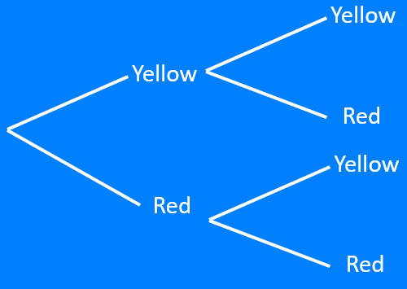
Worked Example
Your Turn
@mrbartonmaths

Slide 3
$$\frac{2}{7}$$
$$\frac{3}{8}$$
$$\frac{5}{7}$$
$$\frac{3}{7}$$
$$\frac{5}{8}$$
$$\frac{4}{8}$$
@mrbartonmaths

Slide 4
$$\frac{2}{7}$$
$$\frac{3}{8}$$
$$\frac{5}{7}$$
$$\frac{3}{7}$$
$$\frac{5}{8}$$
$$\frac{4}{8}$$
@mrbartonmaths

Slide 5
$$\frac{2}{7}$$
$$\frac{3}{8}$$
$$\frac{5}{7}$$
$$\frac{3}{7}$$
$$\frac{5}{8}$$
$$\frac{4}{8}$$
@mrbartonmaths

Slide 6
$$\frac{2}{7}$$
$$\frac{3}{8}$$
$$\frac{5}{7}$$
$$\frac{3}{7}$$
$$\frac{5}{8}$$
$$\frac{4}{8}$$
@mrbartonmaths

Slide 7
$$\frac{2}{7}$$
$$\frac{3}{8}$$
$$\frac{5}{7}$$
$$\frac{3}{7}$$
$$\frac{5}{8}$$
$$\frac{4}{8}$$
@mrbartonmaths

Slide 8
$$\frac{2}{7}$$
$$\frac{3}{8}$$
$$\frac{5}{7}$$
$$\frac{3}{7}$$
$$\frac{5}{8}$$
$$\frac{4}{8}$$
$$\frac{2}{6}$$
$$\frac{3}{7}$$
$$\frac{5}{6}$$
$$\frac{3}{7}$$
$$\frac{4}{7}$$
$$\frac{3}{7}$$
@mrbartonmaths

Slide 9
$$\frac{2}{7}$$
$$\frac{3}{8}$$
$$\frac{5}{7}$$
$$\frac{3}{7}$$
$$\frac{5}{8}$$
$$\frac{4}{8}$$
$$\frac{1}{6}$$
$$\frac{2}{7}$$
$$\frac{5}{6}$$
$$\frac{2}{6}$$
$$\frac{5}{7}$$
$$\frac{4}{6}$$
@mrbartonmaths

Slide 10
$$\frac{2}{7}$$
$$\frac{3}{8}$$
$$\frac{5}{7}$$
$$\frac{3}{7}$$
$$\frac{5}{8}$$
$$\frac{4}{8}$$
$$\frac{3}{7}$$
$$\frac{4}{8}$$
$$\frac{4}{7}$$
$$\frac{4}{7}$$
$$\frac{4}{8}$$
$$\frac{3}{7}$$
@mrbartonmaths

Slide 11
$$\frac{2}{7}$$
$$\frac{3}{8}$$
$$\frac{5}{7}$$
$$\frac{3}{7}$$
$$\frac{5}{8}$$
$$\frac{4}{8}$$
$$\frac{1}{5}$$
$$\frac{2}{6}$$
$$\frac{4}{5}$$
$$\frac{2}{5}$$
$$\frac{4}{6}$$
$$\frac{3}{5}$$
@mrbartonmaths

Slide 12
$$\frac{2}{7}$$
$$\frac{3}{8}$$
$$\frac{5}{7}$$
$$\frac{3}{7}$$
$$\frac{5}{8}$$
$$\frac{4}{8}$$
$$\frac{2}{8}$$
$$\frac{3}{9}$$
$$\frac{6}{8}$$
$$\frac{3}{8}$$
$$\frac{6}{9}$$
$$\frac{5}{8}$$
@mrbartonmaths

Slide 13
Yellow
Yellow
Red
Yellow
Red
Red
This is the editable tree diagram!!!!!
@mrbartonmaths

