Slide 1
Fractions: Adding (where one denominator is a multiple of the other)
Silent
Teacher
Intelligent Practice
Narration
Your Turn
$$\frac{2}{3}+\frac{1}{6}=$$
$$\frac{2}{3}+\frac{1}{12}=$$
$$\frac{2}{3}+\frac{1}{18}=$$
Example
For more videos visit mrbartonmaths.com/videos

Slide 2
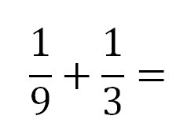
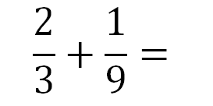
Worked Example
Your Turn
@fortyninecubed

Slide 3
@fortyninecubed

Slide 4
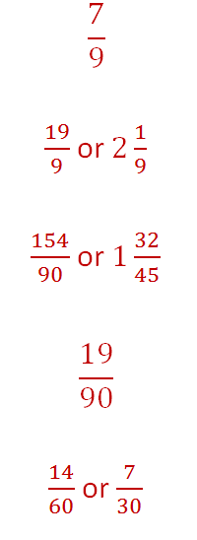
@fortyninecubed

