Slide 1
Standard Form: Big Numbers to Standard Form
Silent
Teacher
Intelligent Practice
Narration
Your Turn
Example
For more videos visit mrbartonmaths.com/videos

Slide 2
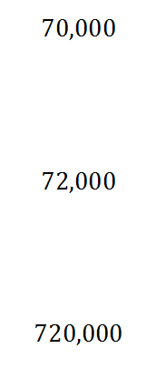
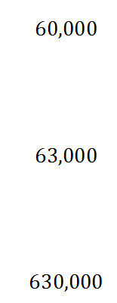
Worked Example
Your Turn
Write in standard form:
Write in standard form:
@fortyninecubed

Slide 3
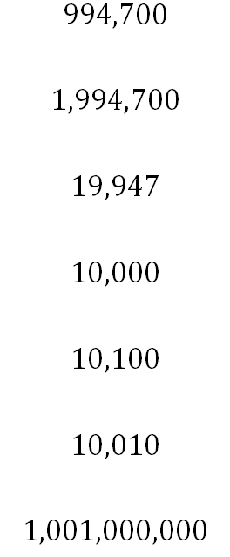
@fortyninecubed

Slide 4
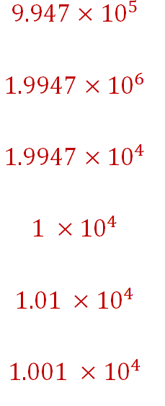
$$1.001×{10}^{9}$$

