Slide 1
Algebra: Brackets and collecting like terms 1
Silent
Teacher
Intelligent Practice
Narration
Your Turn
$$Expand and simplify 2\left(x+1\right)+3(x+2)$$
$$Expand and simplify 3\left(x+1\right)+2(x+2)$$
$$Expand and simplify 3\left(x+2\right)+2(x+1)$$
Example
For more videos visit mrbartonmaths.com/videos

Slide 2
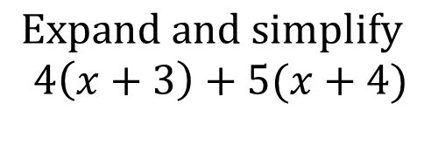
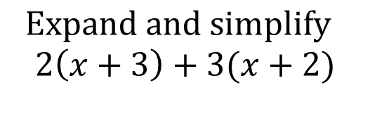
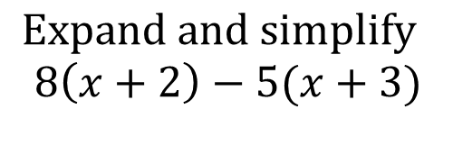
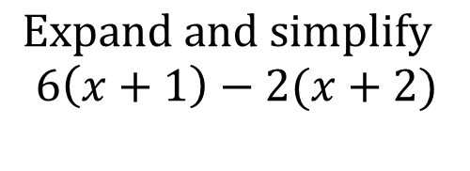
Worked Example
Your Turn
$$Expand and simplify$$
$$2\left(x+3\right)+3(x+2)$$
$$Expand and simplify$$
$$4\left(x+3\right)+5(x+4)$$
$$Expand and simplify$$
$$6\left(x+1\right)−2(x+2)$$
$$Expand and simplify$$
$$8\left(x+2\right)−5(x+3)$$
@mrbartonmaths

Slide 3
Expand and simplify the following:
$$2\left(x+1\right)+3(x+2)$$
$$3\left(x+2\right)+2(x+1)$$
$$3\left(x+1\right)+2(x+2)$$
$$2\left(x+3\right)+2(x+1)$$
$$3\left(x+2\right)+1(x+2)$$
$$3\left(x+1\right)−2(x+2)$$
$$3\left(x+2\right)−2(x+1)$$
$$2\left(x+3\right)−2(x+1)$$
$$3\left(x+2\right)−1(x+2)$$
$$2\left(x+1\right)−3(x+2)$$
@mrbartonmaths

Slide 4
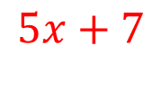
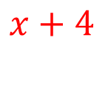
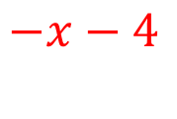
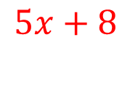
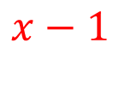
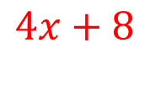
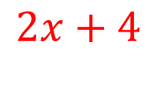

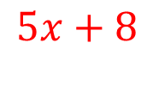
Expand and simplify the following:
$$2\left(x+1\right)+3(x+2)$$
$$5x+8$$
$$3\left(x+2\right)+2(x+1)$$
$$5x+8$$
$$3\left(x+1\right)+2(x+2)$$
$$5x+7$$
$$2\left(x+3\right)+2(x+1)$$
$$4x+8$$
$$3\left(x+2\right)+1(x+2)$$
$$4x+8$$
$$3\left(x+1\right)−2(x+2)$$
$$x−1$$
$$3\left(x+2\right)−2(x+1)$$
$$x+4$$
$$2\left(x+3\right)−2(x+1)$$
$$4$$
$$3\left(x+2\right)−1(x+2)$$
$$2x+4$$
$$2\left(x+1\right)−3(x+2)$$
$$−x−4$$
@mrbartonmaths

