Slide 1
Algebra: Brackets and collecting like terms 2
Silent
Teacher
Intelligent Practice
Narration
Your Turn
$$Expand and simplify 2\left(x+1\right)+3(x−2)$$
$$Expand and simplify 3\left(x+1\right)+2(x−2)$$
$$Expand and simplify 3\left(x−2\right)+2(x+1)$$
Example
For more videos visit mrbartonmaths.com/videos

Slide 2
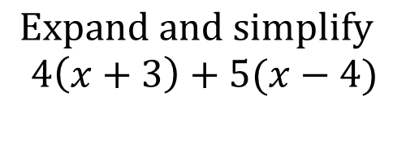
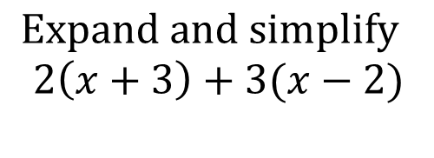
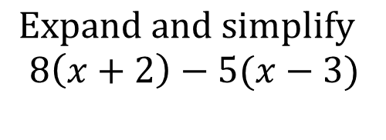
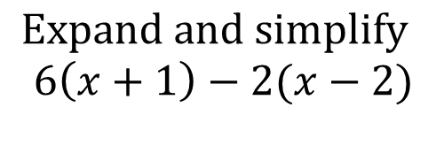
Worked Example
Your Turn
$$Expand and simplify$$
$$2\left(x+3\right)+3(x−2)$$
$$Expand and simplify$$
$$4\left(x+3\right)+5(x−4)$$
$$Expand and simplify$$
$$6\left(x+1\right)−2(x−2)$$
$$Expand and simplify$$
$$8\left(x+2\right)−5(x−3)$$
@mrbartonmaths

Slide 3
Expand and simplify the following:
$$2\left(x+1\right)+3(x−2)$$
$$3\left(x+1\right)+2(x−2)$$
$$3\left(x−2\right)+2(x+1)$$
$$2\left(x−3\right)+2(x+1)$$
$$3\left(x−2\right)+1(x+2)$$
$$3\left(x+1\right)−2(x−2)$$
$$3\left(x−2\right)−2(x+1)$$
$$2\left(x−3\right)−2(x+1)$$
$$3\left(x−2\right)−1(x+2)$$
$$2\left(x+1\right)−3(x−2)$$
@mrbartonmaths

Slide 4
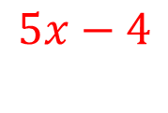
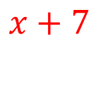
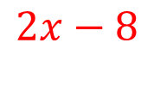
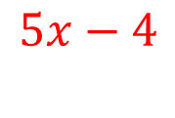
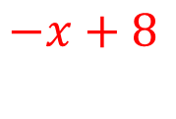
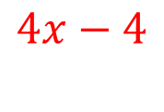

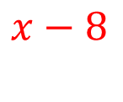
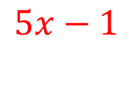
Expand and simplify the following:
$$2\left(x+1\right)+3(x−2)$$
$$5x−4$$
$$3\left(x+1\right)+2(x−2)$$
$$5x−1$$
$$3\left(x−2\right)+2(x+1)$$
$$5x−4$$
$$2\left(x−3\right)+2(x+1)$$
$$4x−4$$
$$3\left(x−2\right)+1(x+2)$$
$$4x−4$$
$$3\left(x+1\right)−2(x−2)$$
$$x+7$$
$$3\left(x−2\right)−2(x+1)$$
$$x−8$$
$$2\left(x−3\right)−2(x+1)$$
$$−8$$
$$3\left(x−2\right)−1(x+2)$$
$$2x−8$$
$$2\left(x+1\right)−3(x−2)$$
$$−x+8$$
@mrbartonmaths

