Slide 1
Algebra: Brackets and collecting like terms 3
Silent
Teacher
Intelligent Practice
Narration
Your Turn
$$Expand and simplify 2x\left(x+1\right)+3x(x+2)$$
$$Expand and simplify 3x\left(x+1\right)+2x(x+2)$$
$$Expand and simplify 3x\left(x+2\right)+2x(x+1)$$
Example
For more videos visit mrbartonmaths.com/videos

Slide 2
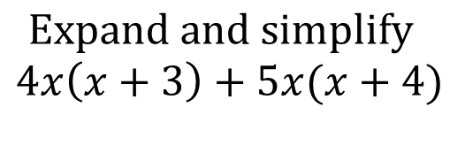
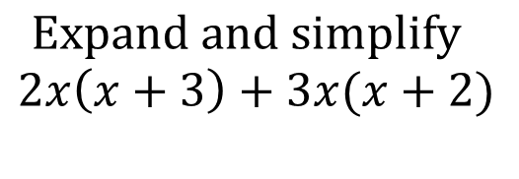
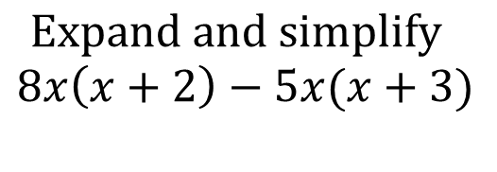
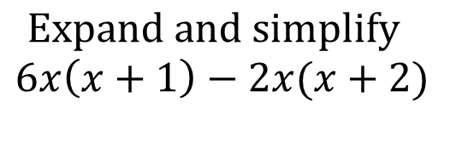
Worked Example
Your Turn
$$Expand and simplify$$
$$2x\left(x+3\right)+3x(x+2)$$
$$Expand and simplify$$
$$4x\left(x+3\right)+5x(x+4)$$
$$Expand and simplify$$
$$6x\left(x+1\right)−2x(x+2)$$
$$Expand and simplify$$
$$8x\left(x+2\right)−5x(x+3)$$
@mrbartonmaths

Slide 3
Expand and simplify the following:
$$2x\left(x+1\right)+3x(x+2)$$
$$3x\left(x+1\right)+2x(x+2)$$
$$3x\left(x+2\right)+2x(x+1)$$
$$2x\left(x+3\right)+2x(x+1)$$
$$3x\left(x+2\right)+1x(x+2)$$
$$3x\left(x+1\right)−2x(x+2)$$
$$3x\left(x+2\right)−2x(x+1)$$
$$2x\left(x+3\right)−2x(x+1)$$
$$3x\left(x+2\right)−x(x+2)$$
$$2x\left(x+1\right)−3x(x+2)$$
@mrbartonmaths

Slide 4

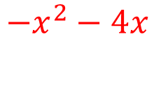
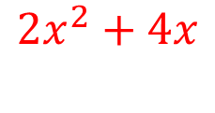
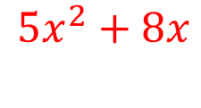


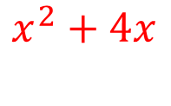
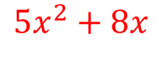
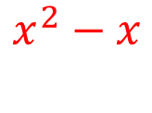
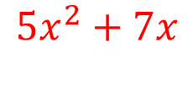
Expand and simplify the following:
$$2x\left(x+1\right)+3x(x+2)$$
$$5x^{2}+8x$$
$$3x\left(x+1\right)+2x(x+2)$$
$$5x^{2}+7x$$
$$3x\left(x+2\right)+2x(x+1)$$
$$5x^{2}+8x$$
$$2x\left(x+3\right)+2x(x+1)$$
$$4x^{2}+8x$$
$$3x\left(x+2\right)+1x(x+2)$$
$$4x^{2}+8x$$
$$3x\left(x+1\right)−2x(x+2)$$
$$x^{2}−x$$
$$3x\left(x+2\right)−2x(x+1)$$
$$x^{2}+4x$$
$$2x\left(x+3\right)−2x(x+1)$$
$$4x$$
$$3x\left(x+2\right)−x(x+2)$$
$$2x^{2}+4x$$
$$2x\left(x+1\right)−3x(x+2)$$
$$−x^{2}−4x$$
@mrbartonmaths

