Slide 1
Algebra: Brackets and collecting like terms 4
Silent
Teacher
Intelligent Practice
Narration
Your Turn
$$Expand and simplify 2x\left(x+1\right)+3(x−2)$$
$$Expand and simplify 3\left(x+1\right)+2x(x−2)$$
$$Expand and simplify 3\left(x−2\right)+2x(x+1)$$
Example
For more videos visit mrbartonmaths.com/videos

Slide 2
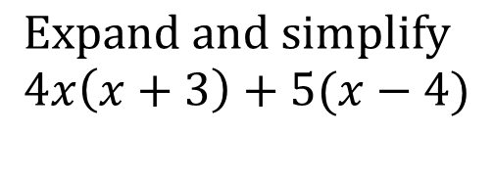
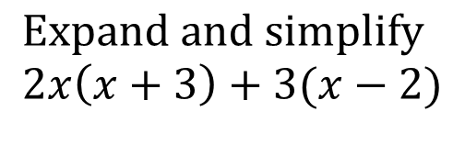
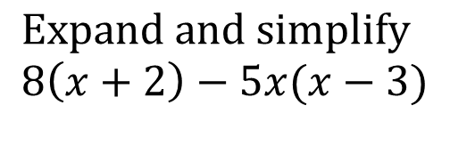
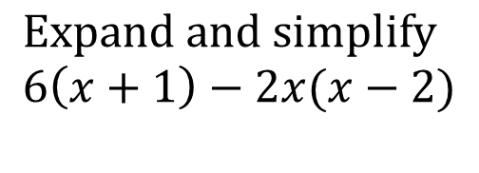
Worked Example
Your Turn
$$Expand and simplify$$
$$2x\left(x+3\right)+3(x−2)$$
$$Expand and simplify$$
$$4x\left(x+3\right)+5(x−4)$$
$$Expand and simplify$$
$$6\left(x+1\right)−2x(x−2)$$
$$Expand and simplify$$
$$8\left(x+2\right)−5x(x−3)$$
@mrbartonmaths

Slide 3
Expand and simplify the following:
$$2x\left(x+1\right)+3(x−2)$$
$$3\left(x+1\right)+2x(x−2)$$
$$3\left(x−2\right)+2x(x+1)$$
$$2\left(x−3\right)+2x(x+1)$$
$$3\left(x−2\right)+1(2x+1)$$
$$3\left(x+1\right)−2x(x−2)$$
$$3\left(x−2\right)−2x(x+1)$$
$$2x\left(x−3\right)−2(x+1)$$
$$3x\left(x−2\right)−1(2x+1)$$
$$2x\left(2x−1\right)−3(x−2)$$
@mrbartonmaths

Slide 4

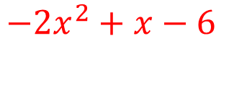
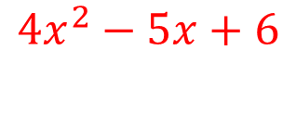
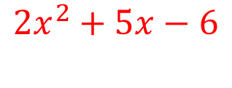

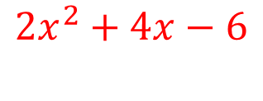
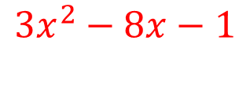
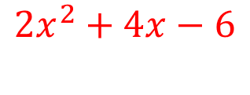
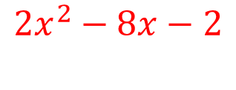
Expand and simplify the following:
$$2x\left(x+1\right)+3(x−2)$$
$$2x^{2}+5x−6$$
$$3\left(x+1\right)+2x(x−2)$$
$$2x^{2}−x+3$$
$$3\left(x−2\right)+2x(x+1)$$
$$2x^{2}+5x−6$$
$$2\left(x−3\right)+2x(x+1)$$
$$2x^{2}+4x−6$$
$$3\left(x−2\right)+x(2x+1)$$
$$2x^{2}+4x−6$$
$$3\left(x+1\right)−2x(x−2)$$
$$−2x^{2}+7x+3$$
$$3\left(x−2\right)−2x(x+1)$$
$$−2x^{2}+x−6$$
$$2x\left(x−3\right)−2(x+1)$$
$$2x^{2}−8x−2$$
$$3x\left(x−2\right)−1(2x+1)$$
$$3x^{2}−8x−1$$
$$2x\left(2x−1\right)−3(x−2)$$
$$4x^{2}−5x+6$$
@mrbartonmaths

