Slide 1
Circles: Circumference of a circle
Silent
Teacher
Intelligent Practice
Narration
Your Turn
Example
For more videos visit mrbartonmaths.com/videos

Slide 2
Worked Example
Your Turn
8cm
4cm
@mathsmrgordon

Slide 3
3cm
6cm
3cm
@mathsmrgordon

Slide 4
5cm
10cm
15cm
@mathsmrgordon

Slide 5
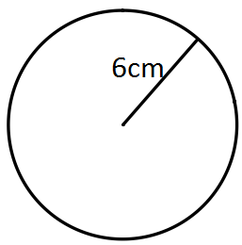
6cm
6m
@mathsmrgordon

Slide 6
1.5cm
15cm
16.5cm
@mathsmrgordon

Slide 7
3cm
$$π×3=3π=9.42477…cm$$
$$π×6=6π=18.84955…cm$$
6cm
3cm
$$π×3×2=6π=18.84955…cm$$
@mathsmrgordon

Slide 8
5cm
$$π×5×2=10π=31.41592…cm$$
10cm
$$π×10×2=20π=62.83185…cm$$
15cm
$$π×15×2=30π=94.24777…cm$$
@mathsmrgordon

Slide 9
6cm
$$π×6×2=12π=37.69911…cm$$
$$π×6×2=12π=37.69911…cm$$
6m
$$π×6×2=12π=37.69911…m$$
@mathsmrgordon

Slide 10
1.5cm
$$π×1.5×2=3π=9.4247…cm$$
15cm
$$π×15×2=30π=94.247…cm$$
16.5cm
$$π×16.5×2=33π=103.672…cm$$
@mathsmrgordon

