Slide 1
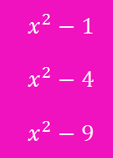
Brackets Difference of Two Squares
Pattern spot
Reflect
Your Turn
Pattern
For more videos visit mrbartonmaths.com/videos

Slide 2
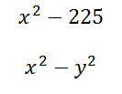
$$. . .$$
$$. . .$$
@fortyninecubed

Slide 3
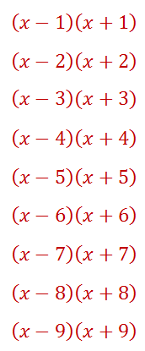
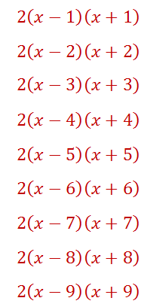
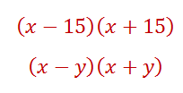
$$. . .$$
$$. . .$$

Slide 4
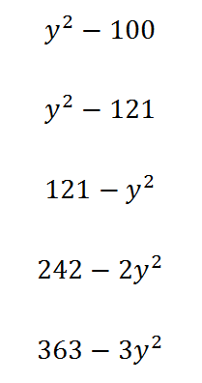
Your Turn
@fortyninecubed

Slide 5
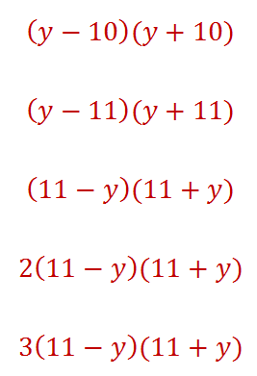
Your Turn - answers
@fortyninecubed

