Slide 1




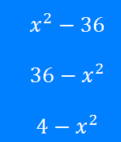
Brackets:
Difference of Two Squares
Silent
Teacher
Intelligent
Practice
Narration
Your Turn
Example
For more videos visit mrbartonmaths.com/videos

Slide 2
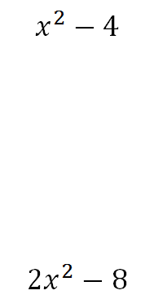
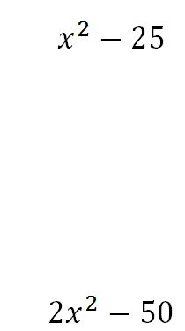
Worked Example
Your Turn
@fortyninecubed

Slide 3
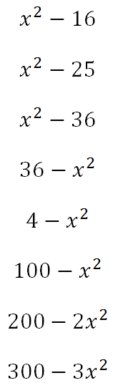
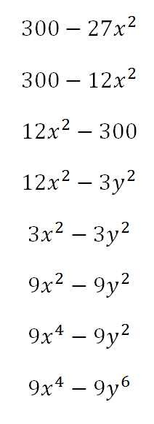
@fortyninecubed

Slide 4
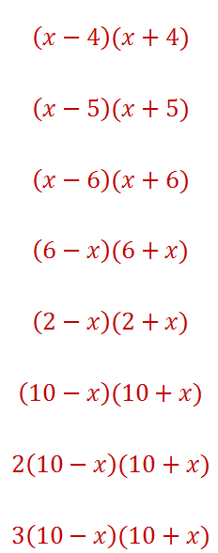
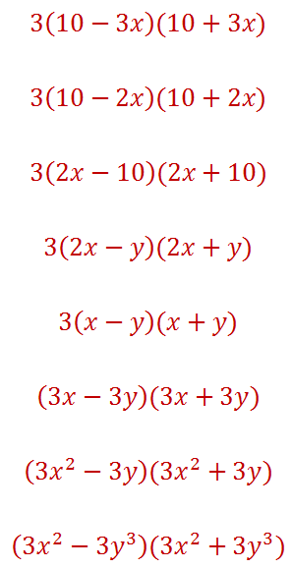
@fortyninecubed

