Slide 1
Straight line graphs: Gradient and y-intercept (implicit 1)
Silent
Teacher
Intelligent Practice
Narration
Your Turn
$$y−2x=5$$
$$y−2x=−5$$
$$y−5=−2x$$
Example
For more videos visit mrbartonmaths.com/videos

Slide 2
Worked Example
Your Turn
$$y+3=2x$$
$$y+3x=2$$
@mrbartonmaths

Slide 3
Gradient | y-intercept
$$y=2x+5$$
Gradient | y-intercept
$$y+2x=5$$
Gradient | y-intercept
$$y−2x=5$$
Gradient | y-intercept
$$y−2x=−5$$
Gradient | y-intercept
$$y−5=−2x$$
@mrbartonmaths

Slide 4
Gradient | y-intercept
$$y+5=−2x$$
Gradient | y-intercept
$$y−2x+5=0$$
Gradient | y-intercept
$$y+2x+5=0$$
Gradient | y-intercept
$$y+2x−5=0$$
Gradient | y-intercept
$$y−2x−5=0$$
@mrbartonmaths

Slide 5
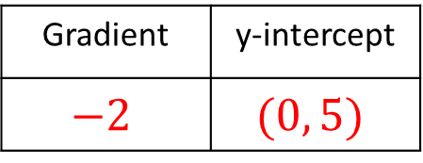
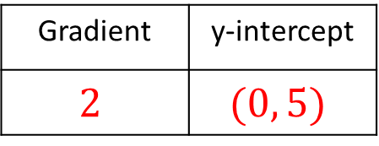
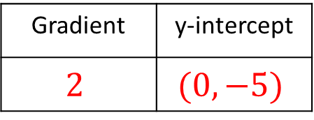
Gradient | y-intercept
$$2$$ | $$(0, 5)$$
$$y=2x+5$$
Gradient | y-intercept
$$−2$$ | $$(0, 5)$$
$$y+2x=5$$
Gradient | y-intercept
$$2$$ | $$(0, 5)$$
$$y−2x=5$$
Gradient | y-intercept
$$2$$ | $$(0, −5)$$
$$y−2x=−5$$
Gradient | y-intercept
$$−2$$ | $$(0, 5)$$
$$y−5=−2x$$
@mrbartonmaths

Slide 6
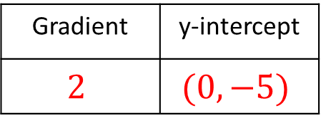
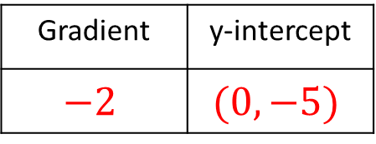
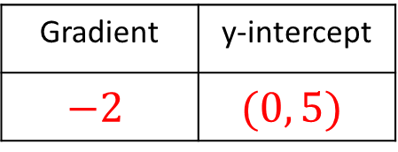
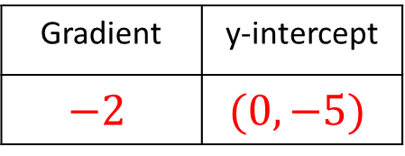
Gradient | y-intercept
$$−2$$ | $$(0, −5)$$
$$y+5=−2x$$
Gradient | y-intercept
$$2$$ | $$(0, −5)$$
$$y−2x+5=0$$
Gradient | y-intercept
$$−2$$ | $$(0, −5)$$
$$y+2x+5=0$$
Gradient | y-intercept
$$−2$$ | $$(0, 5)$$
$$y+2x−5=0$$
Gradient | y-intercept
$$2$$ | $$(0, 5)$$
$$y−2x−5=0$$
@mrbartonmaths

